Slide 1
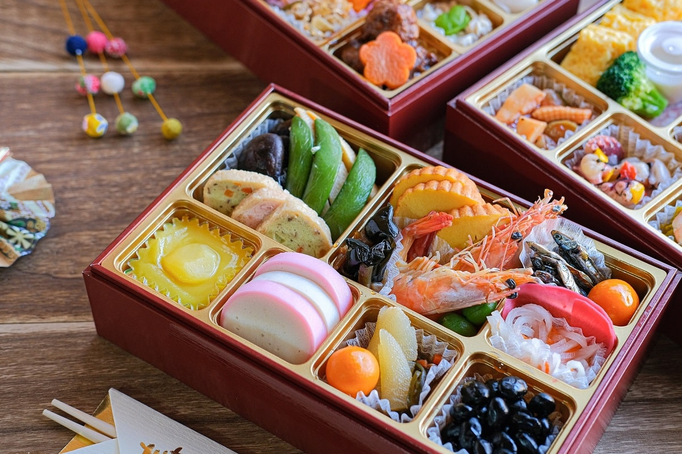
New Years Day
Notes:
This is called Osechi. It is a pack of various foods, served in three-layered boxes. Each food has its own auspicious significance such as living long, family happiness, and prosperity. At the start of the new year, eaters pray for their happy new year.
Kazunoko (Herring Roe): For a large family (many children).
Kuromame (Sweet Black Soybeans): For good health.
Tazukuri (Candied Sardines): For a good harvest.
Datemaki (Sweet Rolled Omelette): For knowledge and scholarship.

Slide 2
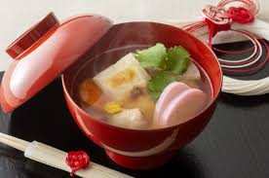
New Years Day
Notes:
It is a clear soup with a rice cake and other ingredients.

Slide 3
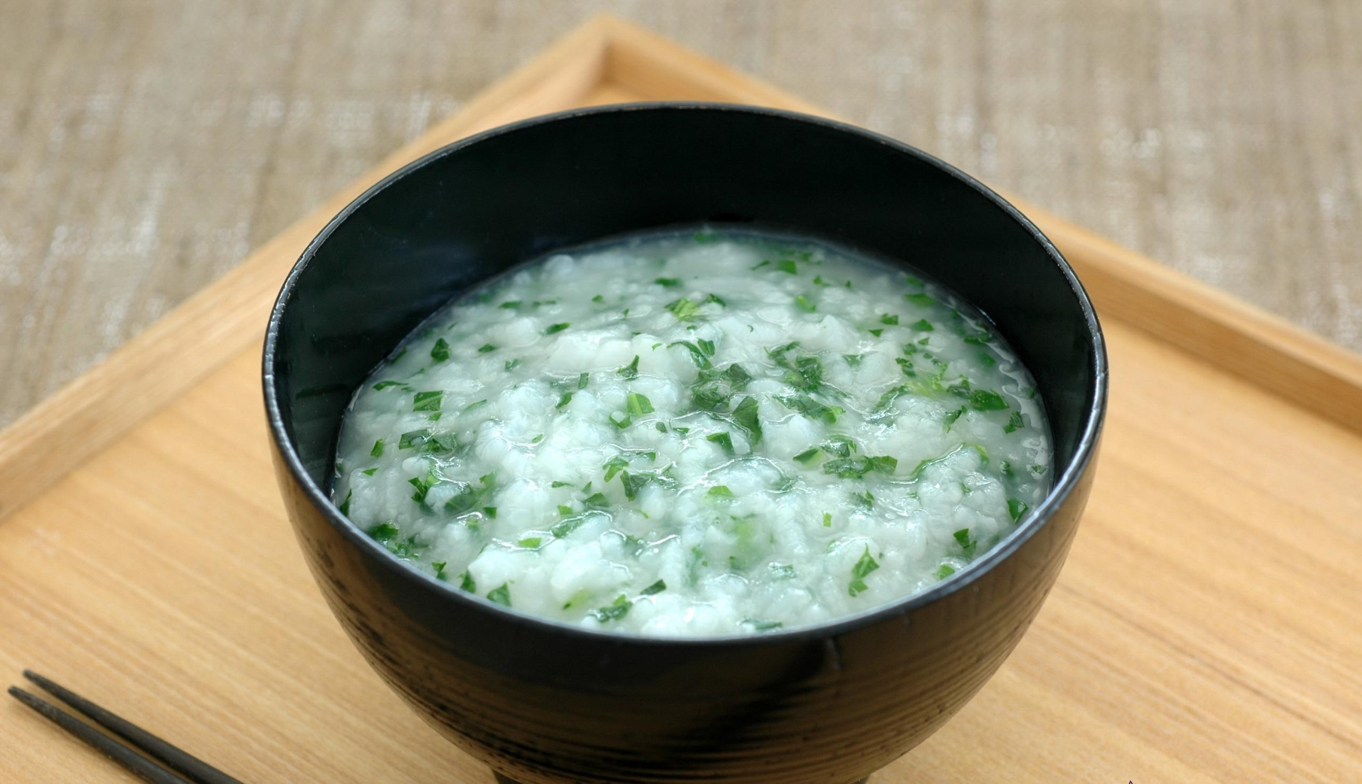
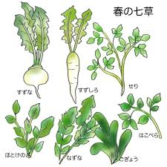
On January 7
Notes:
It is a rice porridge with seven peculiar kinds of herbs. When you eat this on this day, you are said to stay healthy for the rest of the year.
Seri (Japanese parsley), Nazuna (Shepherd's purse), Gogyō (Jersey cudweed), Hakobera (Chickweed), Hotokenoza (Nipplewort), Suzuna (Turnip). Suzushiro (Daikon radish)

Slide 4
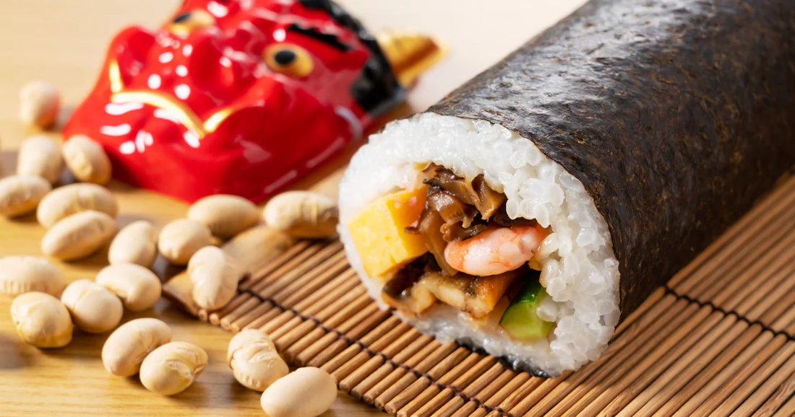
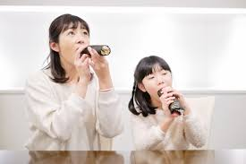
On February 3

Slide 5
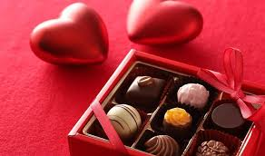
On February 14
Notes:
In Japan, on Valentine’s day, women give some chocolate to the man she loves.

Slide 6
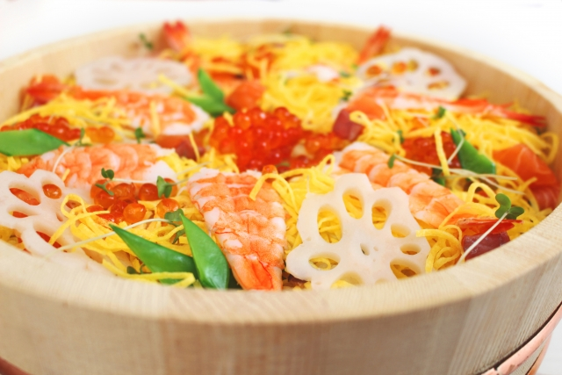
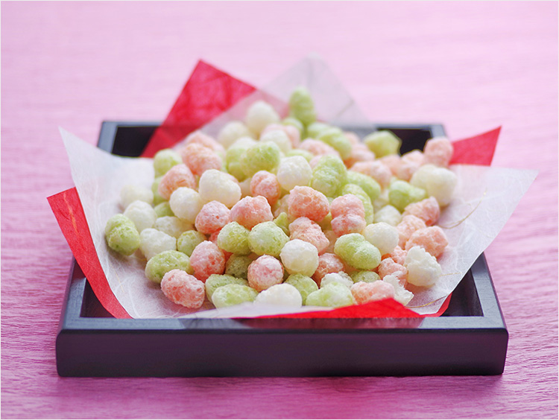
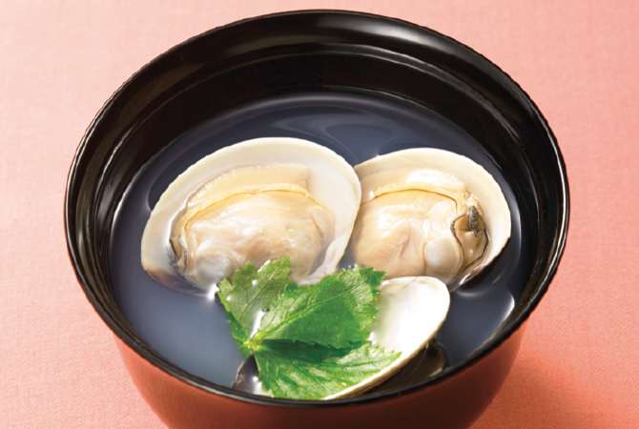
On February 14
Notes:
March 3 is a festival day for girls. In addition, special meals are served for them.
Hina-Arare, small colored pieces of rice cracker. Chirashi-Zushi, sushi rice topped with egg, shrimps, lotus root, and others. Clam clear soup.

Slide 7
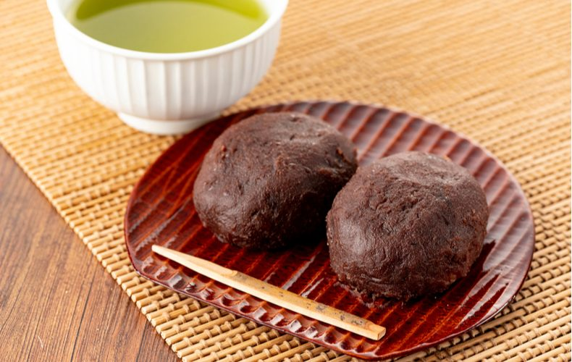
On the Spring Equinox
Notes:
This Bota-Mochi s a rice cake sweet eaten on the Spring Equinox. It is a ball of sweet rice wrapped in ‘Anko,’ smooth sweet red bean paste.

Slide 8
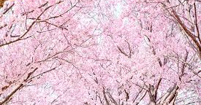
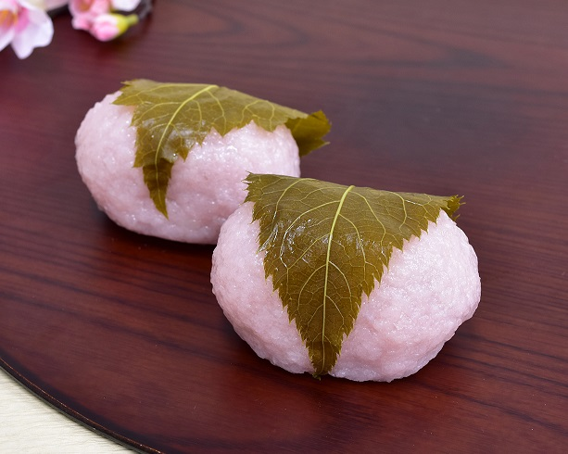
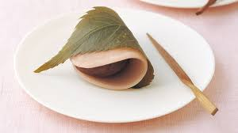
Sakura Period in Spring
Notes:
This Bota-Mochi s a rice cake sweet eaten on the Spring Equinox. It is a ball of sweet rice wrapped in ‘Anko,’ smooth sweet red bean paste.

Slide 9
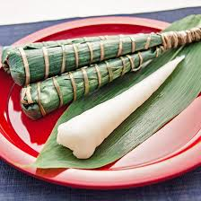
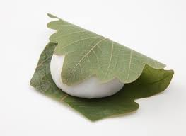
On May 5
Notes:
May 5 is a festival day for Boys. These two sweets, Kahiwa-Mochi and Chimaki, are eaten on this special day.
Kashiwa means an oak leaf. Chimaki means wrapping with a bamboo leaf.

Slide 10
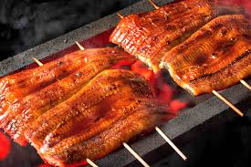
On the Midday of the OX
Notes:
On the Midday of the Ox in the ancient calendar, Eel food is eaten. We don’t know the exact reason, but the common theory is that we eat nourishable eel food just before the hottest days in summer.

Slide 11

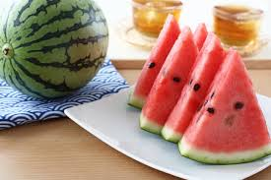
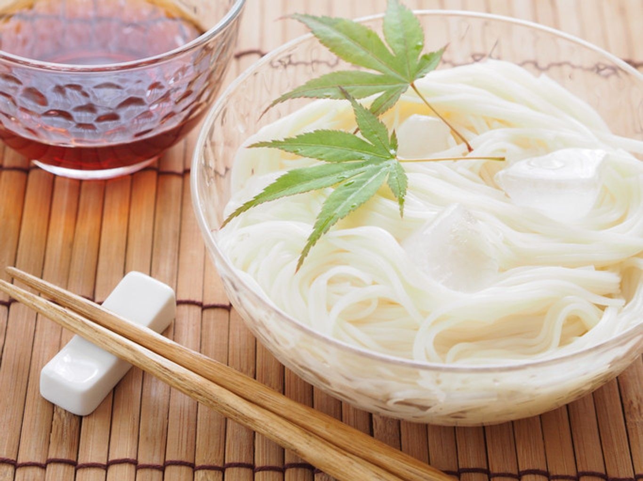
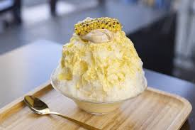
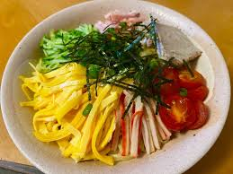
In Summer Vacation
Notes:
Children love summer vacation, when there are special seasonal foods. Of course, they love these foods.
Somen thin noodles, shaved ice, watermelon, and cold ramen.

Slide 12
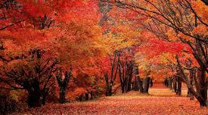
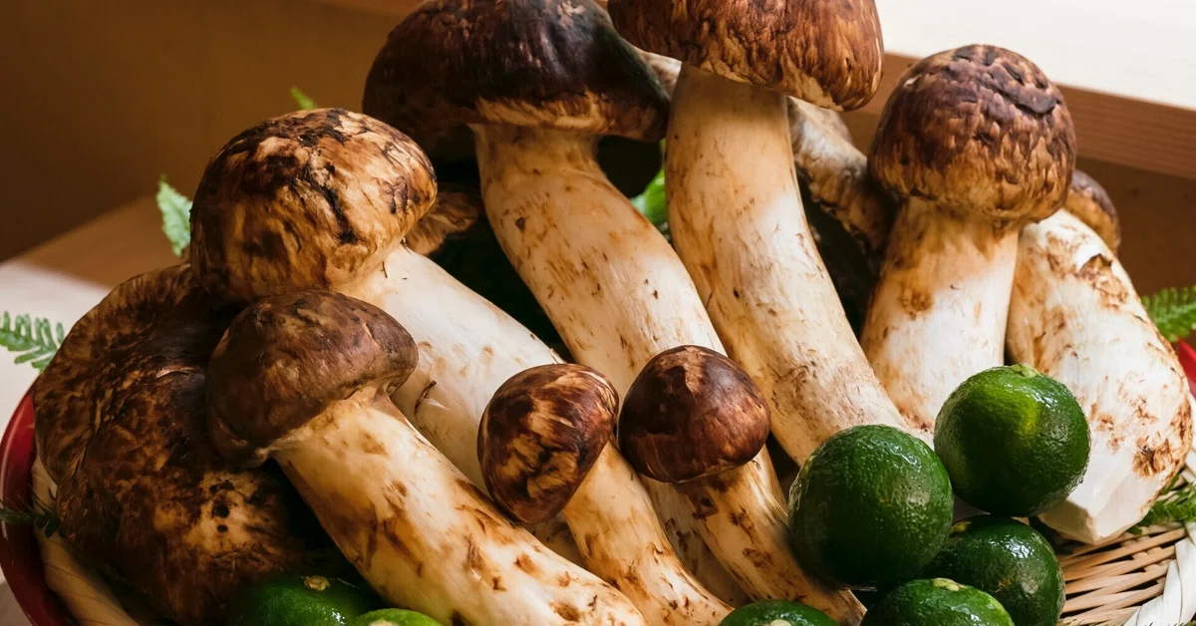
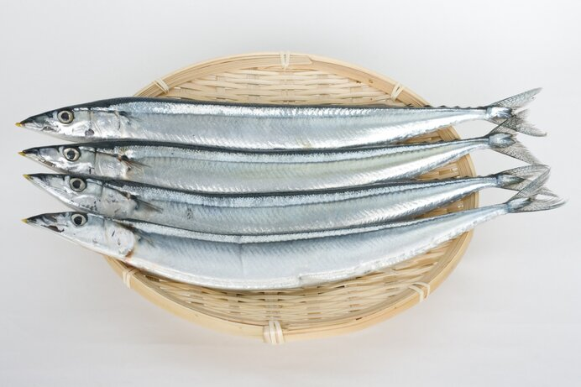
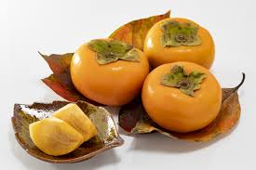
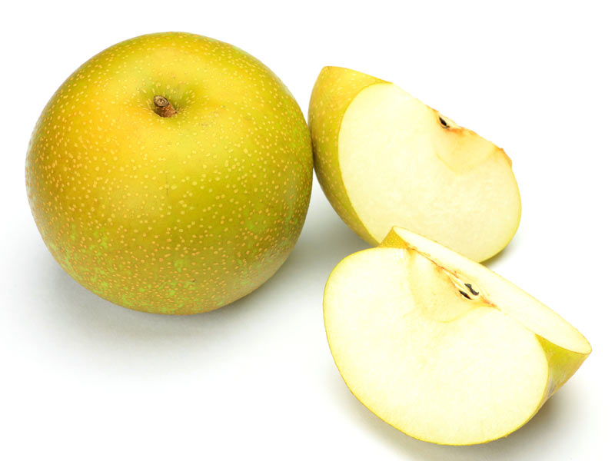
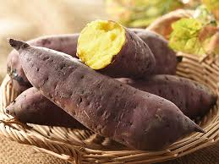
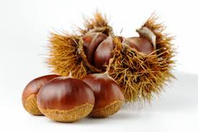
In Fall/Autumn
Notes:
Children love summer vacation, when there are special seasonal foods. Of course, they love these foods.
Somen thin noodles, shaved ice, watermelon, and cold ramen.

Slide 13
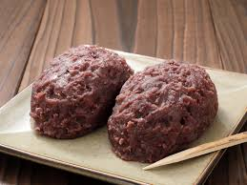
On the Autumn Equinox
Notes:
Ohagi-mochi is a rice sweet with anko. The same food as Botan-mochi.

Slide 14
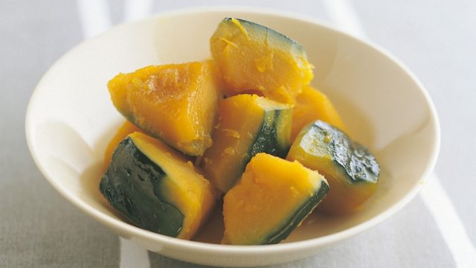
On the Winter Solistice
Notes:
It is our custom to eat pumpkin food on the winter solstice.

Slide 15
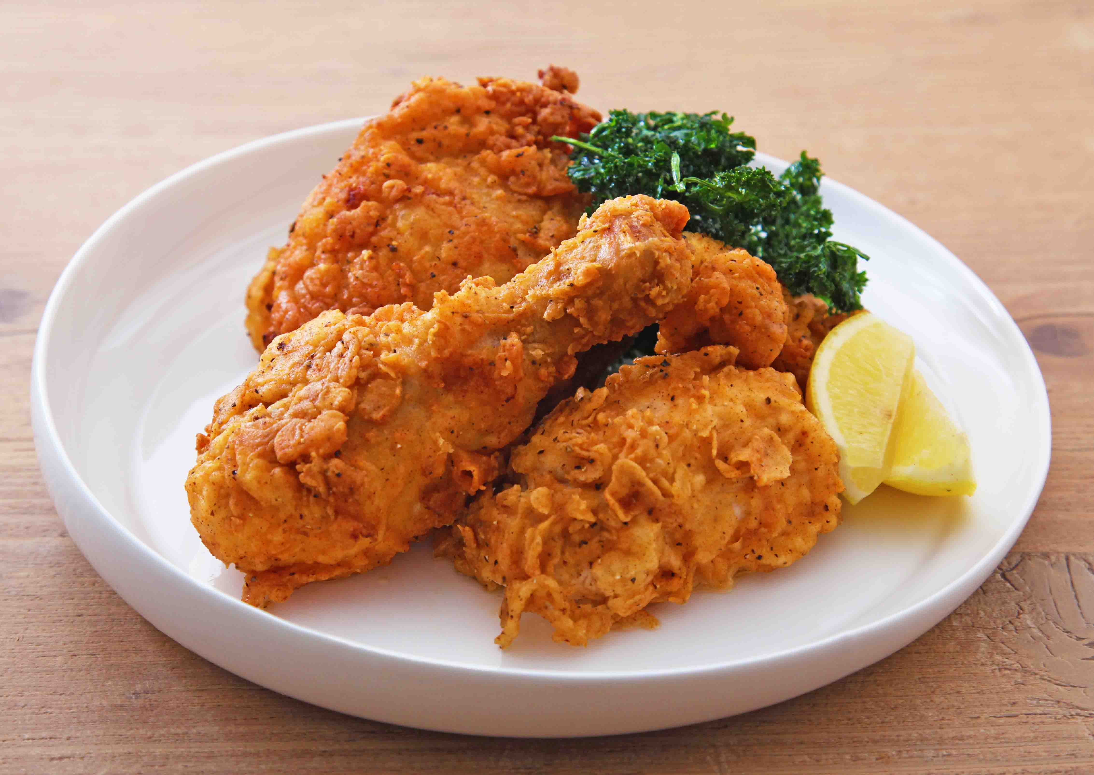

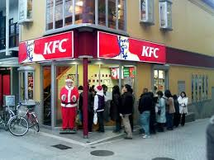
On Christmas Eve
Notes:
We eat chicken, not turkey on Christmas Eve in Japan.

Slide 16
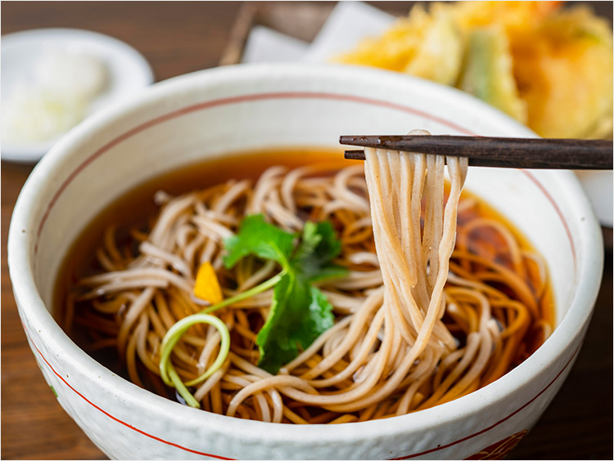
On New Year’s Eve
Notes:
At night on New Year’s Eve, just before the change of year, we eat soba noodles

Slide 17
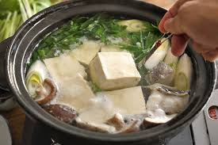
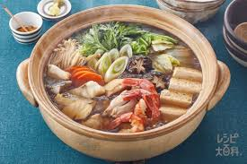
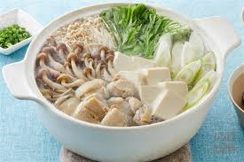
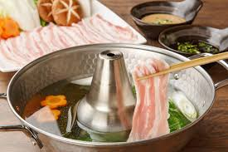
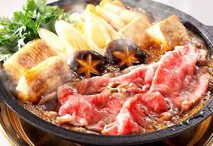
In Winter
Notes:
Winter is the season for pot dishes. There are various kinds of Nabe.

