Slide 1
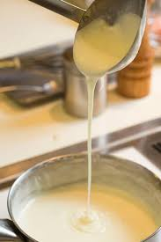
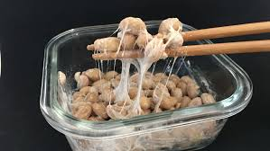
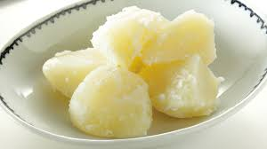
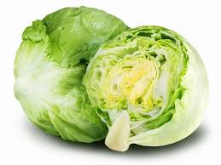
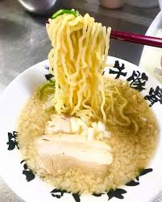
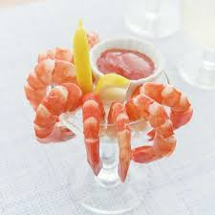
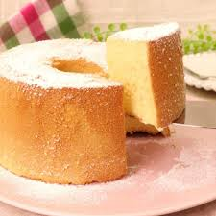
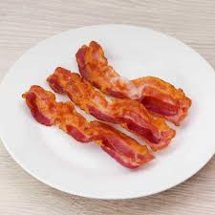

Slide 2
Kari-Kari!!
Shaki-Shaki!!
Fuwa-Fuwa!!
Puri-Puri!!
Toro-Toro!!
Tsuru-Tsuru!!
Hoku-Hoku!!
Neba-Neba!!

Slide 3
Toro-Toro!!
Neba-Neba!!
Hoku-Hoku!!
Shaki-Shaki!!
Kari-Kari!!
Tsuru-Tsuru!!
Puri-Puri!!
Fuwa-Fuwa!!

Slide 4
Creamy!!
Sticky!!
Hot and Fluffy!!
Fresh and Crisp!!
Crispy!!
Slippery!!
Springy!!
Fluffy and Airy!!

