Slide 1


Slide 2
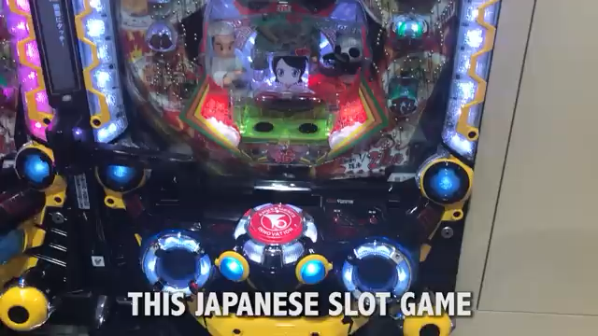

Slide 3
6,839 Pachinko Parlors
About 7 Million Pachinko Fans
0.7 million addicts, estimated
18 thousand lost money per visit on average

Slide 4
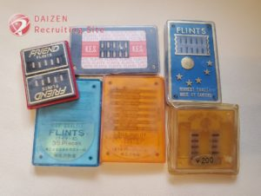
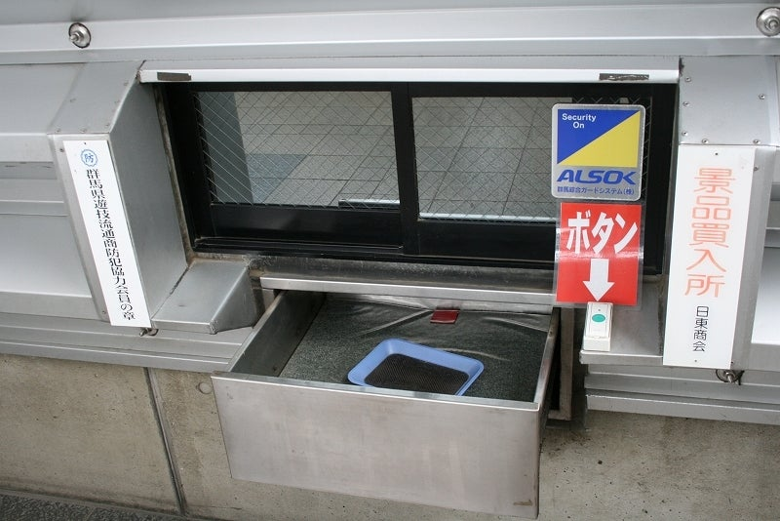
Not a gamble, legally
Change Pachinko Balls to Prizes
The prizes are changed to money outside

Slide 5


