Slide 1
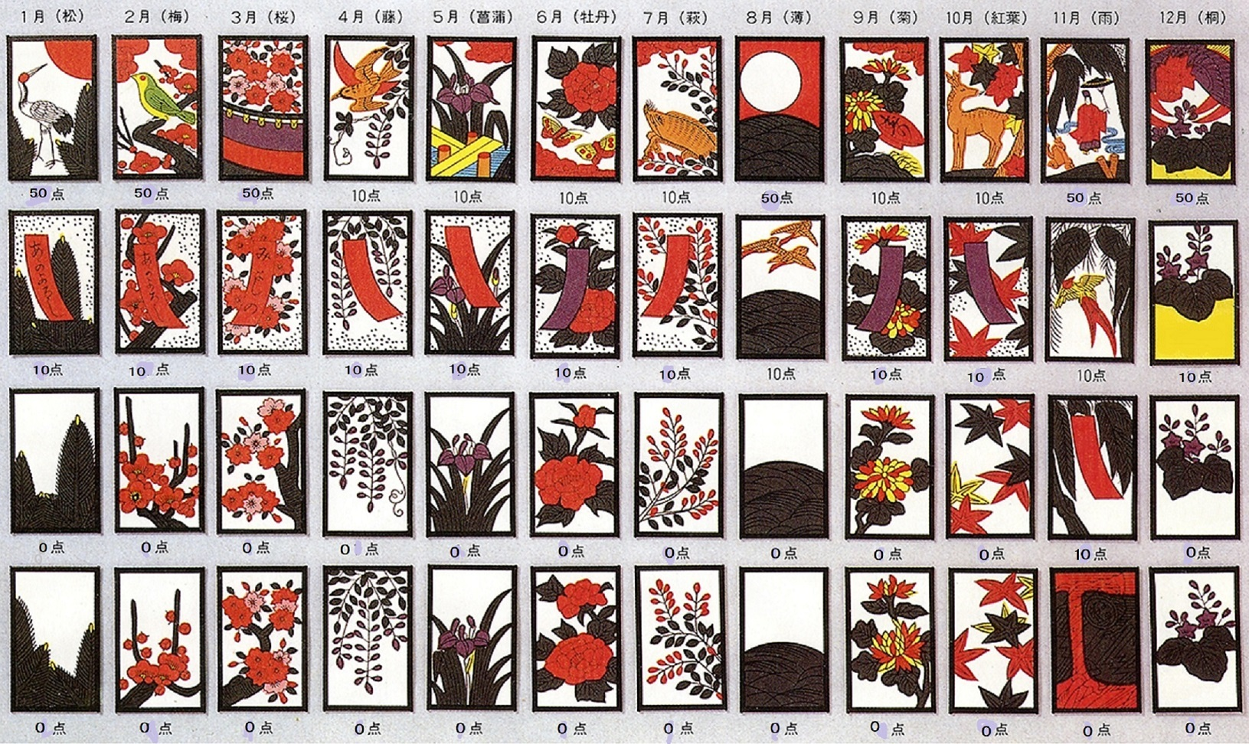

Slide 2
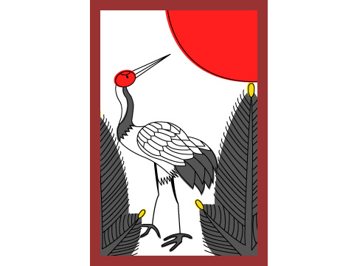
Pine
Crane
Sun

Slide 3
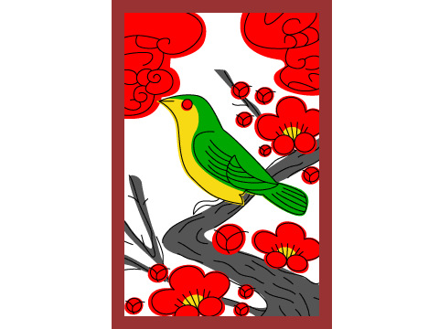
Plum Blossom
Bush Warbler

Slide 4

Cherry Blossom
Curtain

Slide 5

Wisteria
Cuckoo

Slide 6

Water Iris
Plank Bridge

Slide 7
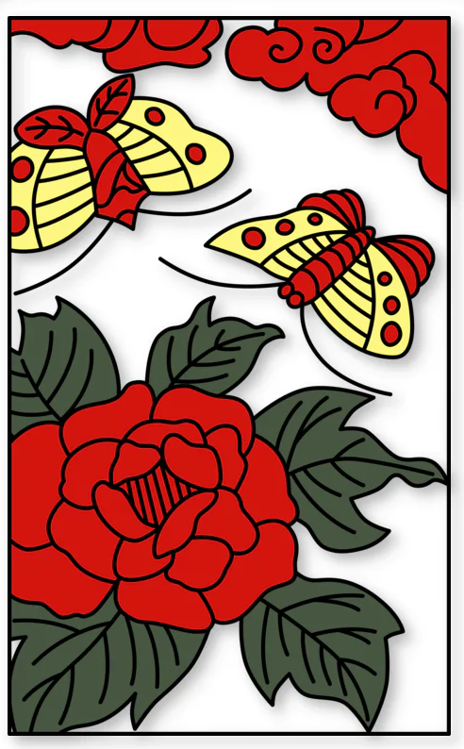
Peony
Butterflies

Slide 8

Bush Clover
Boar

Slide 9

Pampas Grass
Full Moon

Slide 10
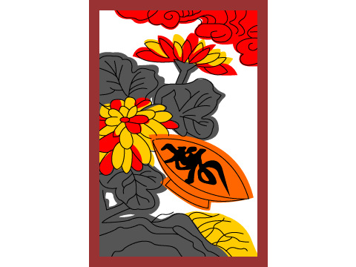
Chrysanthemum
Sake Cup

Slide 11

Maple
Deer

Slide 12
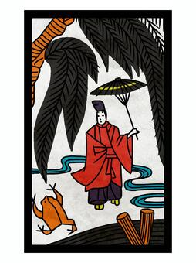
Willow
Ono no Tofu
Frog

Slide 13
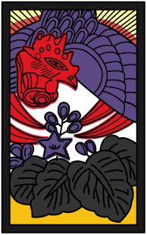
Paulownia
Chinese Phoenix

