Slide 1

OMAMORI
TALISMAN
AMULET
GOOD LUCK CHARM
PROTECTIVE CHARM

Slide 2

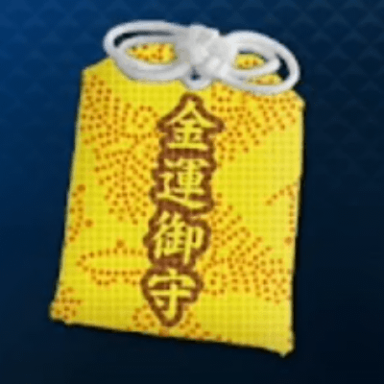
Kin Un Jo Sho
Financial Fortune Rise

Slide 3
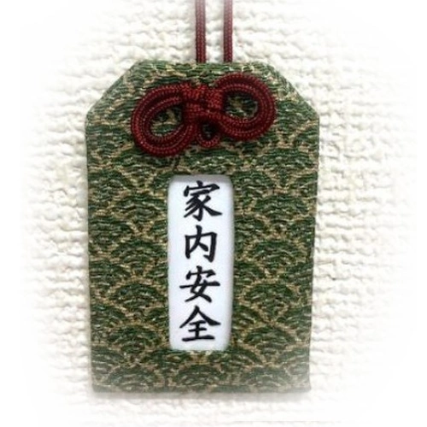
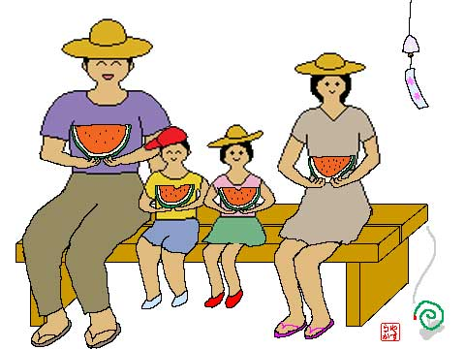
Ka Nai An Zen
Family Well-being

Slide 4
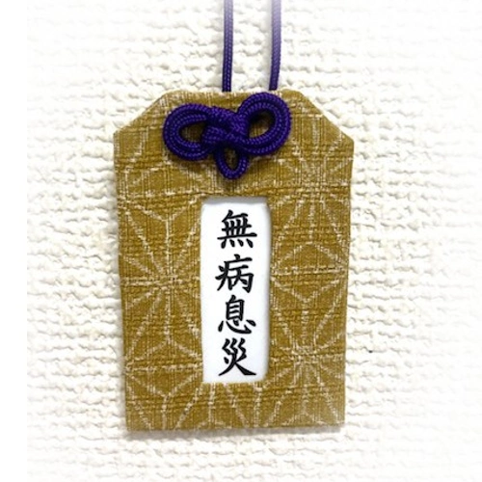

Mu Byo Soku Sai
Good Health and Freedom from Illness

Slide 5

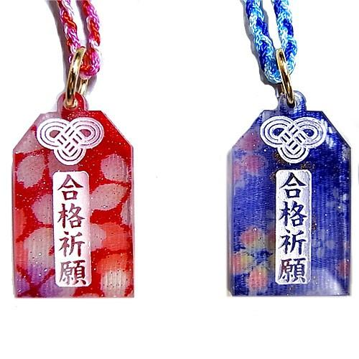
Go Kaku Ki Gan
Prayer for success in exams

Slide 6
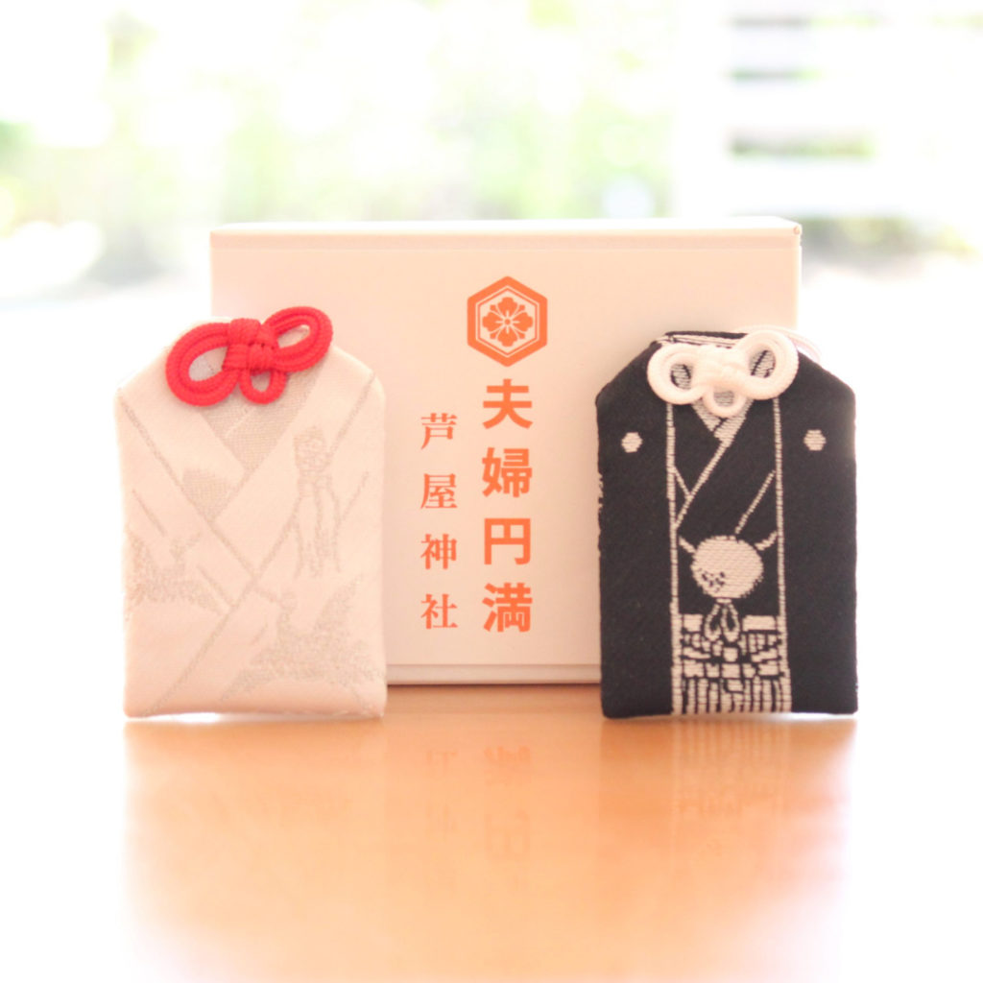

Fu Fu En Man
Marital Harmony

Slide 7
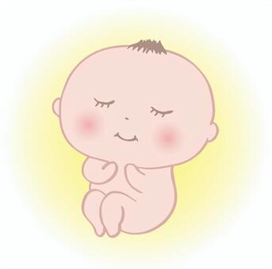
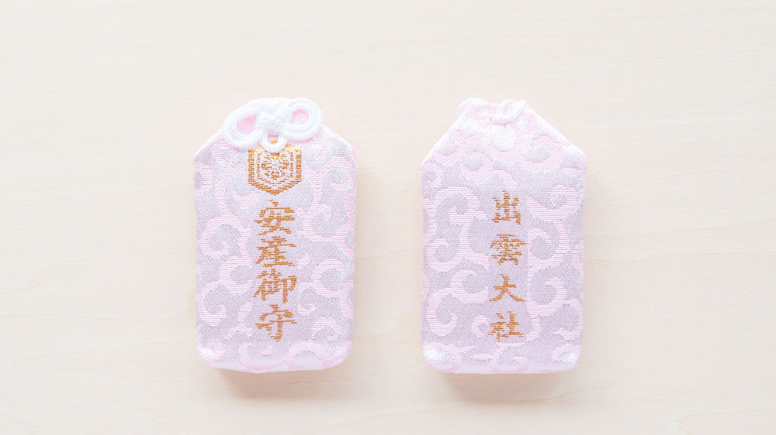
An Zan Ki Gan
Prayer for Safe Childbirth

Slide 8

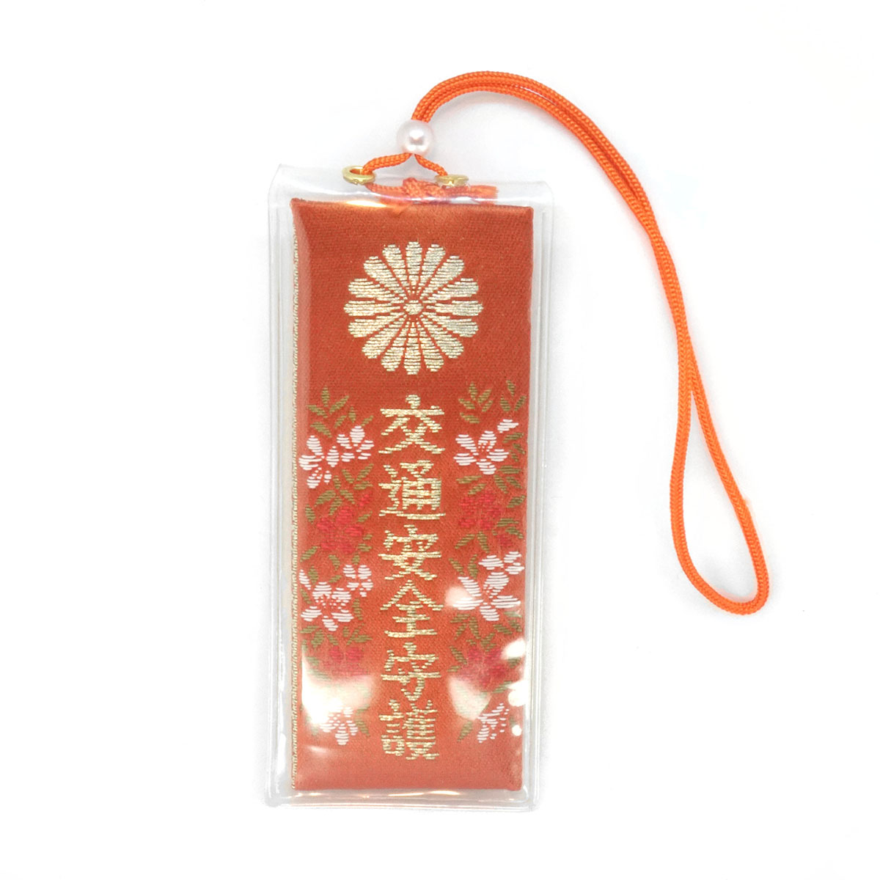
Ko Tsu An Zen
Traffic Safety

Slide 9
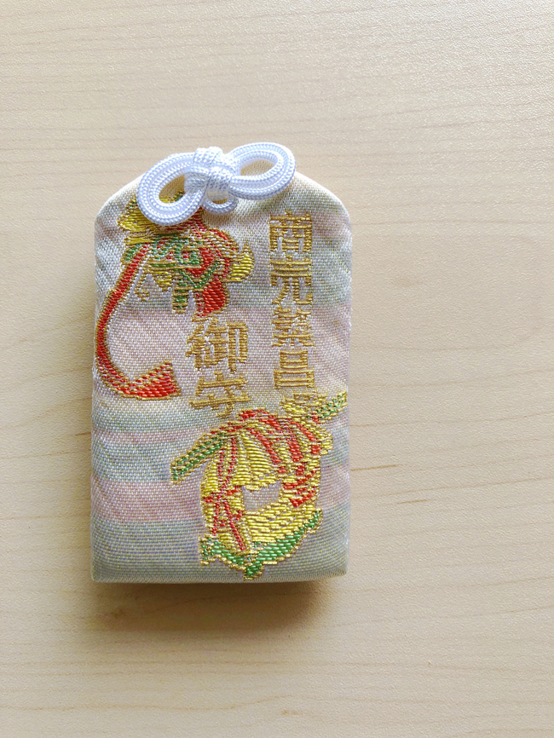

Syo Bai Han Jo
Business Prosperity

