Slide 1
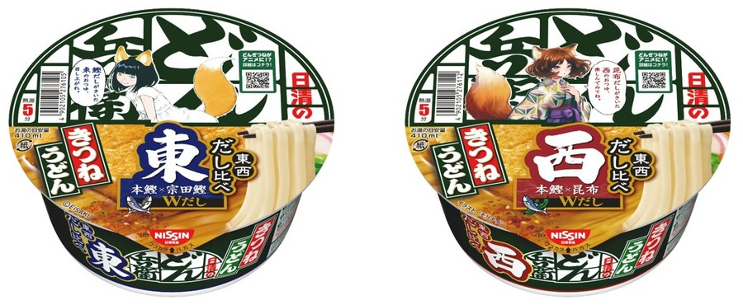
Notes:
The taste of the broth differs between the West and the East.

Slide 2
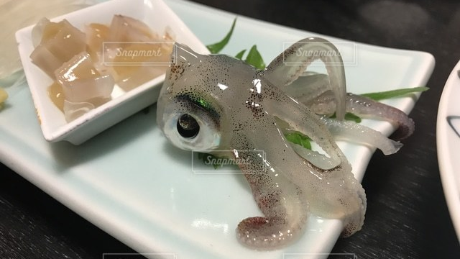
Notes:
Eating seafood, especially squid, while it is still alive is called "odori-gui" (eat dancing food).

Slide 3
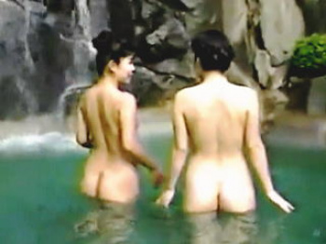
Notes:
In the past, you could see female nudity on television.

Slide 4
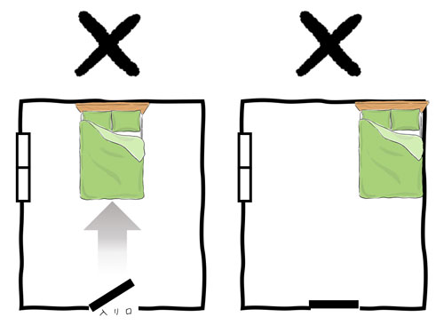

Notes:
Do not place your pillow facing north.

Slide 5
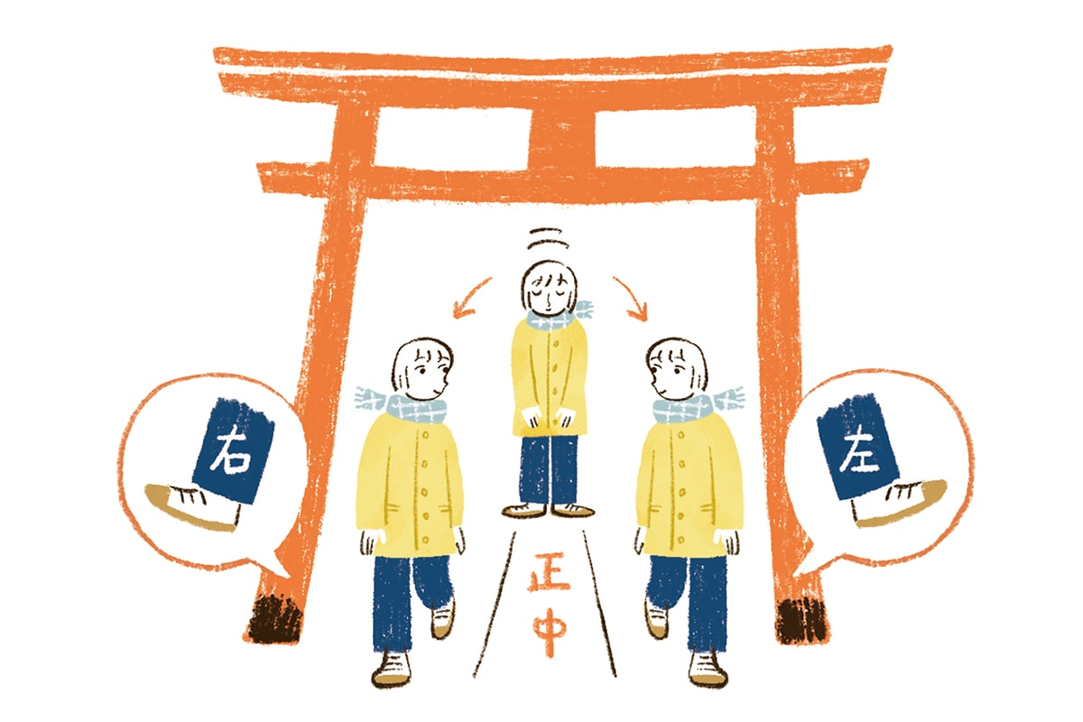
Notes:
You should not walk in the center of the path at a shrine.

Slide 6
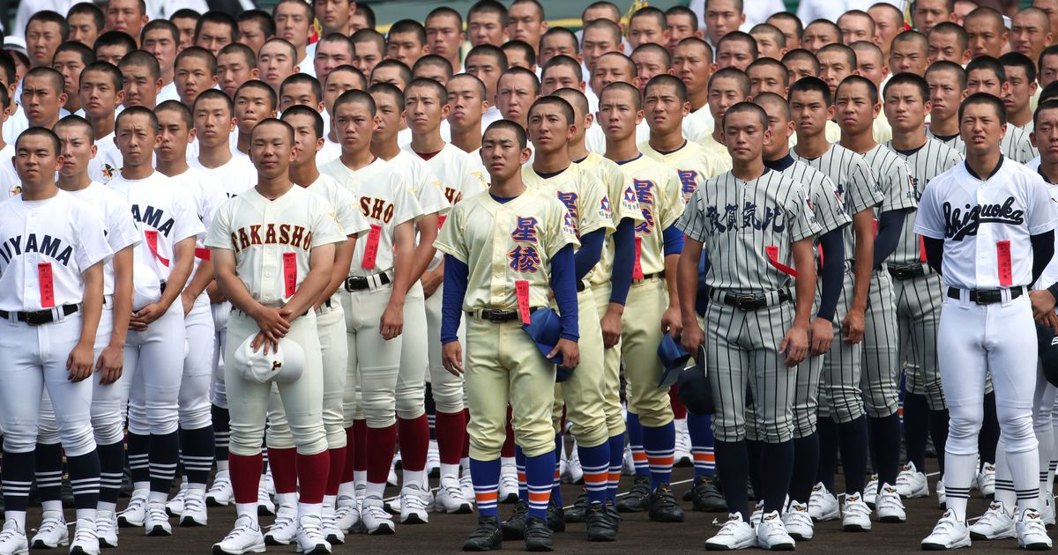
Notes:
Most boys who play baseball in high school have a buzz cut.

Slide 7
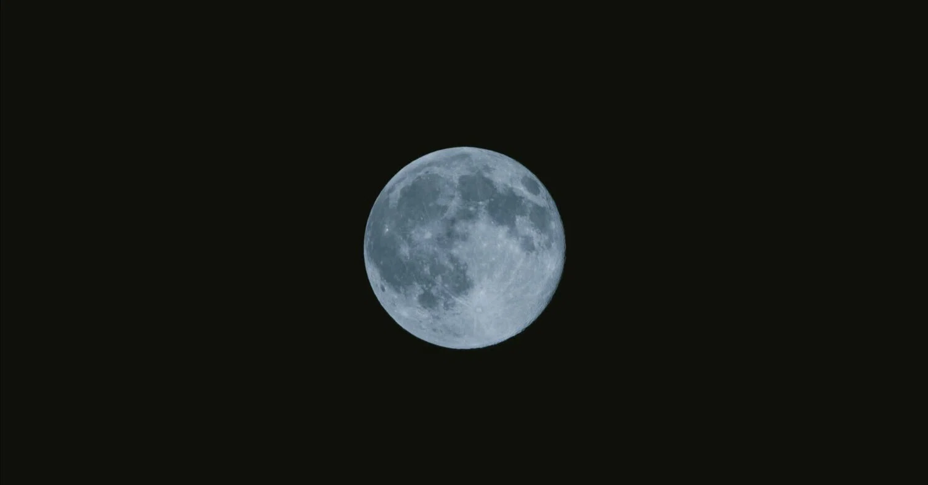
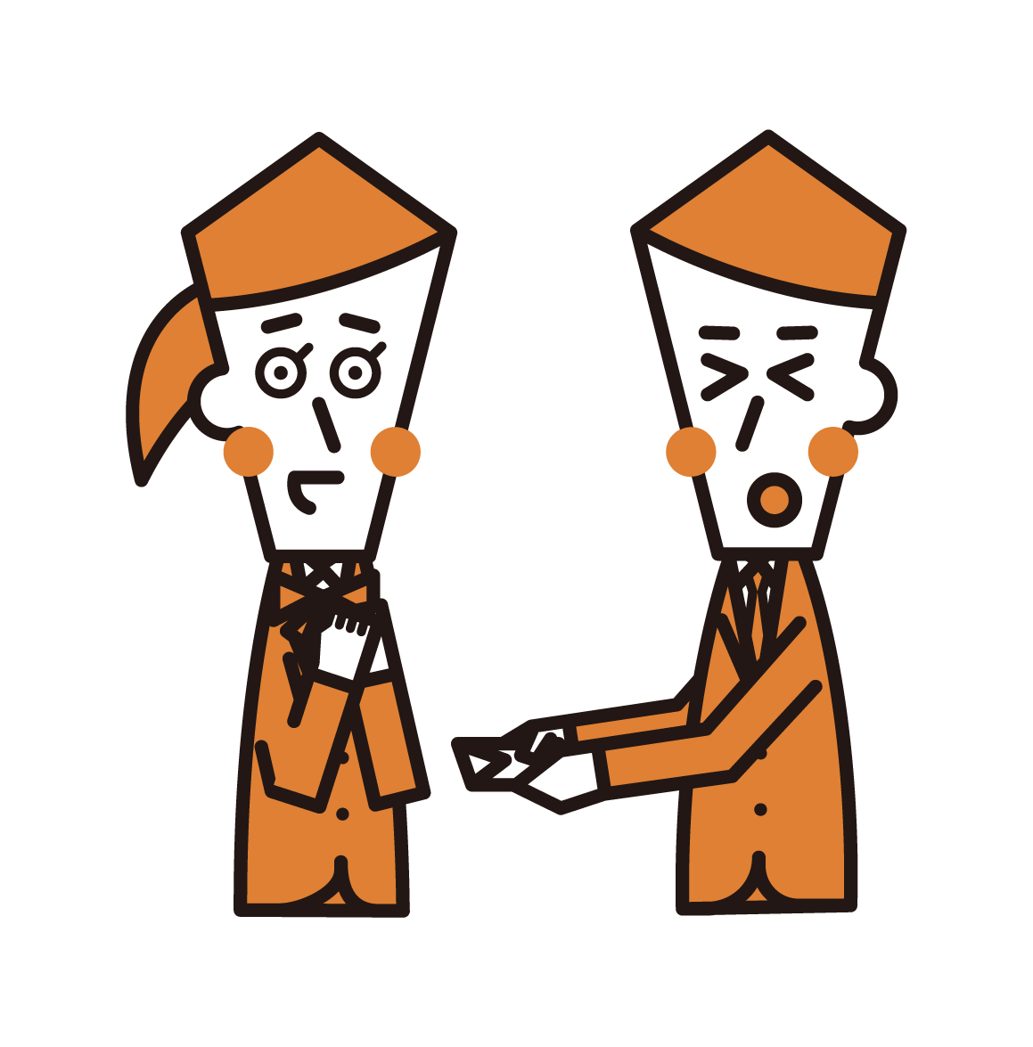
Notes:
The phrase "The moon is beautiful" means "I love you."

Slide 8
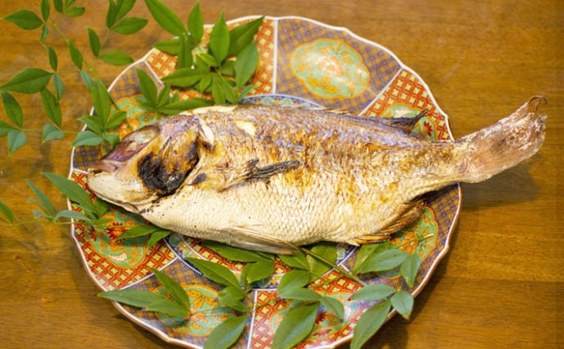
Notes:
When fish dishes are served, the fish's head is always placed on the left side.

Slide 9
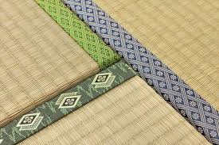
Notes:
Japanese people do not step on the edges of tatami mats.

Slide 10
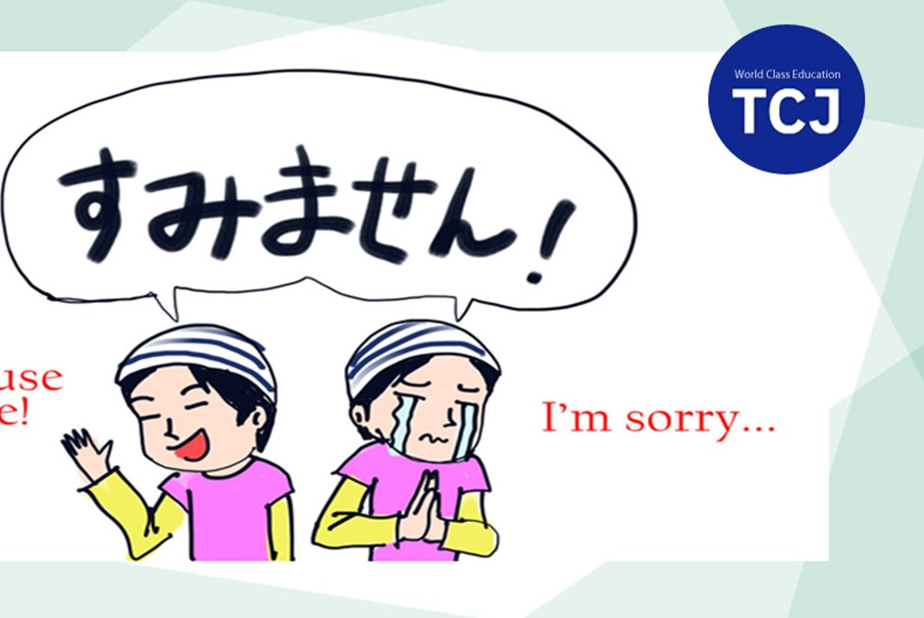
Notes:
Japanese people say "Sorry" instead of "Excuse me" when they should say "Excuse me."

Slide 11
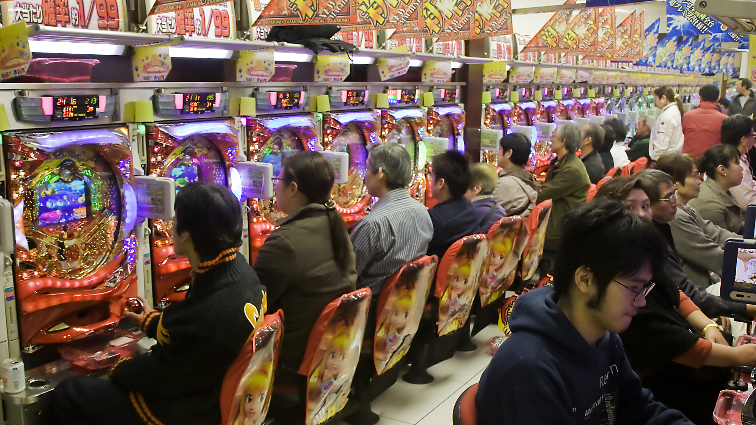
Notes:
Pachinko is not gambling, but it is gambling.

Slide 12
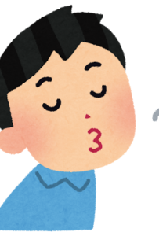

Notes:
Many people believe that if you whistle at night, a snake will appear.

Slide 13
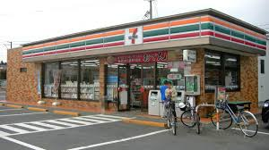
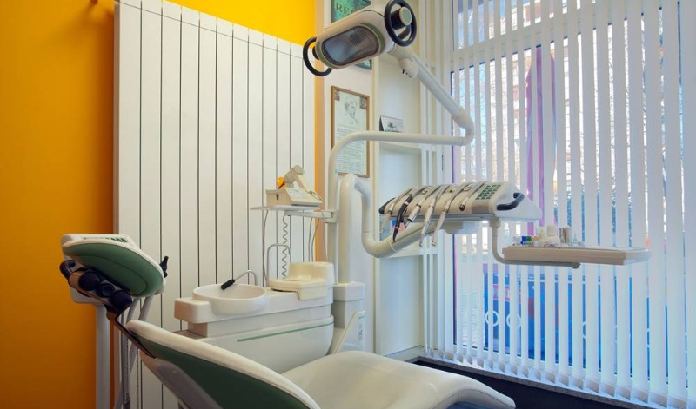
Notes:
There are more dental clinics than convenience stores in Japan.

Slide 14
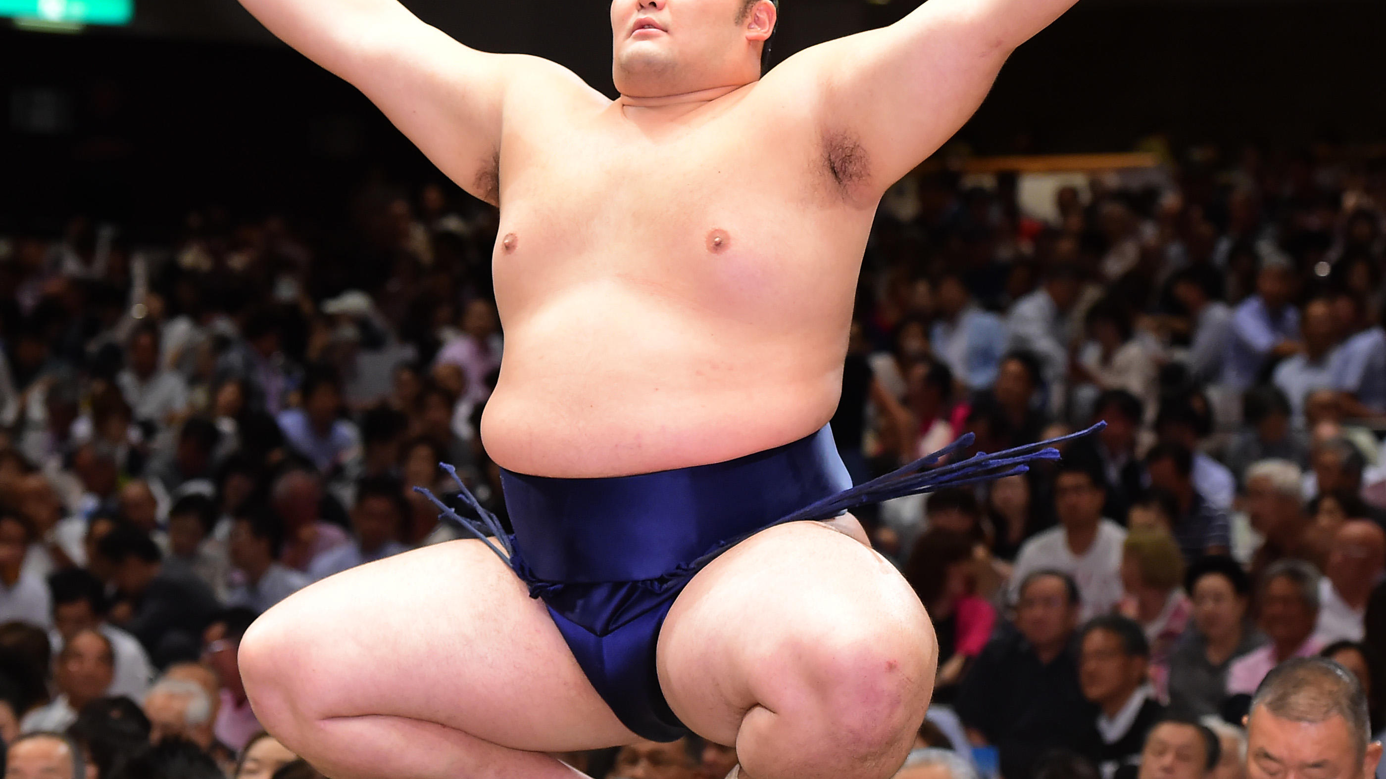
Notes:
Sumo wrestlers' mawashi (belts) are never washed.

Slide 15
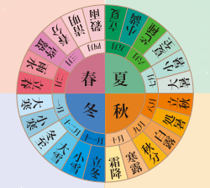
Notes:
In addition to dividing the seasons into four, they are also divided into twenty-four periods.

Slide 16
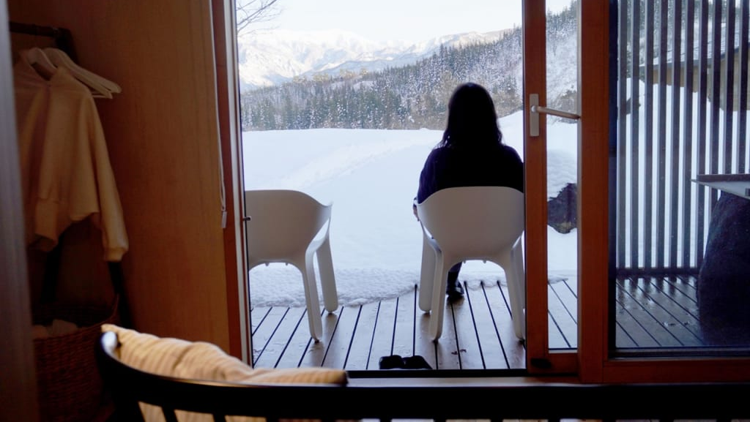
Notes:
Japanese women often travel to the north when they experience a breakup.

