Slide 1
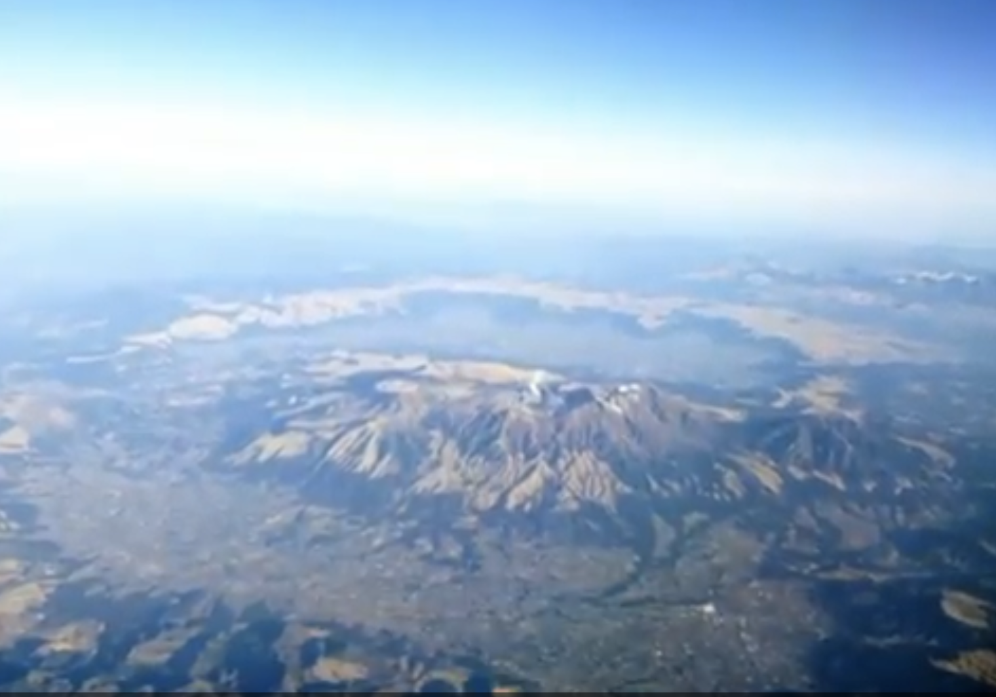

Slide 2
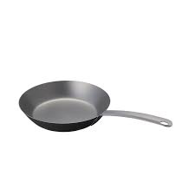
Notes:
The word ‘caldera’ is derivated from a Portuguese word meaning ‘frying pan.’

Slide 3
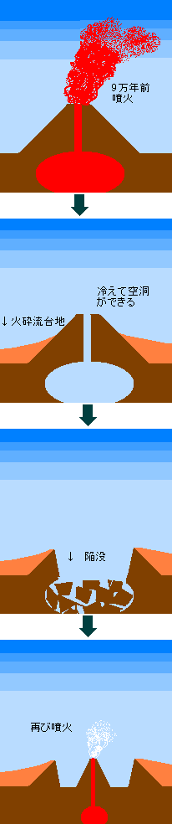
Notes:
About nine hundred thousand years ago, the eruptions began.

Slide 4
Notes:
The lava underground was blown out and a hollow space was created.

Slide 5
Notes:
The volcano crushed and sank.

Slide 6
Notes:
And then again eruptions began again in the center of the sunken area.

Slide 7
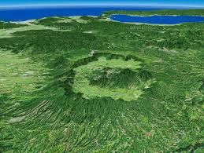
Notes:
This is an overview of Mt. Aso from the sky.

