Slide 1
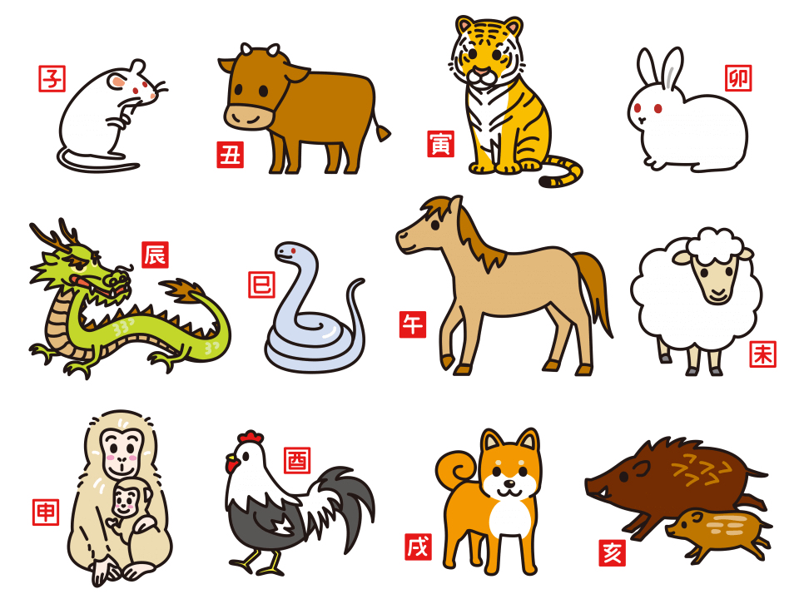

Slide 2
RAT | 1936 | 1948 | 1960 | 1972 | 1984 | 1996 | 2008 | 2020
OX | 1937 | 1949 | 1961 | 1973 | 1985 | 1997 | 2009 | 2021
TIGER | 1938 | 1950 | 1962 | 1974 | 1986 | 1998 | 2010 | 2022
RABBI | 1939 | 1951 | 1963 | 1975 | 1987 | 1999 | 2011 | 2023
DRAGON | 1940 | 1952 | 1964 | 1976 | 1988 | 2000 | 2012 | 2024
SNAKE | 1941 | 1953 | 1965 | 1977 | 1989 | 2001 | 2013 | 2025
HORSE | 1942 | 1954 | 1966 | 1978 | 1990 | 2002 | 2014 | 2026
SHEEP | 1943 | 1955 | 1967 | 1979 | 1991 | 2003 | 2015 | 2027
MONKEY | 1944 | 1956 | 1968 | 1980 | 1992 | 2004 | 2016 | 2028
ROOSTER | 1945 | 1957 | 1969 | 1981 | 1993 | 2005 | 2017 | 2029
DOG | 1946 | 1958 | 1970 | 1982 | 1994 | 2006 | 2018 | 2030
BOAR | 1947 | 1959 | 1971 | 1983 | 1995 | 2007 | 2019 | 2031

Slide 3
Strengths
Weaknesses

Slide 4

The Rat
Strengths: Adaptable and insightful
Weaknesses: Sometimes overly sensitive

Slide 5

The Ox
Strengths: Loyal and stable
Weaknesses: Can be stubborn

Slide 6

The Tiger
Strengths: Energetic and a natural leader
Weaknesses : Reckless and impatient

Slide 7

The Rabbit
Strengths : Sociable and calm
Weaknesses : Sometimes too timid

Slide 8

The Dragon
Strengths : Enthusiastic and confident
Weaknesses : Overly ambitious and self-centered

Slide 9

The Snake
Strengths : Thoughtful and insightful
Weaknesses : Prone to jealousy

Slide 10

The Horse
Strengths : Active and cheerful
Weaknesses : Can be whimsical

Slide 11

The Sheep
Strengths Sensitive and considerate
Weaknesses :
Too reserved

Slide 12

The Monkey
Strengths : Witty and creative
Weaknesses : Restless

Slide 13
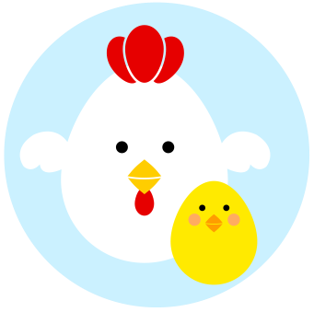
The Rooster
Strengths : Meticulous and focused
Weaknesses : Overly critical

Slide 14

The Dog
Strengths : Trustworthy and honest
Weaknesses : Sometimes too sensitive

Slide 15

The Boar
Strengths: Energetic and decisive
Weaknesses: Occasionally careless

