Slide 1
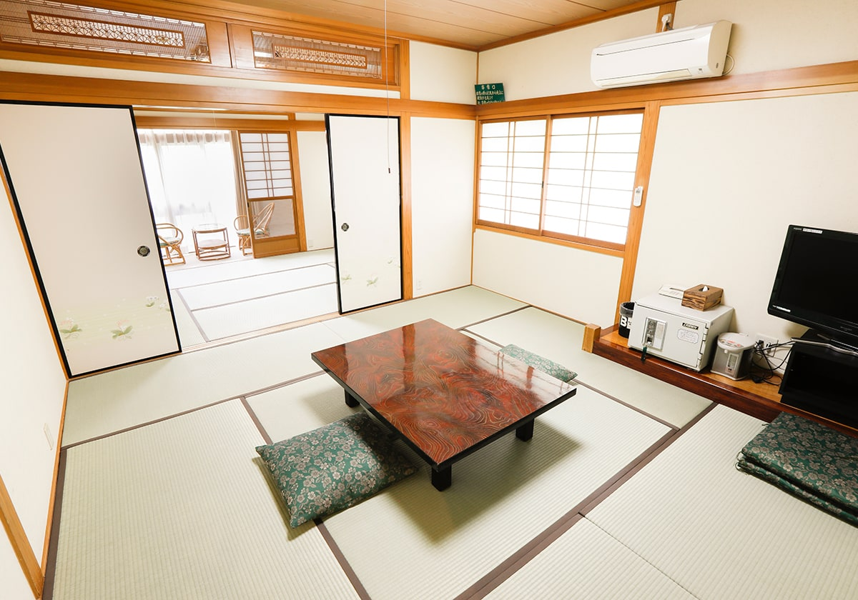
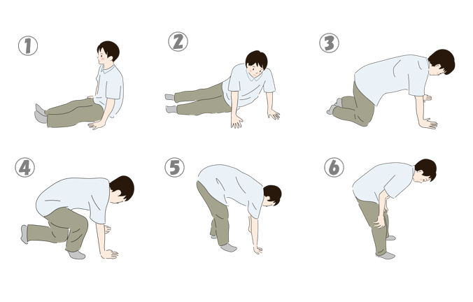
Tatami-matted room
Notes:
Chairs or legless chairs may not be provided. Naturally, there won’t be beds. Because you get up and down frequently, this can be tough for those with troubled legs, hips, or knees. Shoes are not worn indoors.

Slide 2
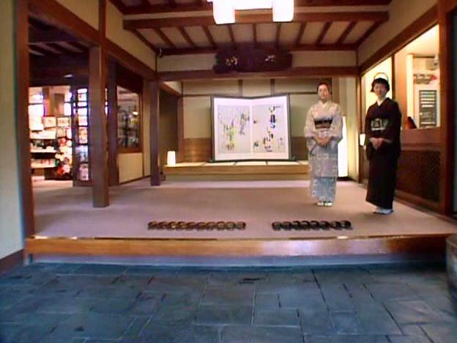
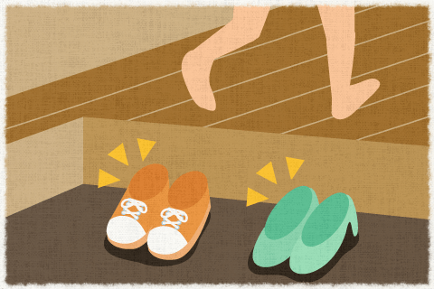
2 Shoes and Slippers.
Notes:
Shoes are removed. Slippers are worn. Then slippers are removed.
At a traditional ryokan, you take off your shoes at the entrance and change into slippers. Inside, you walk around in slippers, but when entering your guest room, you remove them.
The timing for removing shoes and slippers follows a basic rule: areas where you walk with outside shoes (“doma”, earthen floor) and living areas kept clean (“yuka”, flooring) are separated by a step or boundary.

Slide 3
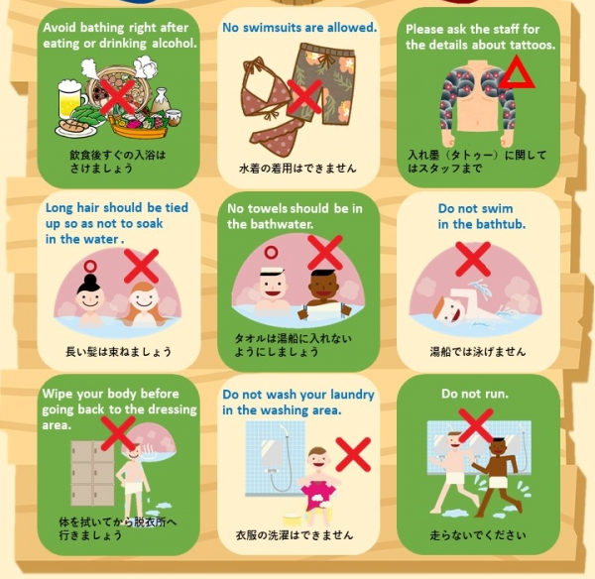
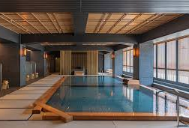
3 Public Bath
Notes:
Cautions for public baths:
Bathing is done naked—do not bring swimsuits or towels into the tub.
Pour hot water or shower yourself before entering the tub.
Wash your body or hair while seated, being careful not to splash water on others.
Small towels should not be dipped into the bath; place them on your head or outside the tub.
Photography is prohibited in most bath areas.
If you have tattoos, check with the staff.

Slide 4
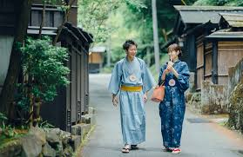
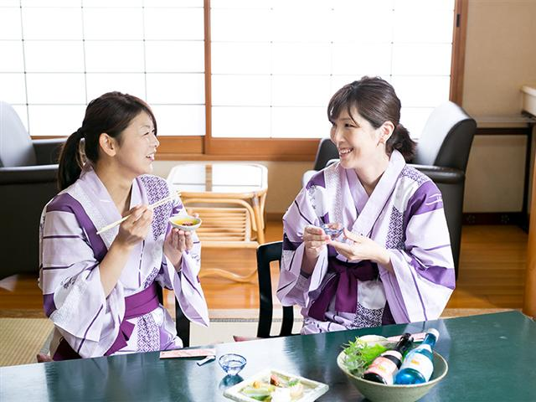
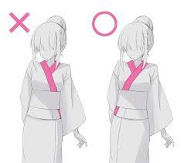
4 Yukata Kimono
Notes:
The yukata (cotton robe) provided by the inn should be worn with the left side over the right (left front). Right over left is for funerals, so take care.
Various sizes are available.
It is fine to wear the yukata around the inn or on walks in the onsen town.
Hotels branding themselves as onsen also allow yukata in their facilities.

Slide 5
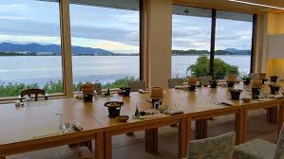
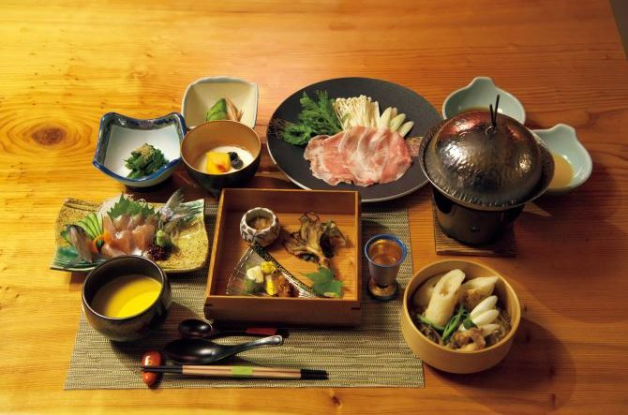
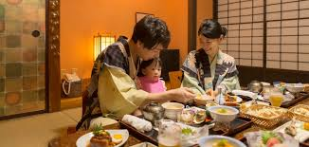
5 Meals
Notes:
Dinner and breakfast are often served in your room or a designated dining area. You’ll be informed in advance regarding time and place, so please be punctual.
If you have dietary restrictions or allergies, inform the staff beforehand so they can accommodate you.

Slide 6
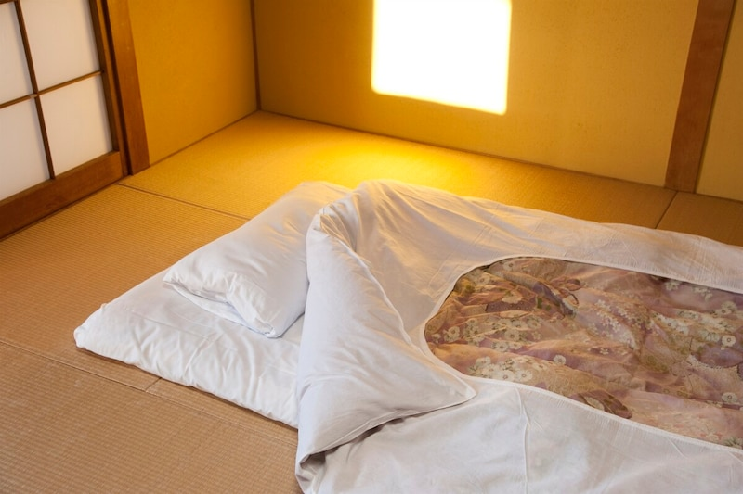
6 Futon
Notes:
Futons are typically laid out by staff, though sometimes you’ll do it yourself.
If staff handle it, they will set out the futon when you’re eating outside your room.
You don’t need to put away the futon in the morning; staff will do it for you, usually while you’re having breakfast elsewhere.

Slide 7
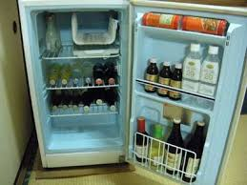
7 Refrigerator
Notes:
There may be drinks already placed inside. Most of the time, these are charged and payment is settled at checkout.

Slide 8
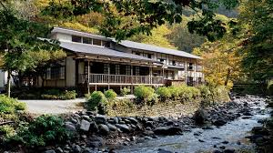


8 Too Far in the mountain/ Too old.
Notes:
In remote mountain areas, mobile phone signal may not be available. Old inns may not have Wi-Fi.

Slide 9
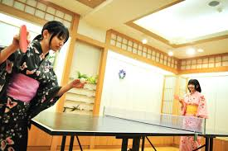
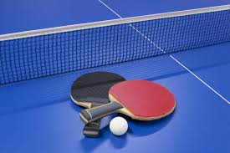
9 Table-Tennis Table
Notes:
Many onsen inns have table tennis tables. For some reason, many Japanese people think playing table tennis is part of the onsen experience.

