Slide 1
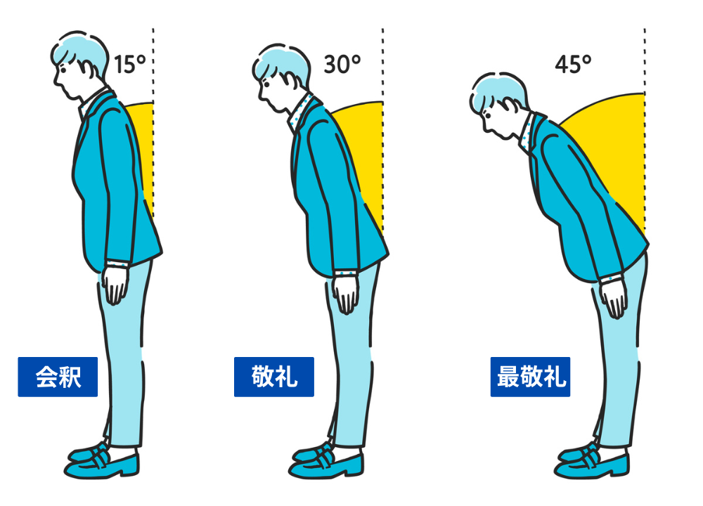
Notes:
Making a Bow
Bowing holds significant meaning for Japanese people. The depth and duration of a bow vary depending on the situation, ranging from a simple greeting to a gesture of deep respect, gratitude, or even an apology.

Slide 2
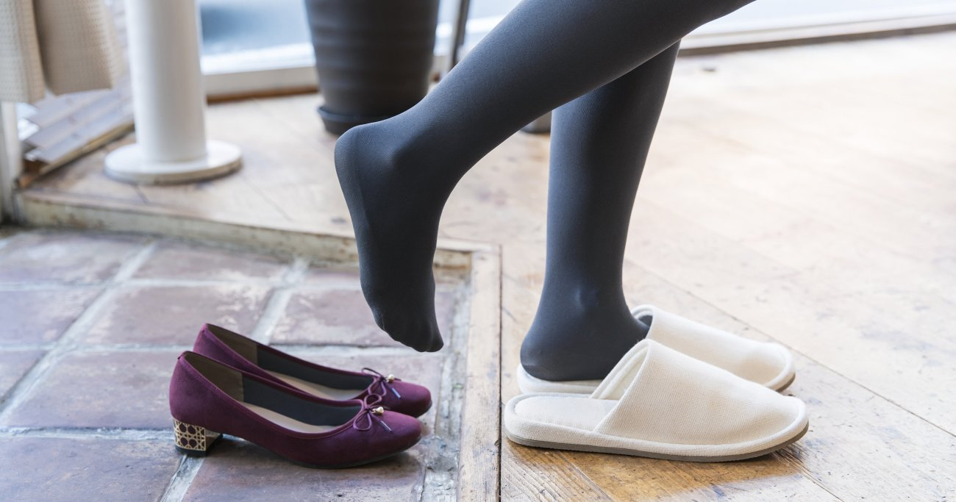
Notes:
Taking Off Shoes
The custom of removing shoes indoors stems from several factors: weather, traditional architecture, and a cultural sense of purity.
Japan is a rainy country where roads were often muddy in the past. Shoes worn outdoors would become dirty from walking on these roads.
Furthermore, Japan's high humidity led to architectural designs where floors were raised above the ground to improve ventilation and keep moisture out. Tatami mats were then placed on these floors. Without the custom of removing shoes, the interior of homes would easily become dirty and uncomfortable.
This practice is also supported by a deep-rooted sense of cleanliness, influenced by both Shinto and Buddhism.

Slide 3
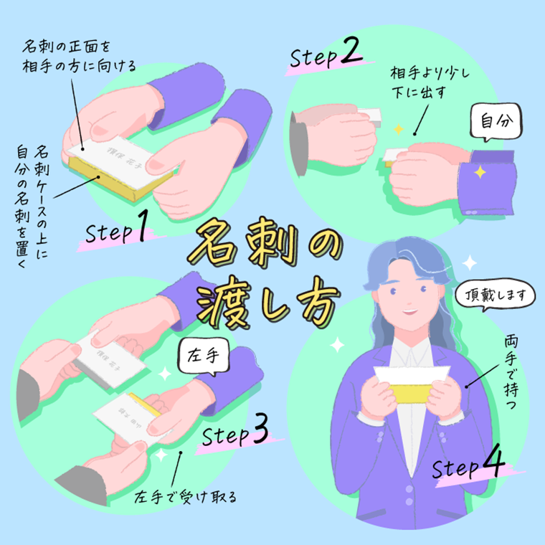
Notes:
Exchanging Business Cards
Exchanging business cards (meishi) is a common Japanese business custom, and there is a specific etiquette for doing so properly.

Slide 4
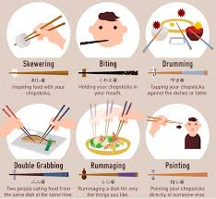
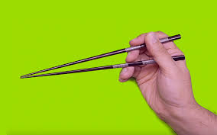
Notes:
Using Chopsticks
There are many rules of etiquette for using chopsticks. However, there is only one correct way to grip them.

Slide 5
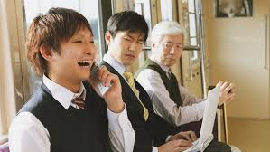
×
Notes:
Keeping Quiet in Public Places
It is considered polite to avoid talking loudly or on the phone in public spaces like trains and buses.

Slide 6
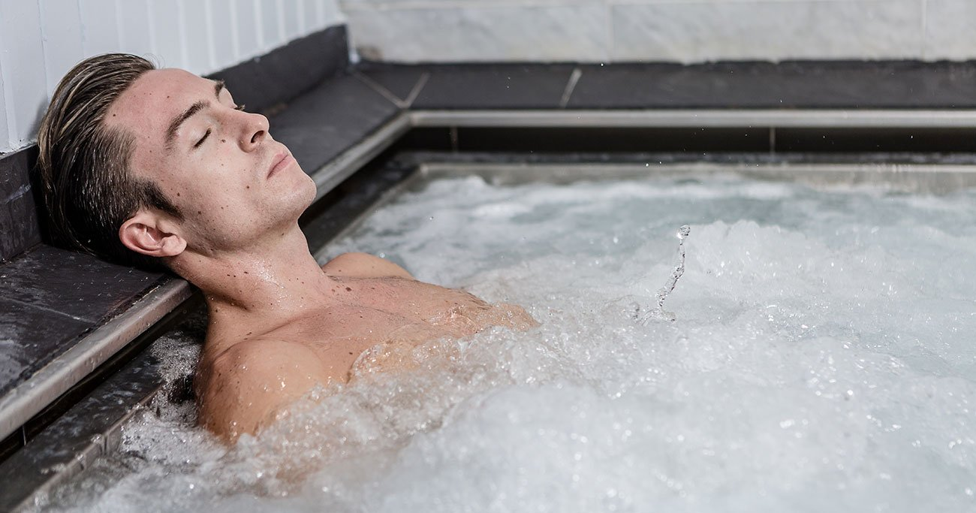
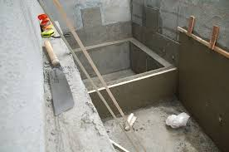
Notes:
Taking a Bath
Most Japanese people take a bath (or a shower) daily. This is a relatively new custom, only about 120-130 years old. It became popular because Japan is a country with abundant water and many natural hot springs, combined with the influence of Buddhist practices that emphasize purification.

Slide 7
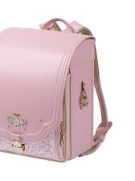
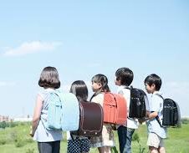
Notes:
Randoseru Bag
A randoseru is a sturdy backpack for schoolchildren. The term comes from the Dutch word ‘ransel’ (or German ‘Ranzen’). The tradition began in 1887, when Prince Yoshihito (later Emperor Taishō) was given this type of bag by Prime Minister Ito Hirobumi upon entering elementary school.

Slide 8
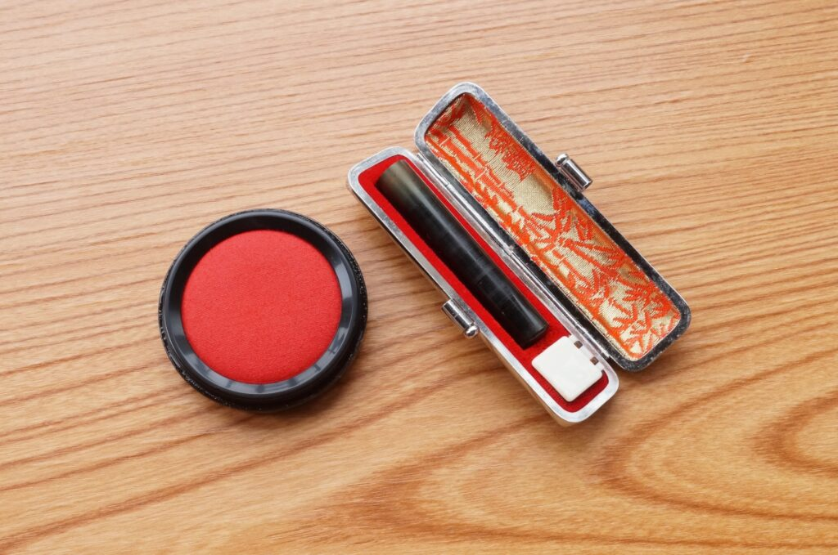
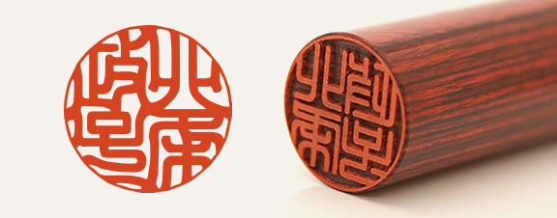
Notes:
Hanko Stamp
Hanko (personal seals) function like signatures. While they are used less frequently today, they are still required for important occasions like bank transactions and official public documents.

Slide 9
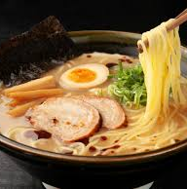
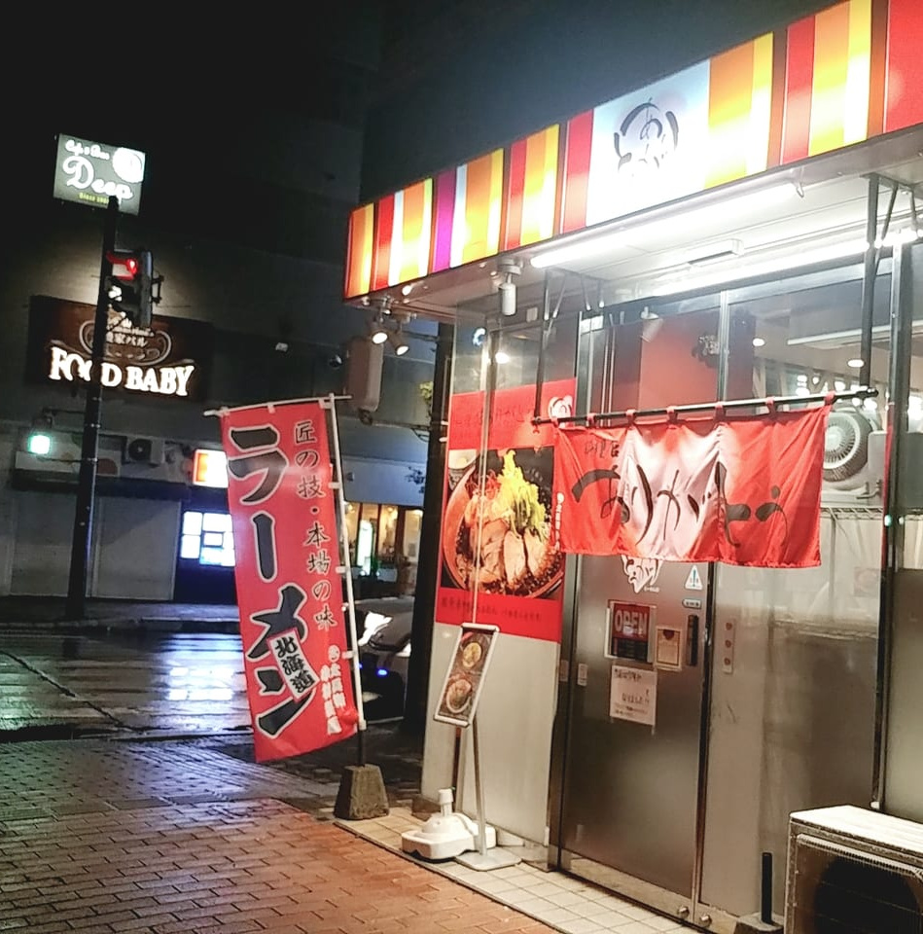
Notes:
Ramen: The Final Meal of the Night
It is a common custom to end a night of drinking by eating a bowl of ramen.

Slide 10
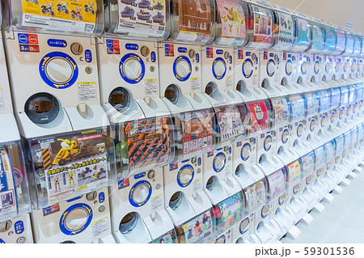
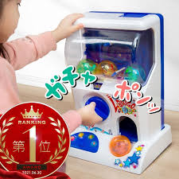
Notes:
Capsule Toys
Capsule toys, called ‘Gachapon’ or ‘Gachagacha,’ are very popular. The toys inside can be anime characters, animals, or other unique figures.

Slide 11
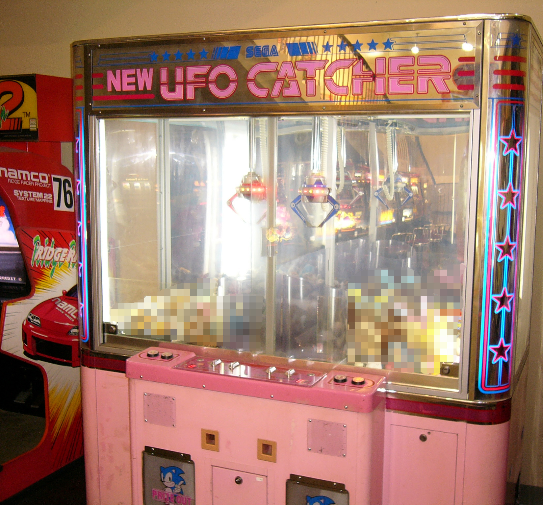
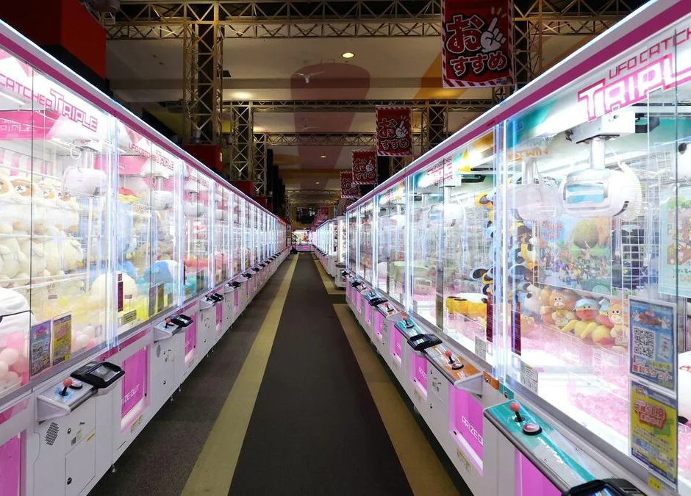
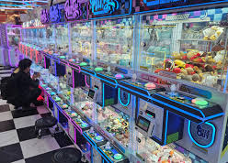
Notes:
Crane Games
"UFO Catchers" are the Japanese version of claw machines, but they are much more skill-based and strategic. Instead of just grabbing a prize, players often have to push or hook it into a chute. They are known for offering high-quality anime merchandise and are a major part of Japanese arcade culture.

