Slide 1
4 9
Notes:
The numbers "4" (shi) and "9" (ku) are considered unlucky because they sound like the words for "death" and "suffering."

Slide 2
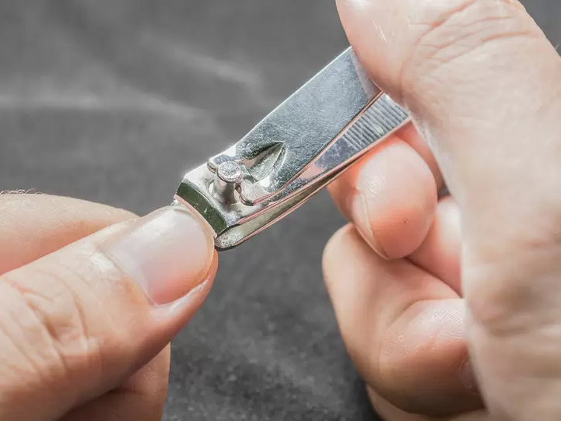

Notes:
If you cut your nails before bed, you won’t be able to see your parents before they die.

Slide 3

Notes:
If three people take a photo together, the person in the middle will die young.

Slide 4
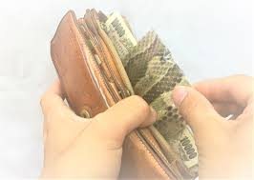
Notes:
If you put a snake’s shed skin in your wallet, you’ll save money.

Slide 5
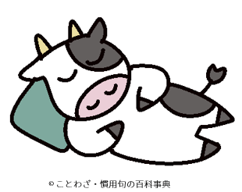
Notes:
If you sleep right after eating, you’ll turn into a cow.

Slide 6
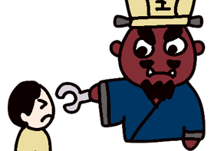
Notes:
If you tell a lie, the King of Hell (Enma) will pull out your tongue.

Slide 7
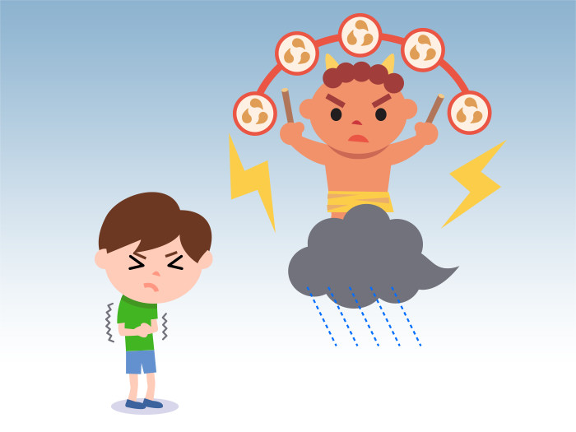
Notes:
When thunder rumbles, you should hide your belly button (or a lightning god might steal it).

Slide 8
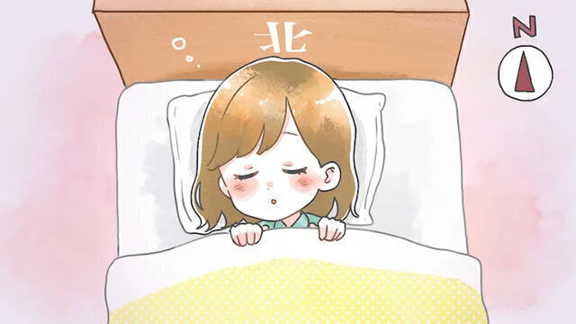
Notes:
You should never sleep with your head facing north (as it’s associated with death).

Slide 9
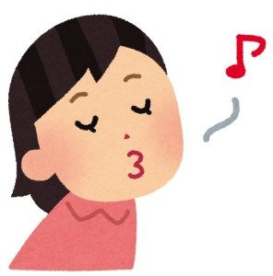

Notes:
If you whistle at night, a snake will come to you.

Slide 10
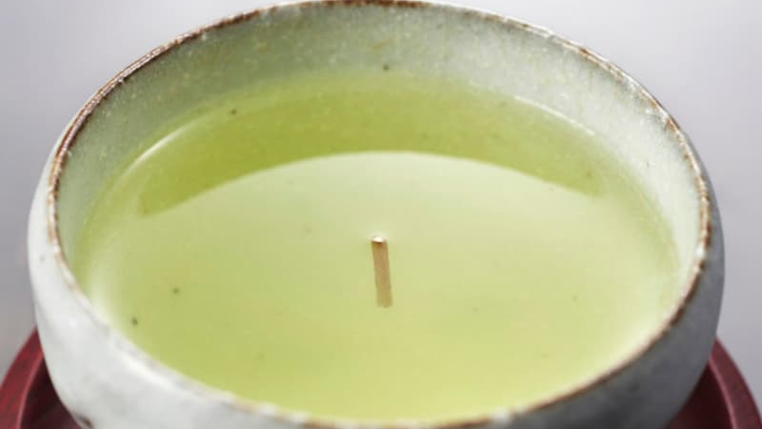
Notes:
If a tea stalk stands upright in your cup, it’s good luck.

Slide 11

Notes:
Finding a four-leaf clover brings good luck.

Slide 12

Notes:
If your first dream of the year is of "Mt. Fuji, a hawk, and an eggplant," it’s very auspicious.

Slide 13

Notes:
If you sneeze, someone is talking about you.

