Slide 1
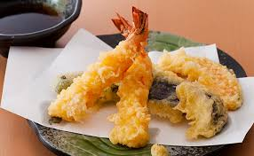
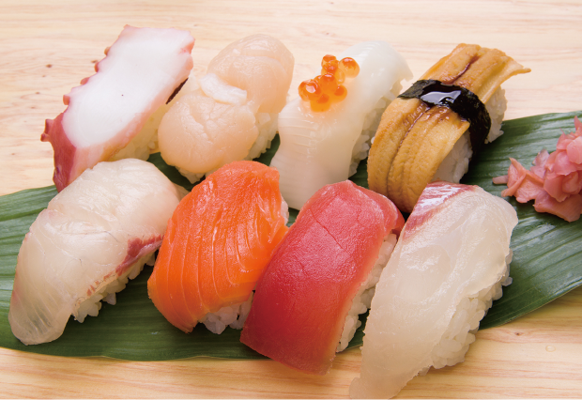
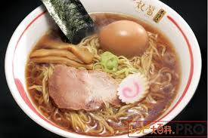
Sushi, Tempura, Ramen…
What is the next?

Slide 2
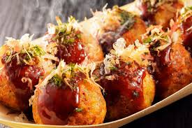
1. Takoyaki (octopus balls)

Slide 3
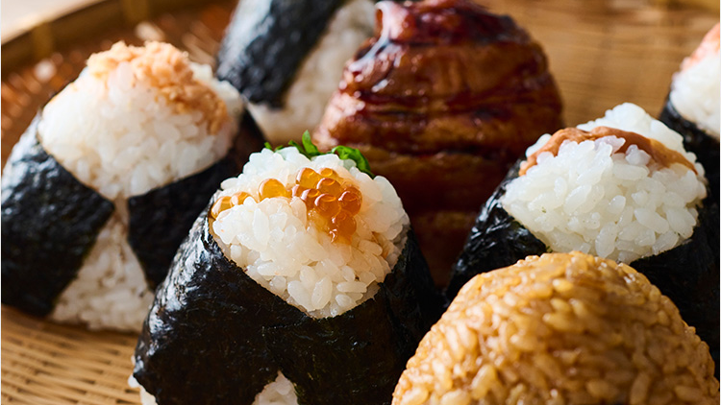
2. Onigiri(rice balls)

Slide 4
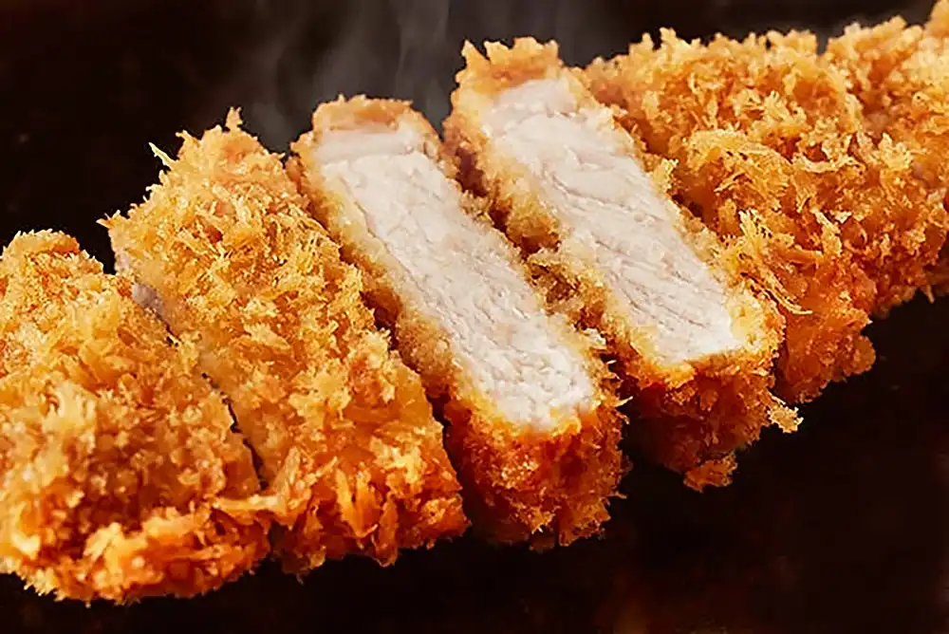
3. Tonkatsu(pork cultlet)

Slide 5
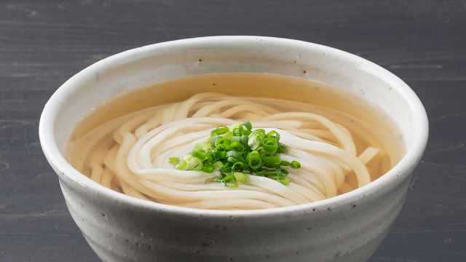
4. Udon(Udon Noodles)

Slide 6
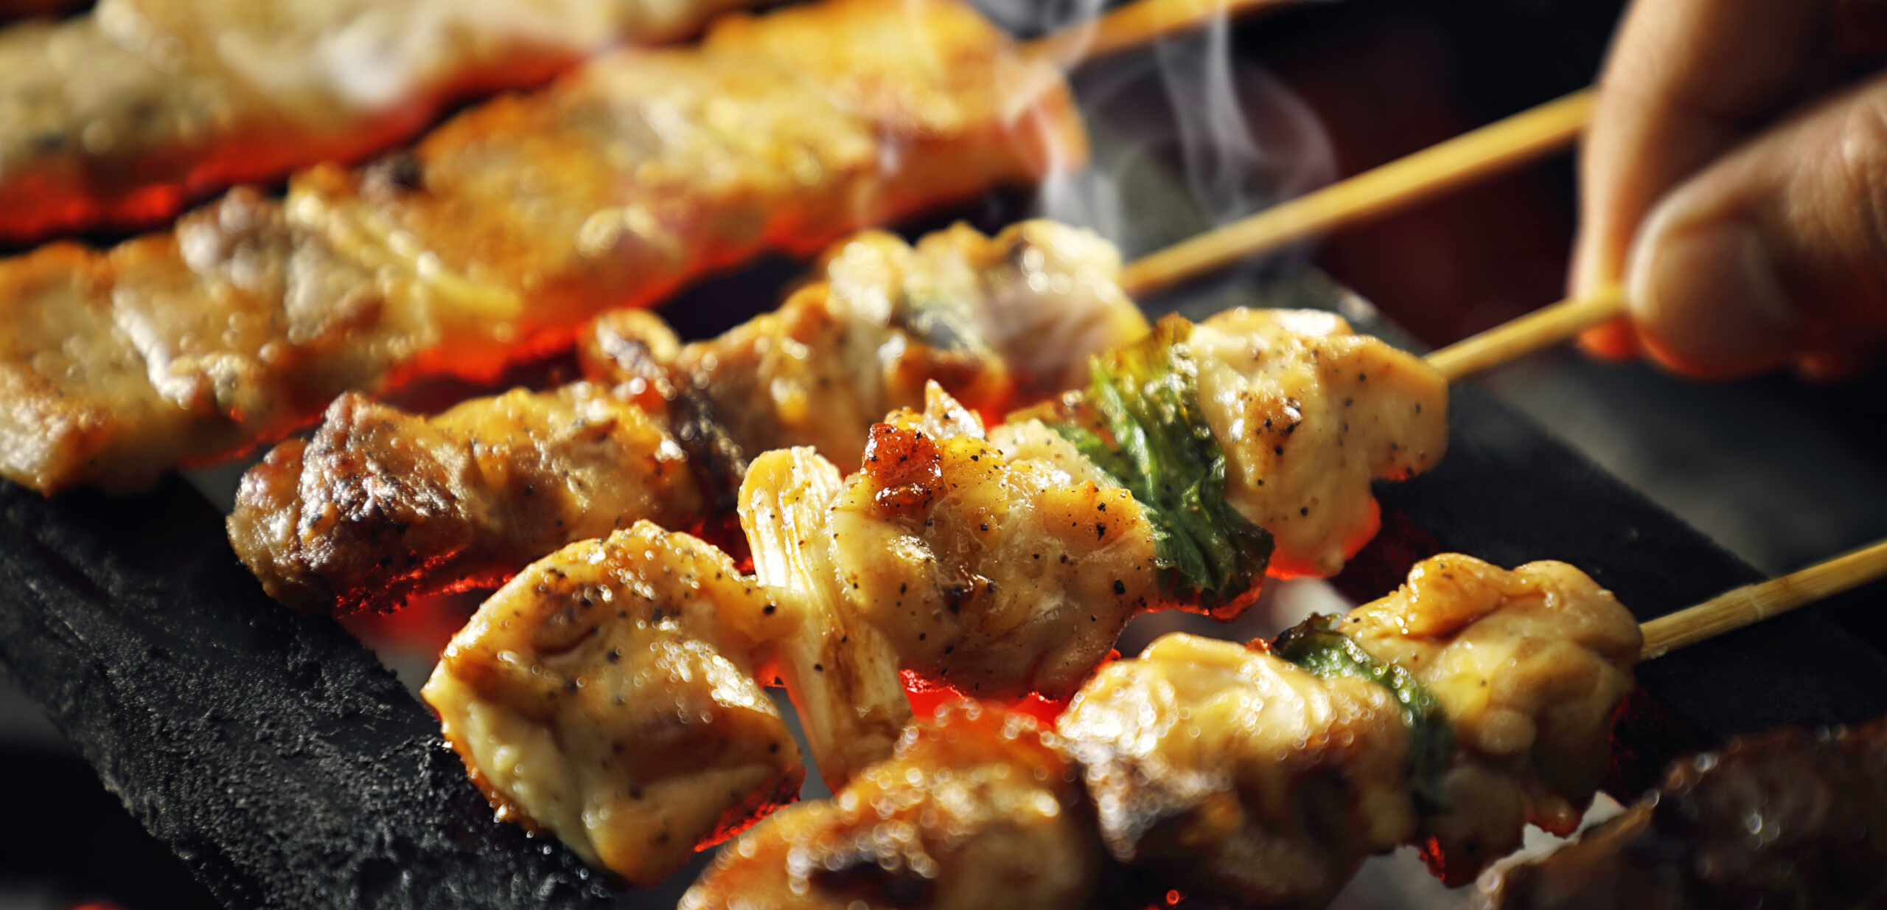
5. Yakitori(Grilled Chicken Skewers)

Slide 7
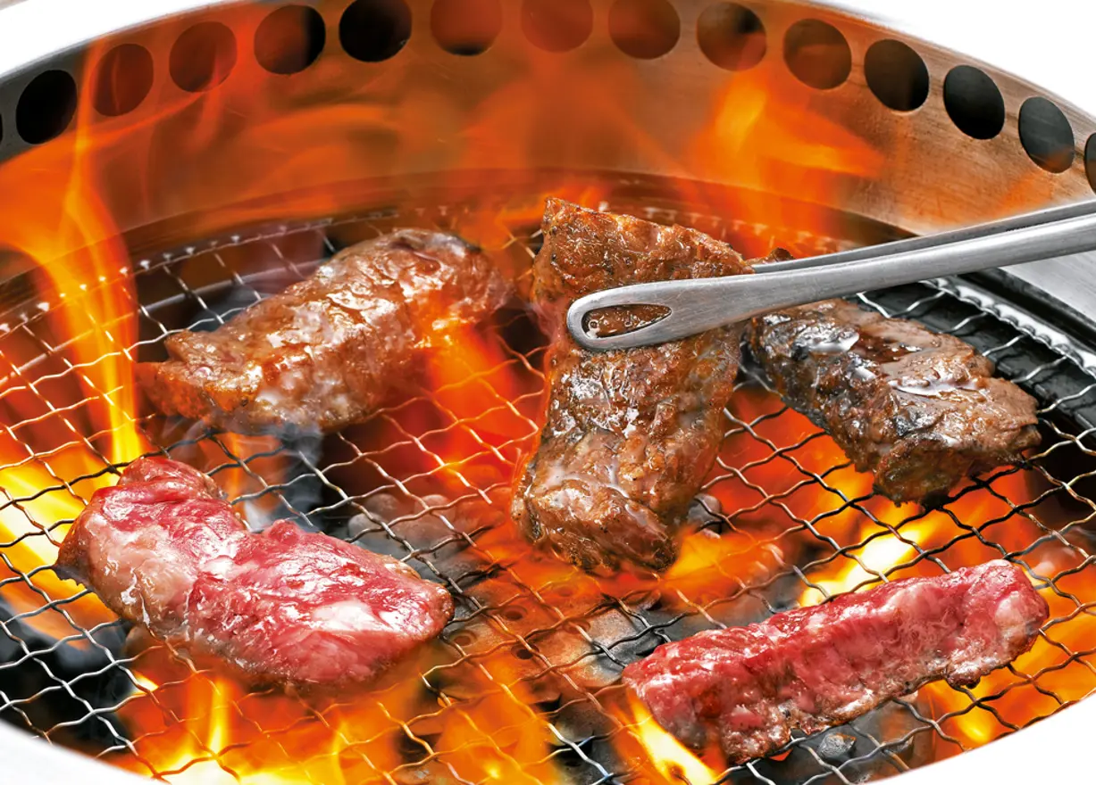
6. Yakiniku(Korean BBQ)

Slide 8
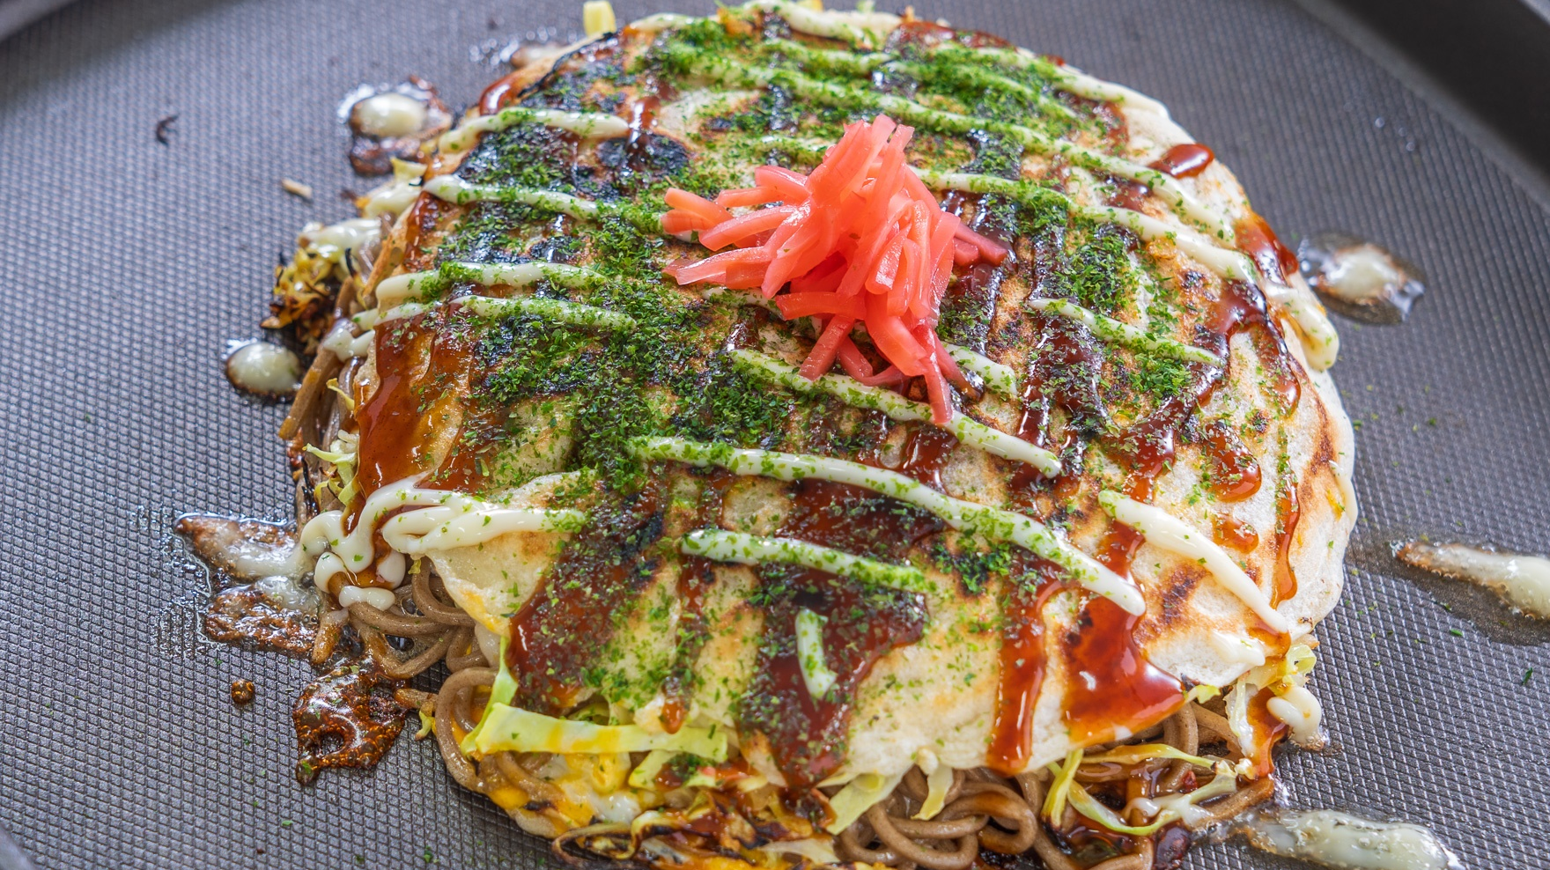
7. Okonomiyaki(Savory Japanese Pancake)

Slide 9
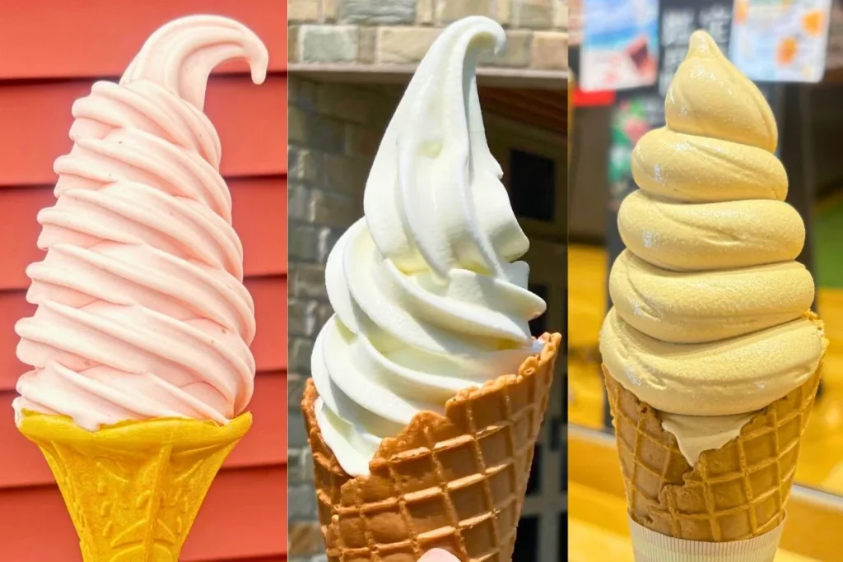
8. Sofuto-Kurimu(soft-serve ice cream)

Slide 10
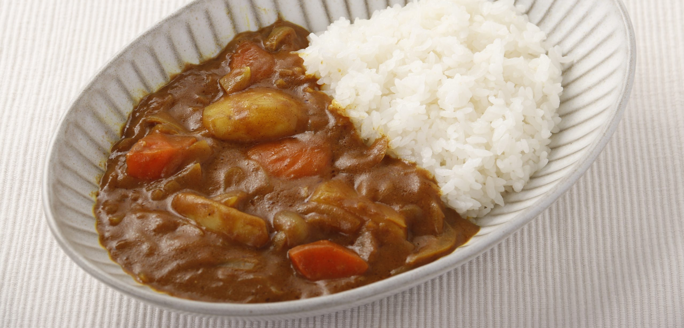
9. Curry Rice(curry with rice)

Slide 11
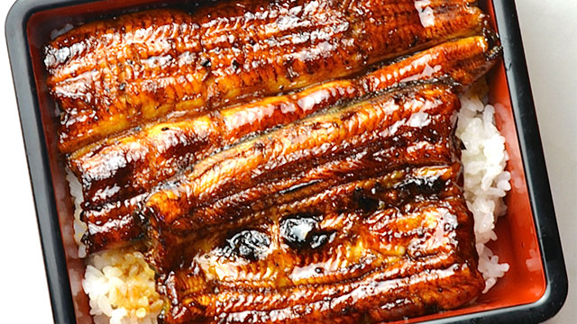
10. Unagi(grilled eel)

Slide 12
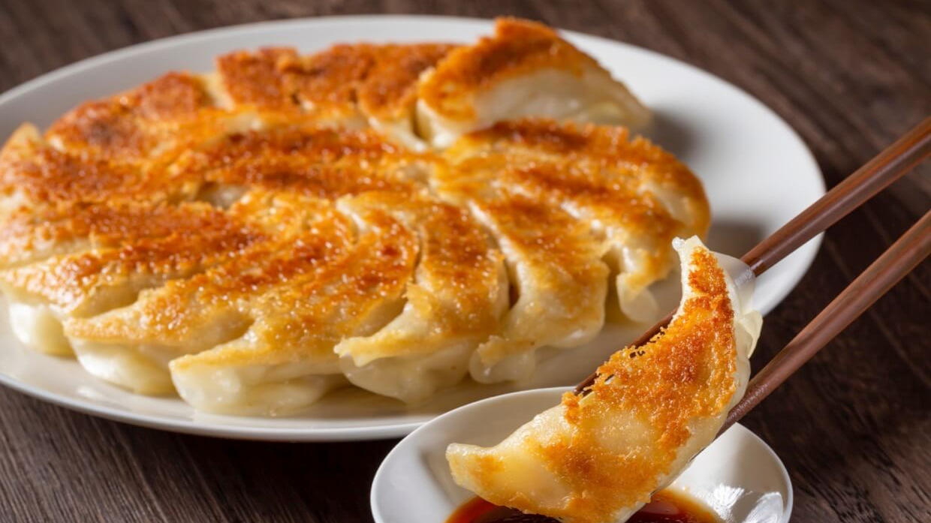
11. Gyoza(gyoza dumplings)

Slide 13
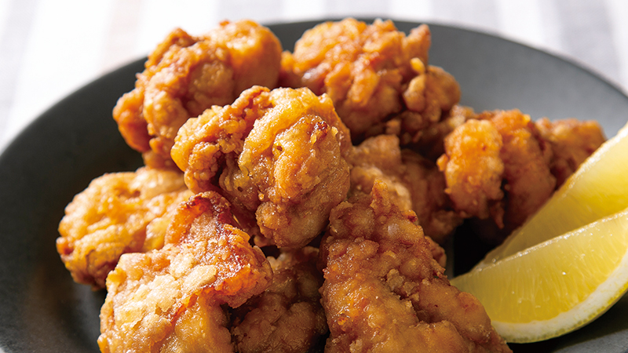
12. Karaage(fried chicken)

Slide 14
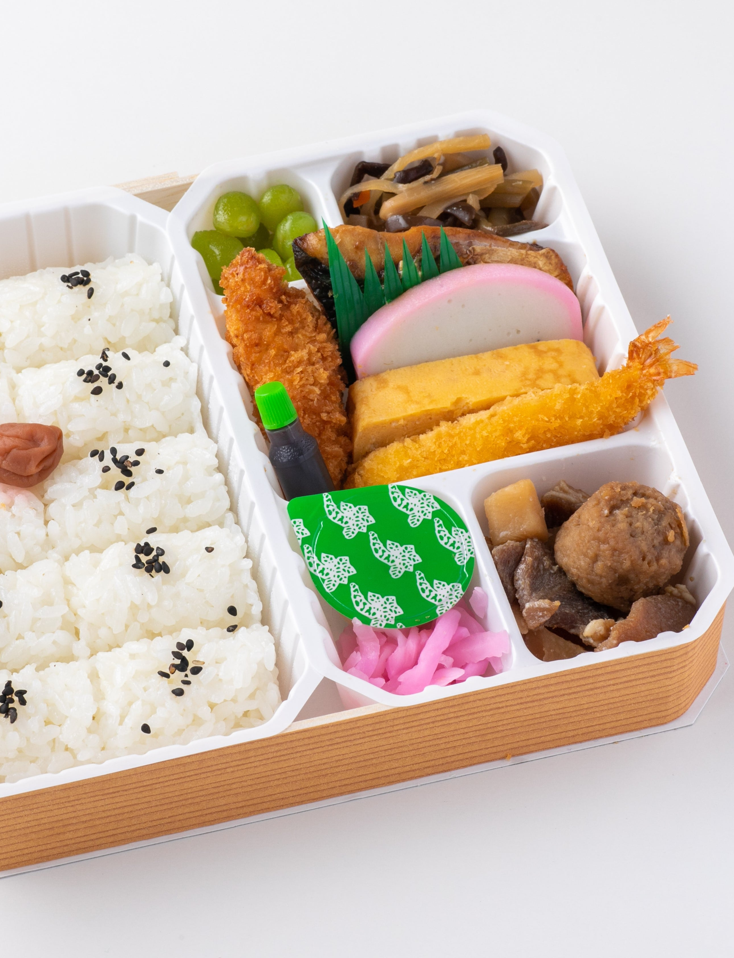
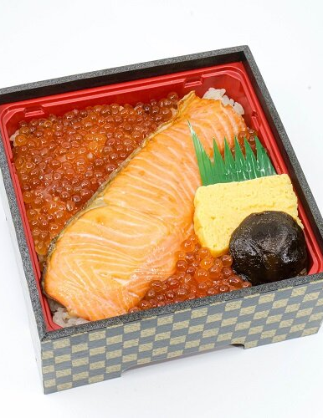
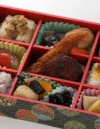
Special. Ekiben (lunch box)

