Slide 1

More than four hundred
Color Words
Notes:
The vast array of colors found in Japan is deeply influenced by the richness of its nature, the complexity of its history, and the refinement of its aesthetic sense. These elements have given rise to an uncountable number of subtle tones, each with its own significance and story.

Slide 2
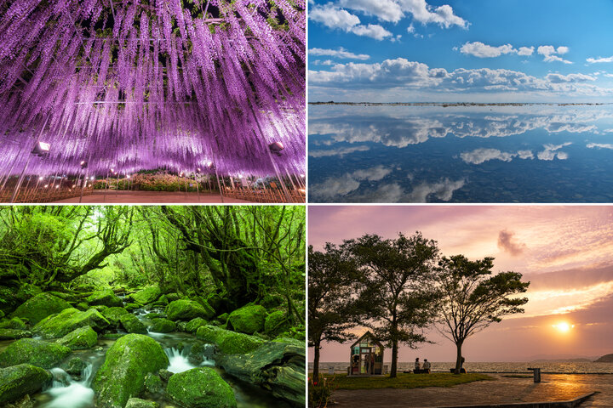
Notes:
Japan's varied geological features—mountains, rivers, and plains—combined with its mild climate, give rise to a wide variety of plants.

Slide 3
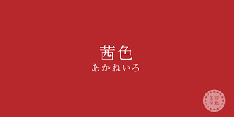
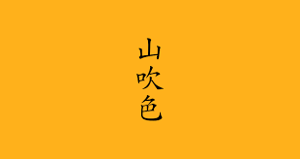
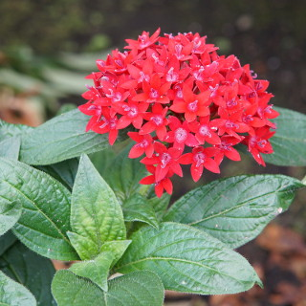
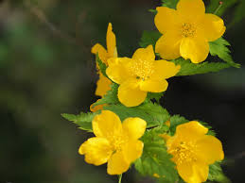
Notes:
In ancient times, the leaves, petals, nuts, and roots of these plants were used as dyes. This practice was the origin of what are known as "traditional colors." For example, Akane-iro, a red tone, comes from the root of the madder plant (Akane), and Yamabuki-iro, a yellow tone, comes from the blossom of the Japanese rose (Yamabuki).

Slide 4
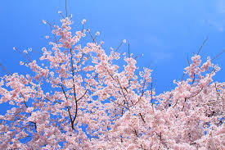
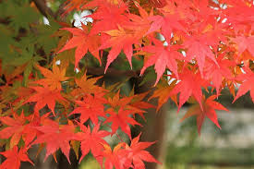
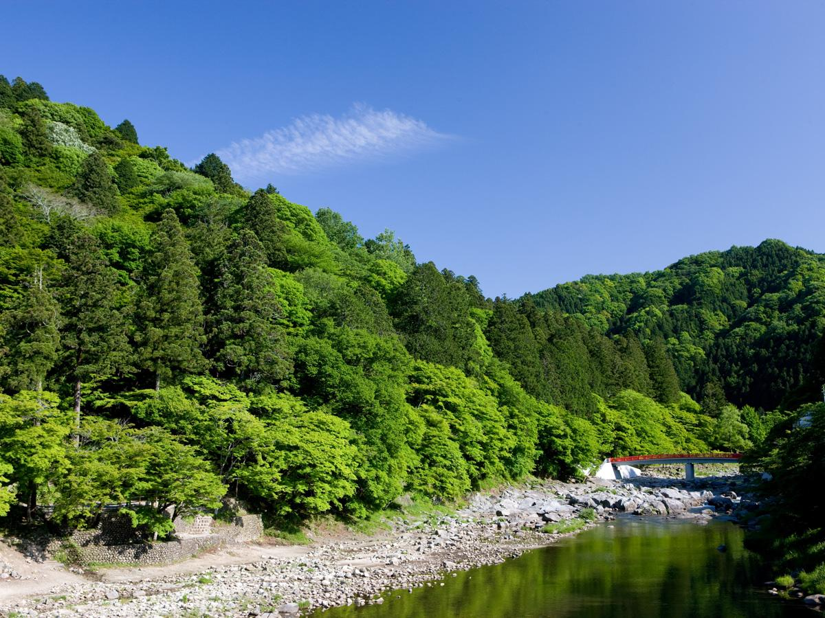
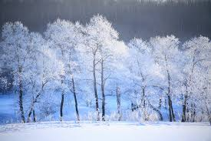
Notes:
The delicate tones of seasonal scenery—such as cherry blossoms in spring, fresh greenery in summer, autumn leaves, and snowy landscapes in winter—were given names in ancient times, many of which are still preserved in the language.

Slide 5
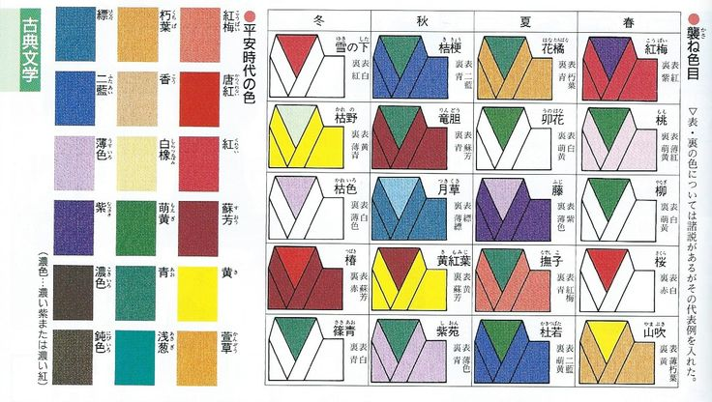
Notes:
The aristocrats of the Heian period developed 'Kasane-no-Irome,' a culture of color combination that celebrated the changing seasons. They appreciated these exquisite transitions by wearing kimonos layered with carefully chosen color combinations.

Slide 6
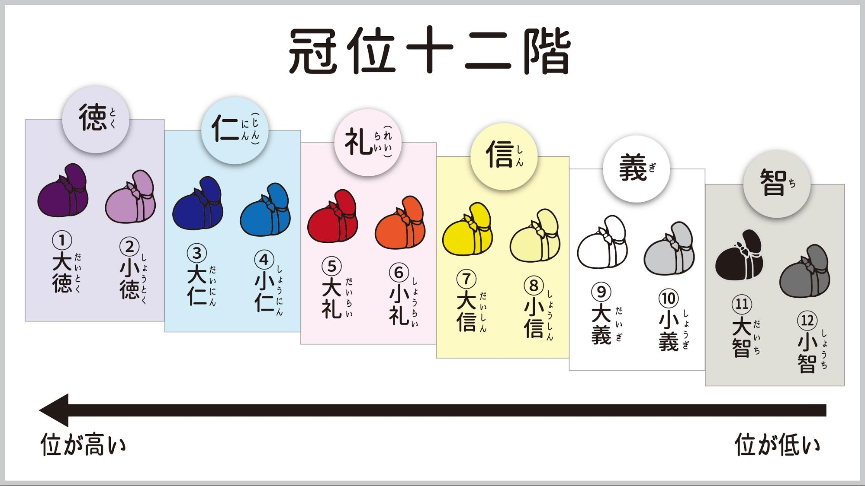
Notes:
In 603, during the Asuka period, Prince Shōtoku established a cap and rank system which designated specific colors for courtiers' crowns and dress according to their rank.

Slide 7
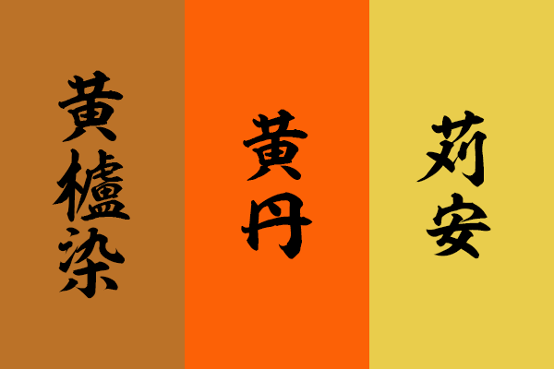
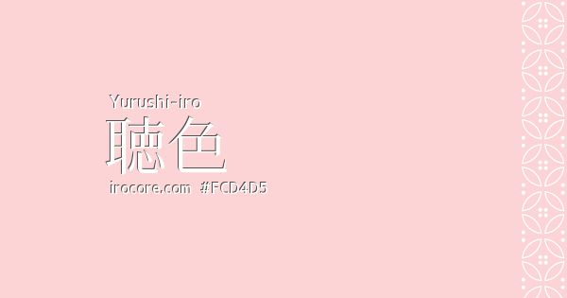
Notes:
There were also ‘Kinjiki’ (forbidden colors), which were reserved exclusively for the imperial family and high-ranking aristocrats. Conversely, ‘Yurushiiro’ (permitted color) was regulated for commoners. This codification sharpened the public's sensitivity to color.

Slide 8
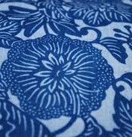
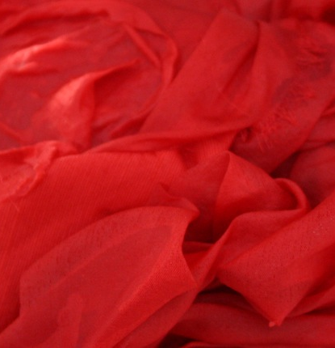
Notes:
Dyeing techniques using plant materials, such as indigo and safflower (benibana), became highly advanced.

Slide 9
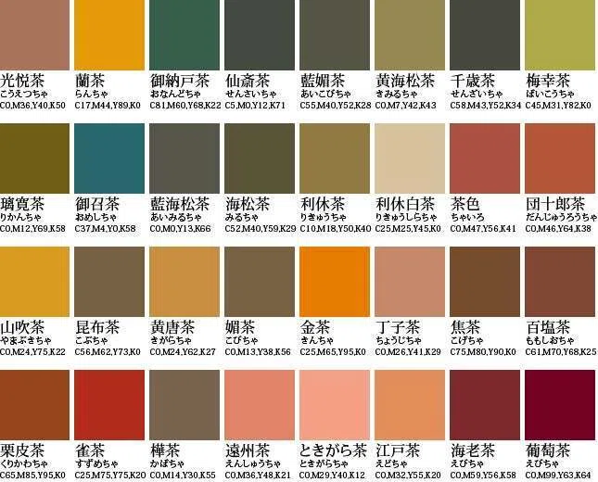
四十八茶百鼠
Notes:
During the Edo period, sumptuary laws banned commoners from wearing vivid, luxurious colors. As a result, they were restricted to subdued browns and grays. Nevertheless, they innovated within these constraints, producing a vast spectrum of hues and appreciating the subtle variations within these color families.

Slide 10
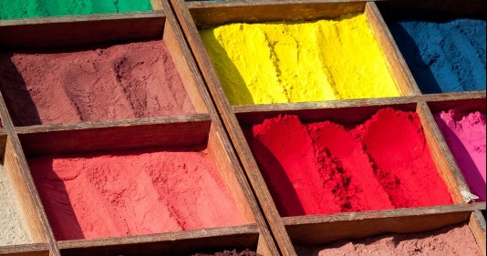
Notes:
New dyeing techniques and color concepts were introduced to Japan from China and Korea in ancient times, and later from Western countries in the modern era. Each of these influences profoundly shaped the Japanese sense of color.

Slide 11
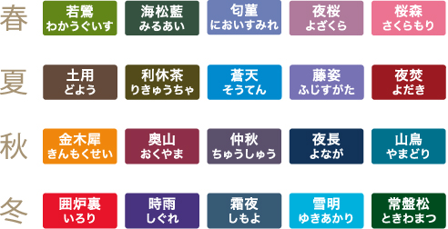
Notes:
The traditional Japanese sense of beauty is based on coexistence with nature and respect for its every element. Color words function not only as descriptions but also as critical evocations of natural scenery and the feelings associated with it.

Slide 12
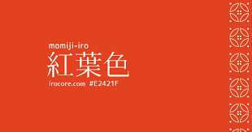
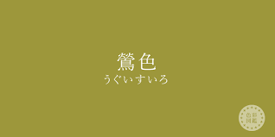
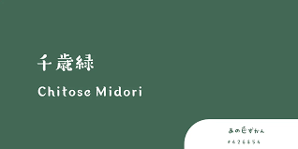
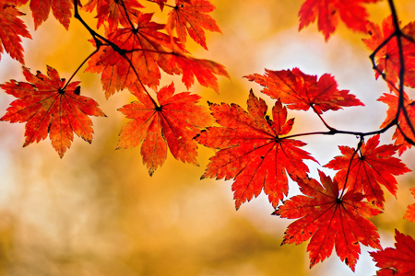
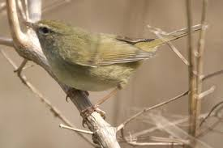
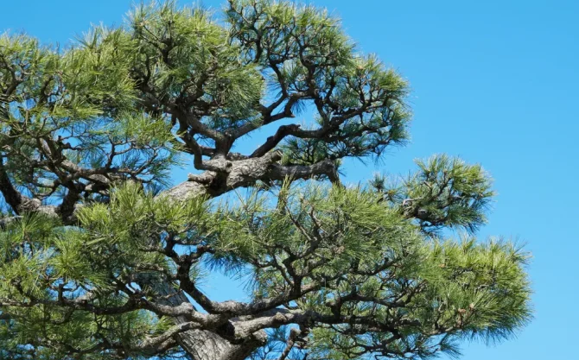
Notes:
The Japanese language contains many poetic color names that evoke natural imagery, such as ‘Momiji-iro’ (maple-leaf red), ‘Uguisu-iro’ (bush-warbler greenish-brown), and ‘Chitose-iro’ (the evergreen green of a thousand-year-old pine). These names reflect a refined aesthetic that finds deep meaning and narrative in color.

Slide 13
