Slide 1
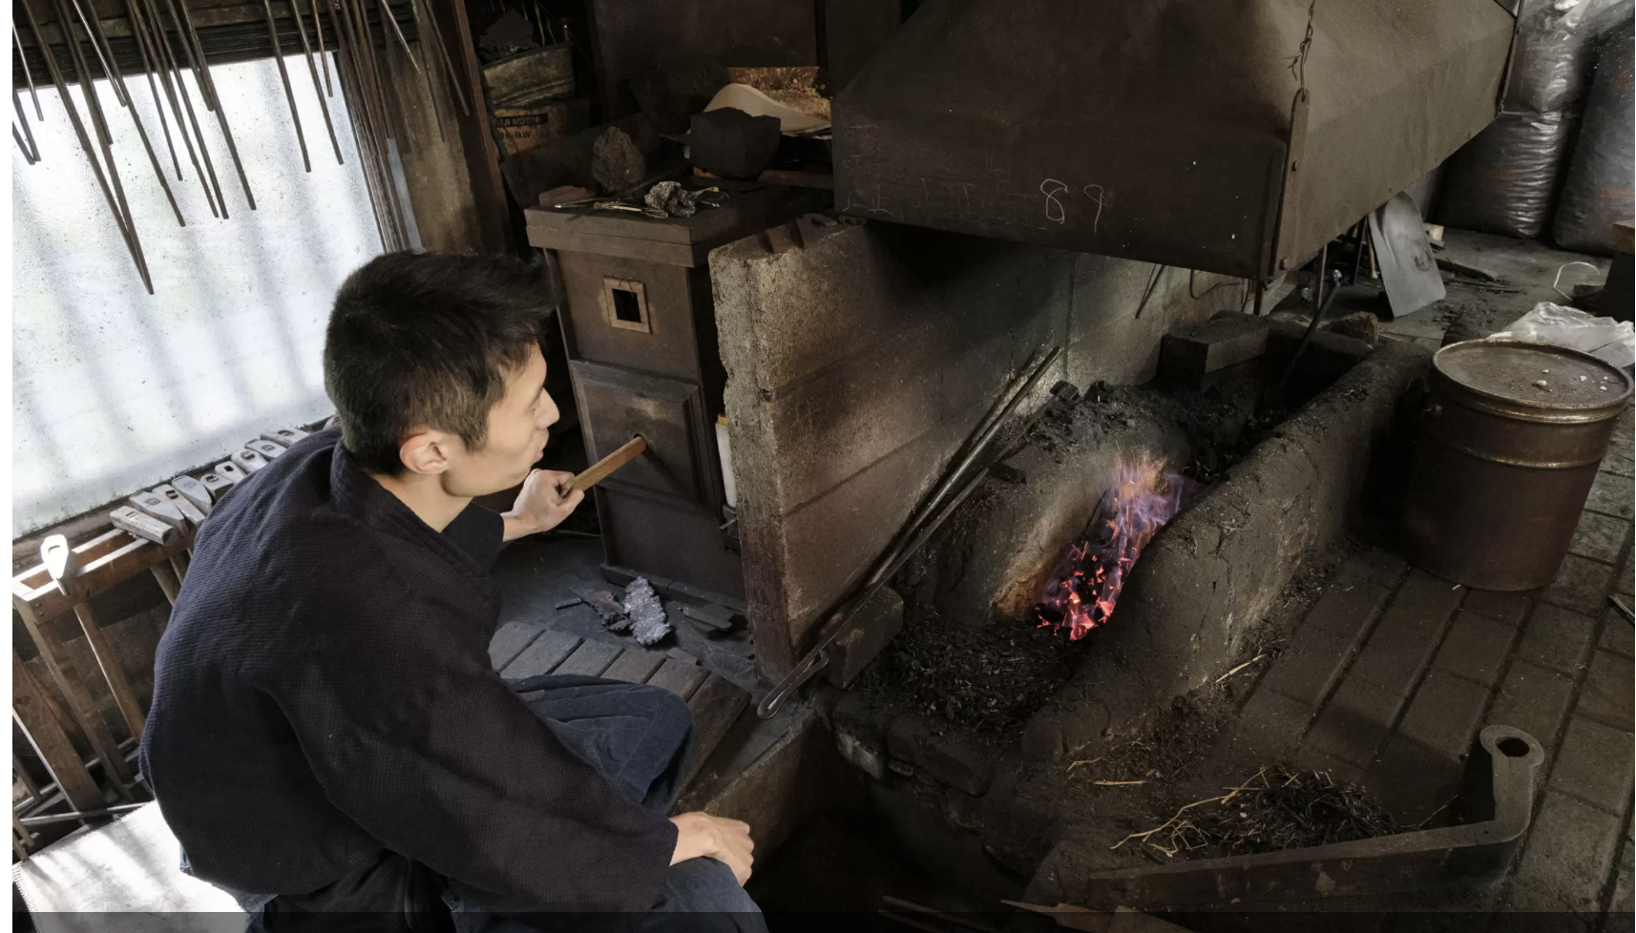
1 玉鋼造り
Notes:
1 Making of Tamahagane Steel
Make tamahagane steel by the old-fashioned method of foot-operated bellows. Burn iron sand three days and nights with charcoal to make a plank- shaped lump of steel, called tamahagane,

Slide 2
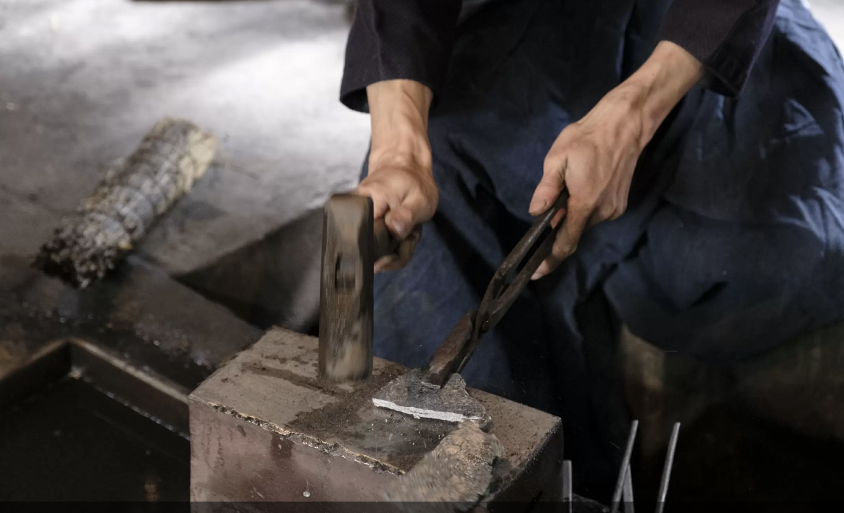
2 玉鋼の小割り
Notes:
2 Breaking Tamahagane into Pieces
Hammer and break a plank-shaped tamahagane into pieces. Checking the amounts of carbons and impurities, classified it into two types: hard with more carbons and soft with less carbon. The former is used for the blade part called ‘Kawa-gane,’ and the latter for the core part called ‘Shing-gane.”

Slide 3
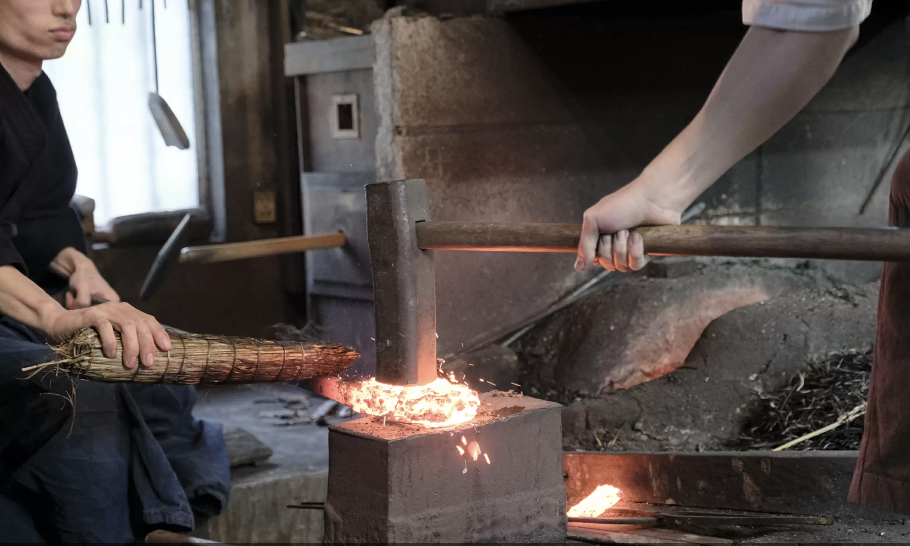
3積み沸かし（つみわかし）
Notes:
3 Piling and Boiling
Pile up small pieces of tamahagane steel on the anvil, after wrapped in a piece of Japanese paper and poured with muddy water, and hamper them with a hammer to put them together.

Slide 4
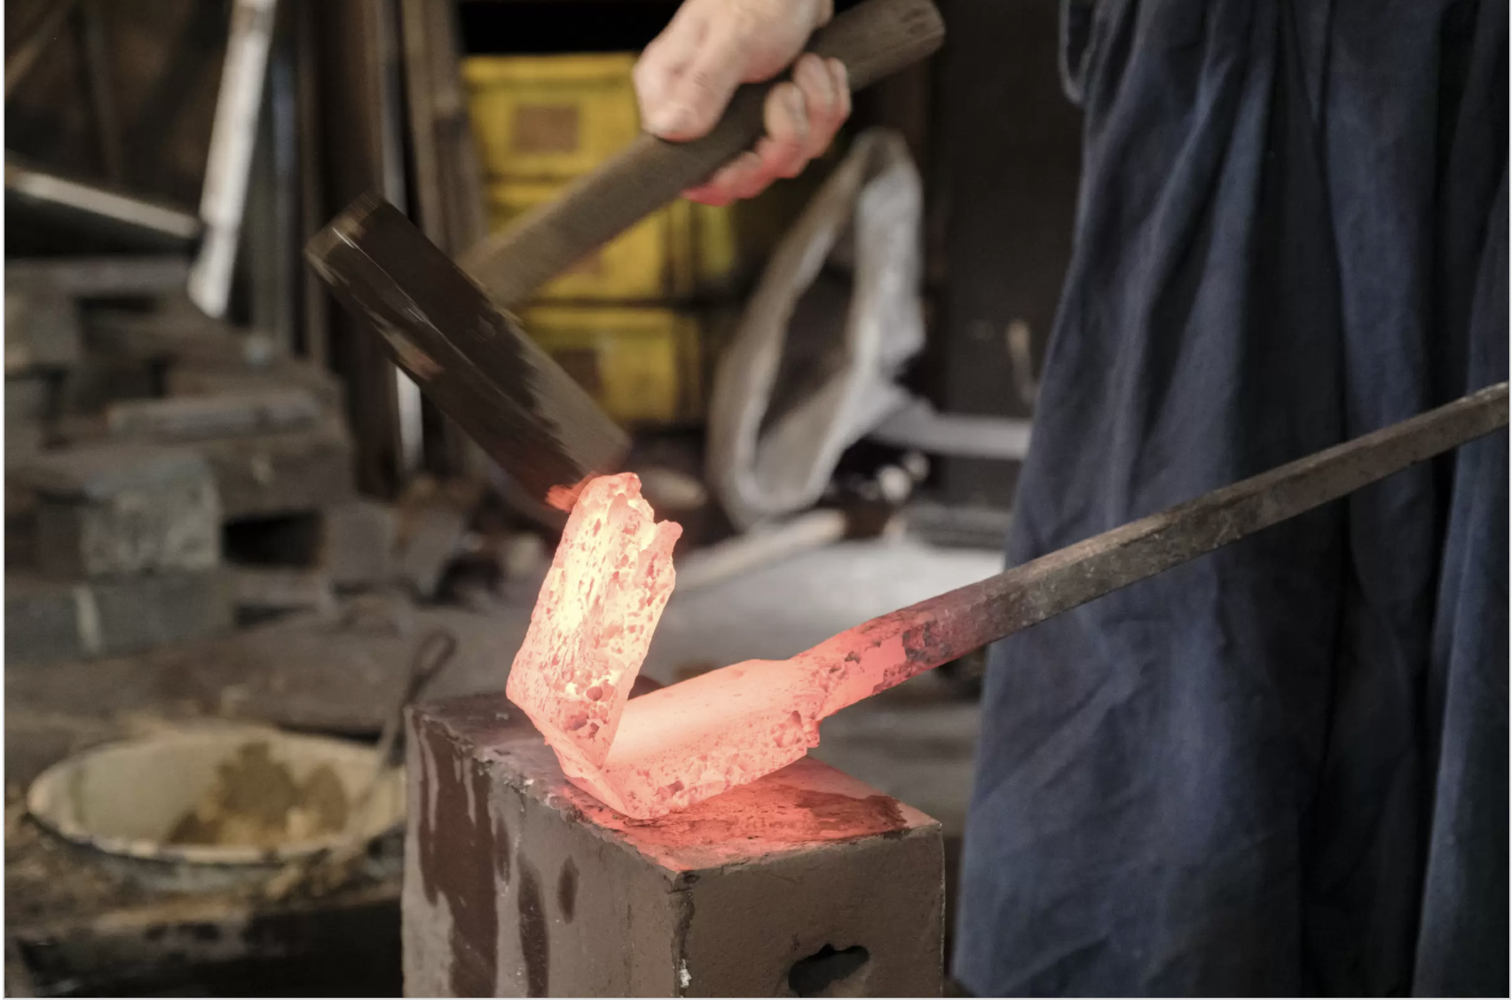
4折り返し鍛錬
Notes:
4 Tempering in Repetitions
Burn the folded steel, hammer it into a thin plate, fold it into half, and hammer it flat again. This process is repeated. By hammering it, its impurities were removed in form of sparks, and the steel gets firm by making layers. Kawagane must go under this process ten and more times, while Shitetsu only needs it five or six times.

Slide 5
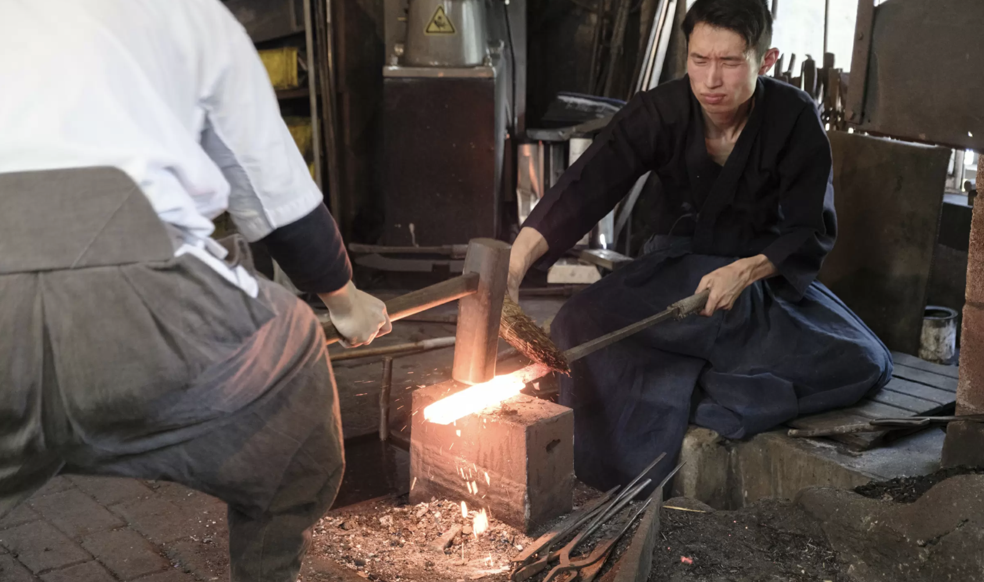
5甲伏せ
Notes:
5 Inserting the Shitetsu into the Kawatetsu
Heat the Kawatetstu steel, fold it into a letter-U from, and insert the Shintetsu steel in the middle of the fold, and hamper them together into one steel.

Slide 6
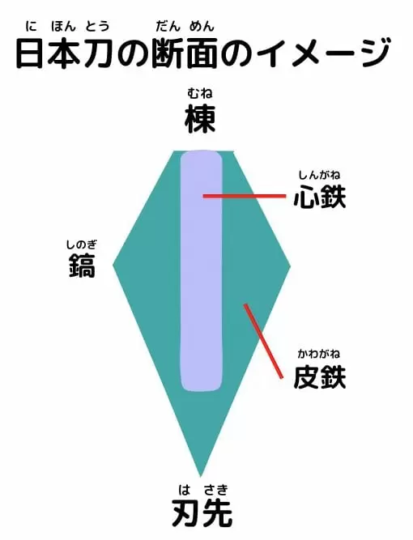
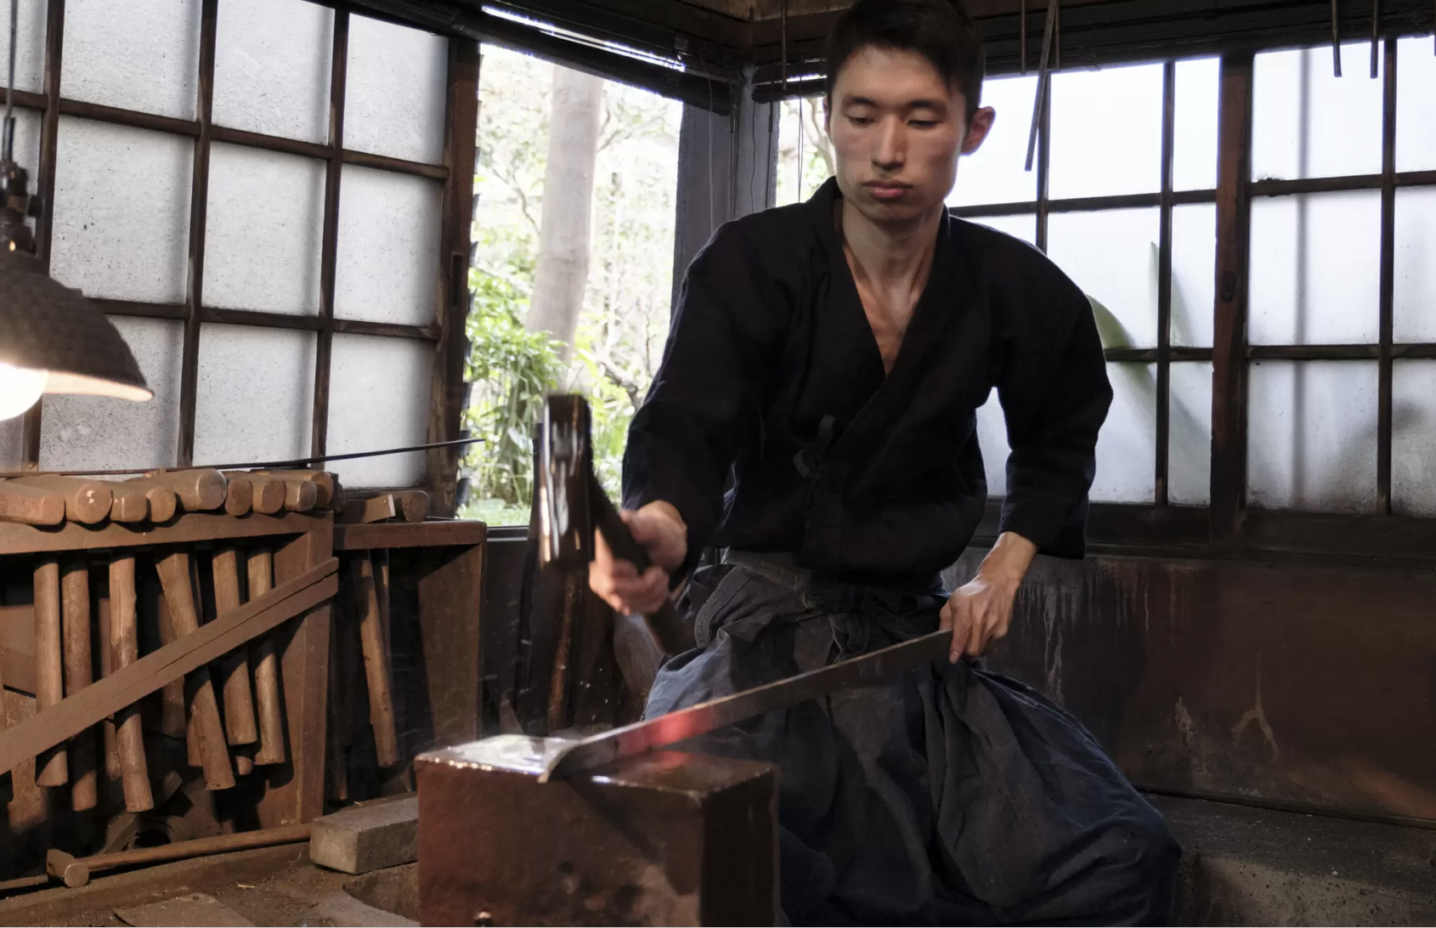
6素延べ・火づくり
Notes:
6 Extending, Forming
Heat and hammer the unified steel with hammer into a long bar shape. With no design paper, form it into with the ideal cubic beautiful style the craftsman want to realize, including the shape of the edge of the sward. The ridge, side, and blade are beautifully arranged. This is the very part where the craftsman needs his skills most.

Slide 7
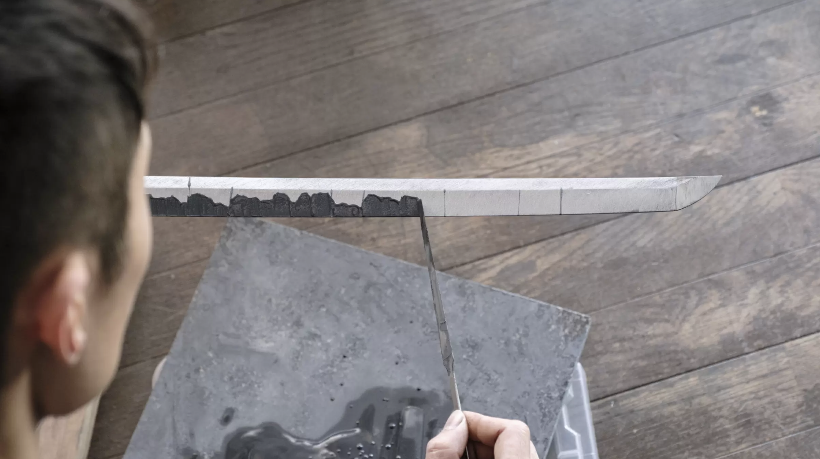
7土置き
Notes:
7. Placing Mud
Put some mud, named ‘mud for burnt blade,’ on the blade. Put it thinly on the part where the blade should be, and thickly on the other part.

Slide 8
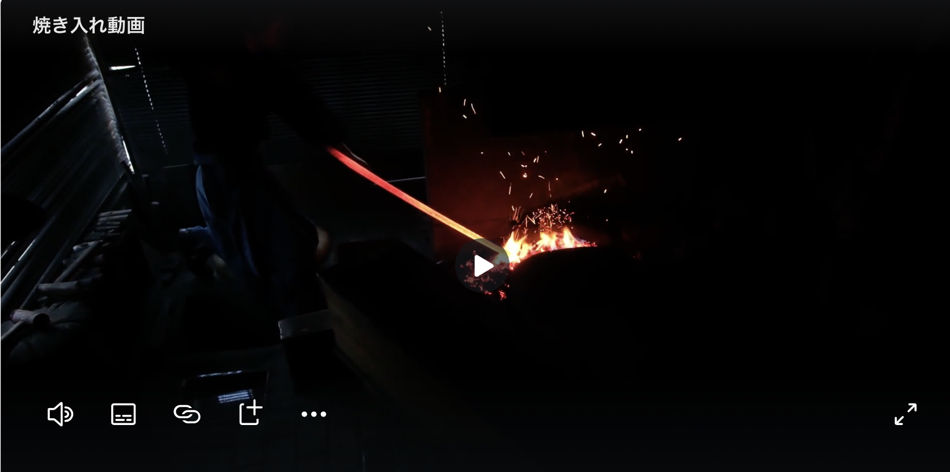
8焼き入れ
Notes:
8 Buring
Burn the steel with mud on it with one-third fire of that in the process of tampering, that is, reddened slowly at a lower temperature, and then put it into water to cool down. The difference of thickness of the mud on the blade makes the pattern, which is called ‘Hamon.’ In addition, when the steel is firm, it swells much, making a good ‘Sori,’ the shape of arch.

Slide 9
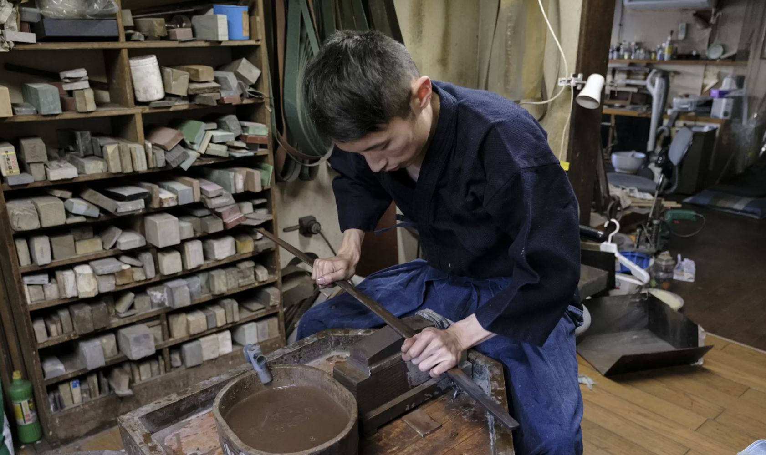
9合い取り
Notes:
9 Another Buring
After the burning is successful, heat the steel again, at a lower temperature of 100-200 degrees. This makes it firmer, to prevent the blade from chipping.

Slide 10
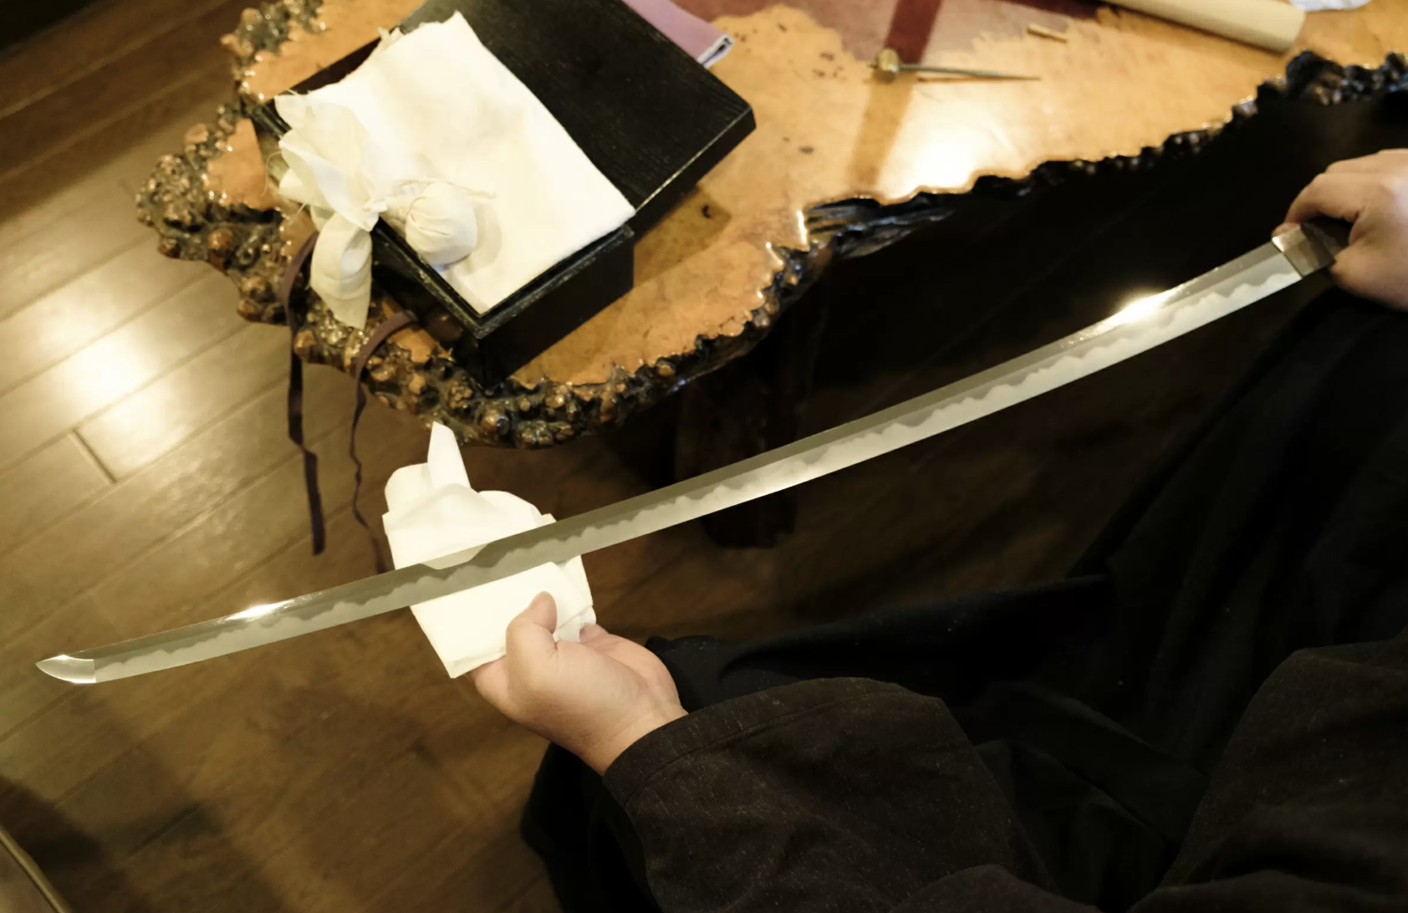
10研ぎ
Notes:
10 Polishing
Lastly, the polisher polishes the blade perfectly to make it sharp in cutting and beautiful in the pattern.

