Slide 1
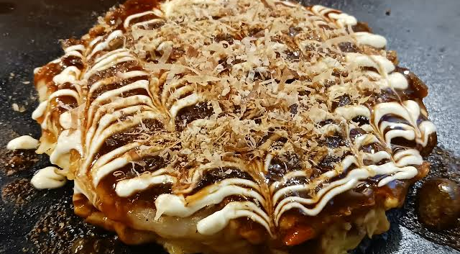
Notes:
Okonomiyaki
A flour-based dish that represents Osaka’s cuisine. It’s made by mixing cabbage, meat, seafood, and other ingredients into a flour batter, then grilling it on an iron plate. It’s topped with a sweet and savory sauce, mayonnaise, green laver, and bonito flakes. Some restaurants even let you cook it yourself at the table.

Slide 2
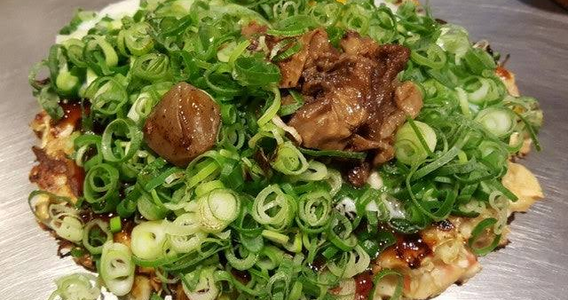
Notes:
Negiyaki
It may look similar to okonomiyaki, but it’s made with plenty of green onions instead of cabbage. Its light soy sauce flavor makes it refreshing and popular among local foodies.

Slide 3
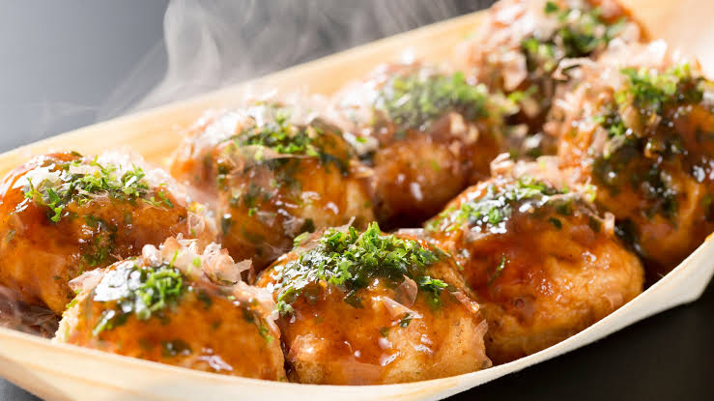
Notes:
Takoyaki
Crispy on the outside and soft and melty on the inside. These round snacks are made by grilling batter with pieces of octopus inside. It’s considered the soul food of Osaka. They’re usually served with sauce and mayonnaise, though some shops offer soy sauce broth or salt instead.

Slide 4
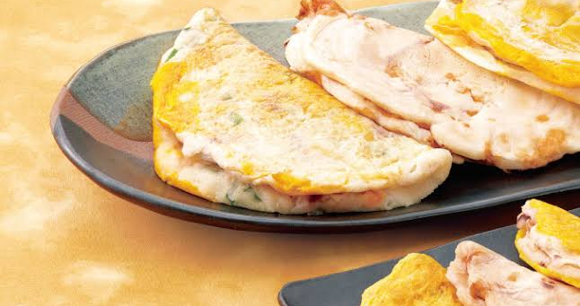
Notes:
This doesn’t refer to the grilled squid found elsewhere. In Osaka, ikayaki is made by pressing a mixture of squid and flour batter on an iron plate, giving it a chewy texture and savory sauce flavor. The version sold at Hanshin Department Store is especially famous.

Slide 5
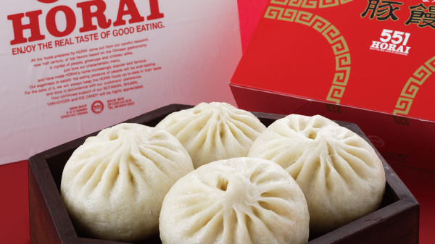
Notes:
551 Horai Pork Bun
A classic Osaka souvenir. The fluffy bun is filled with juicy pork and onions. The mouthwatering aroma from station kiosks often draws long lines of customers.

Slide 6
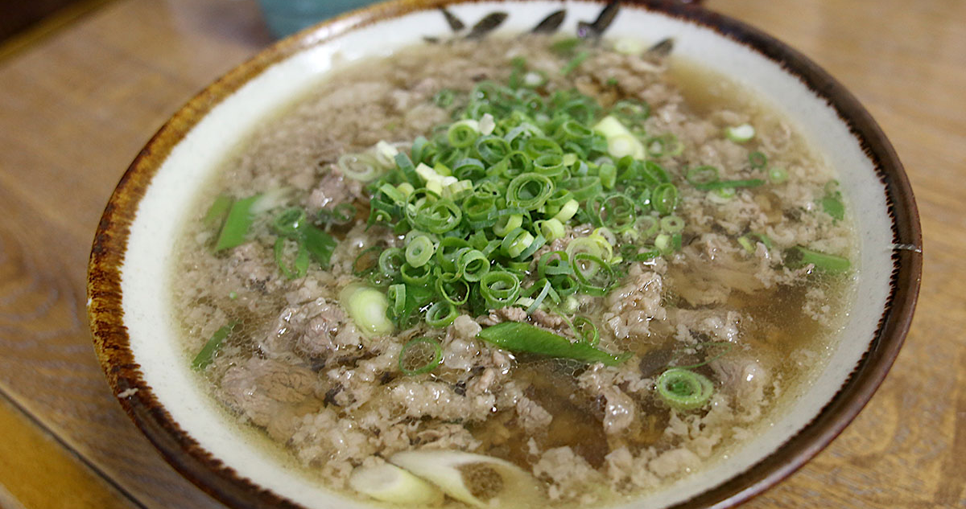
Notes:
Nikusui
This dish was originally created as “meat Udon without meat.” It’s a beef soup dish similar to sukiyaki, known for its rich, comforting flavor that soothes tired bodies. It’s particularly loved by comedians and night owls.

Slide 7
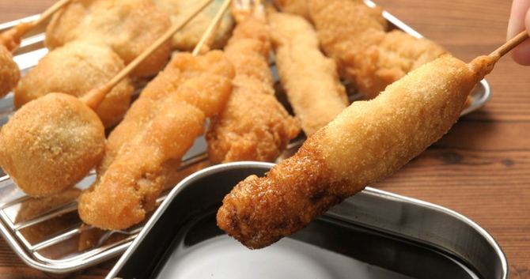
Notes:
Kushikatsu
A local Osaka specialty consisting of skewered meat, vegetables, and seafood coated in breadcrumbs and deep-fried to perfection. The famous rule at kushikatsu restaurants — “No double-dipping in the sauce!” — is well known throughout Japan. The Shinsekai area is considered the birthplace of this beloved dish.

Slide 8
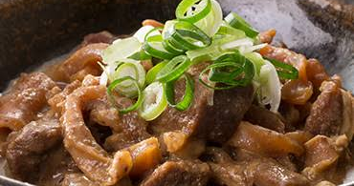
Notes:
Doteyaki
A popular izakaya dish made by simmering beef tendon slowly in miso and mirin until tender. Its rich flavor pairs perfectly with beer or rice. It’s often enjoyed together with kushikatsu (fried skewers).

Slide 9
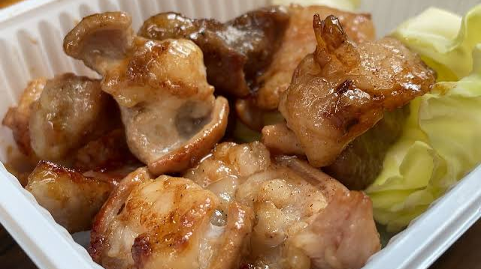
Notes:
Horumonyaki
A hearty dish made by grilling beef or pork offal with a special sauce. The word “horumon” comes from the Kansai dialect meaning “discarded parts.” Despite the name, it’s a local favorite for its aroma and rich taste.

Slide 10
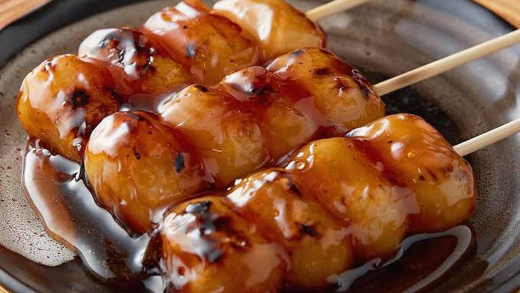
Notes:
Kihachisou Sohonpo Mitarashi Dango
Osaka-style mitarashi dango—grilled rice dumplings glazed with a sweet and salty soy sauce. The aroma from the grill and the slightly charred flavor are irresistible. This shop is one of the most famous mitarashi dango makers in Osaka.

Slide 11
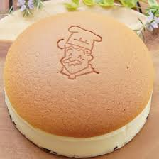
Notes:
Rikuro Ojisan’s Cheesecake
A soft, soufflé-style cheesecake famous for its fluffy, jiggly texture right out of the oven. Its mild sweetness makes it easy to eat the whole cake at once. It’s often sold at train stations and attracts long queues.

Slide 12
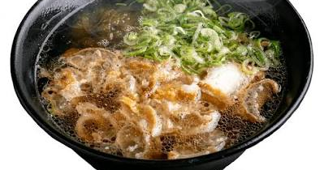
Notes:
Kasu Udon
A type of udon topped with aburakasu (deep-fried beef intestines). The rich, flavorful broth pairs perfectly with the chewy noodles. It’s a popular late-night dish, often enjoyed as the final meal after a night out in Osaka.

Slide 13
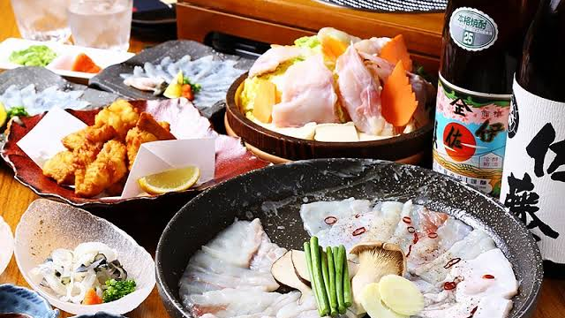
Notes:
Tecchiri / Tessa
These are Osaka’s famous blowfish dishes—tessa refers to thinly sliced sashimi, and tecchiri to hot pot. Both are winter specialties, and many fishmongers in Osaka specialize in blowfish.

Slide 14
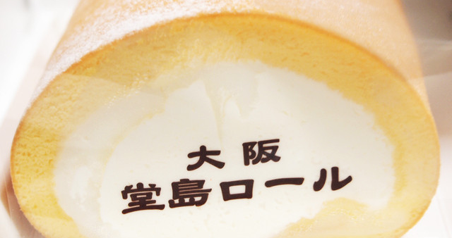
Notes:
Dojima Roll
A rolled sponge cake filled with rich fresh cream. Loved across Japan for its perfect balance of moist sponge and smooth cream.

