Slide 1
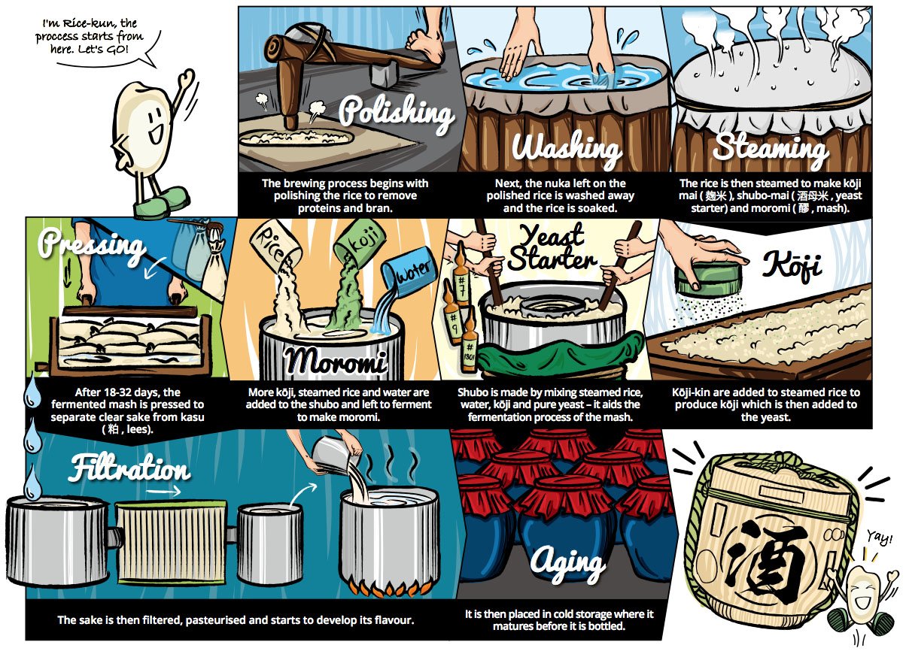
Sake Making Process

Slide 3
1
Notes:
The brewing process begins with polishing the rice to remove proteins and bran

Slide 4
2
Notes:
Next, the nuka left on the polished rice is washed away and the rice is soaked.

Slide 5
3
Notes:
The rice is then steamed to make koji mai （麹米, rice malt）, shubo-mai (酒母米, yeast）, and moromi (醪,mash).

Slide 6
4
Notes:
Koji-kin are added to steamed rice to produce koji which is then added to the yeast.

Slide 7
5
Notes:
Shubo is made by mixing steamed rice, water, koji, and pure yeast---it aids the fermentation process of the mash.

Slide 8
6
Notes:
More koji, steamed rice and water are added to the shubo and left to ferment to make moromi.

Slide 9
8
Notes:
After 18-32 days, the fermented mash is pressed to separate clear sake from kasu (粕 lees).

Slide 10
9
Notes:
The sake is then filtered, pasteurized and starts to develop its flavor.

Slide 11
10
Notes:
It is then placed in cold storage where it matures before it is bottled.

Slide 13
Steamed Rice
麹菌 Koji Mold
Yeast
麹Koji (Enzyme)
Water
Change Starch to Sugar
酒母Yeast Mash
Fermentation (sugar+water→alcohol+CO2)
もろみMoromi Mash

