Slide 1
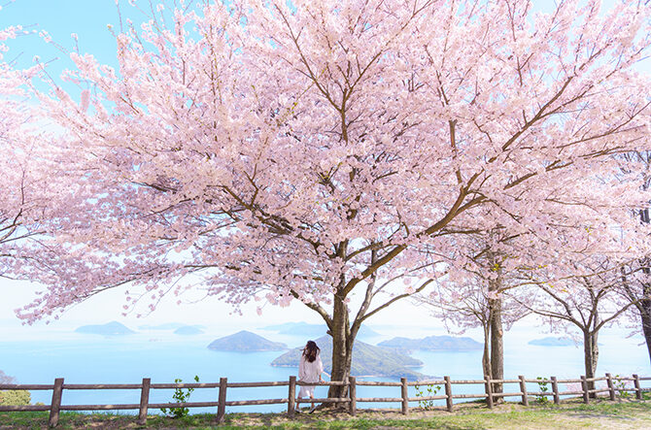
Spring
January |  |  | February |  |  | March |  |  | April |  |  | May |  |  | June |  |  | July |  |  | August |  |  | September |  |  | October |  |  | November |  |  | December
Sakura・Cherry

Slide 2
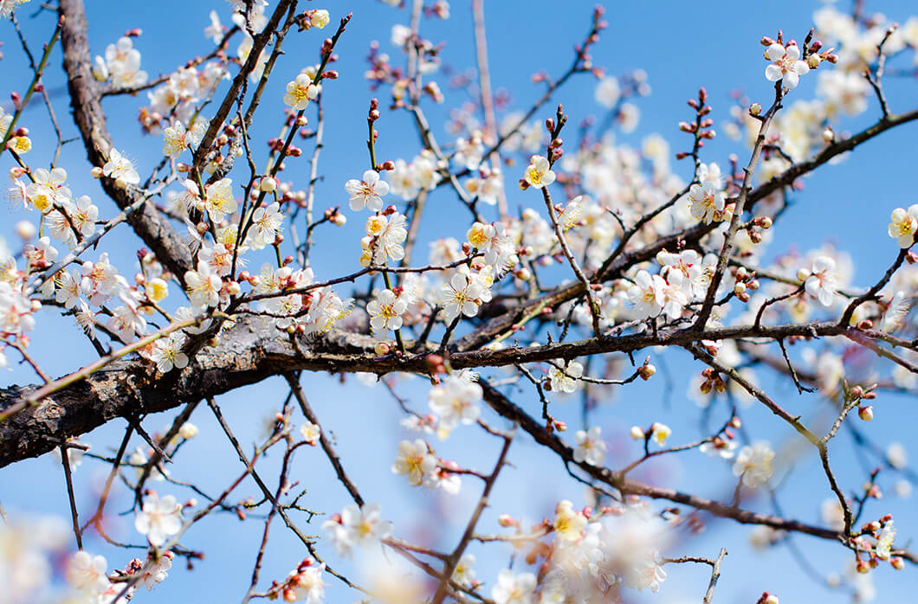
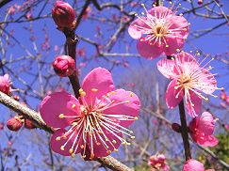
Spring
January |  |  | February |  |  | March |  |  | April |  |  | May |  |  | June |  |  | July |  |  | August |  |  | September |  |  | October |  |  | November |  |  | December
Ume・Plum

Slide 3
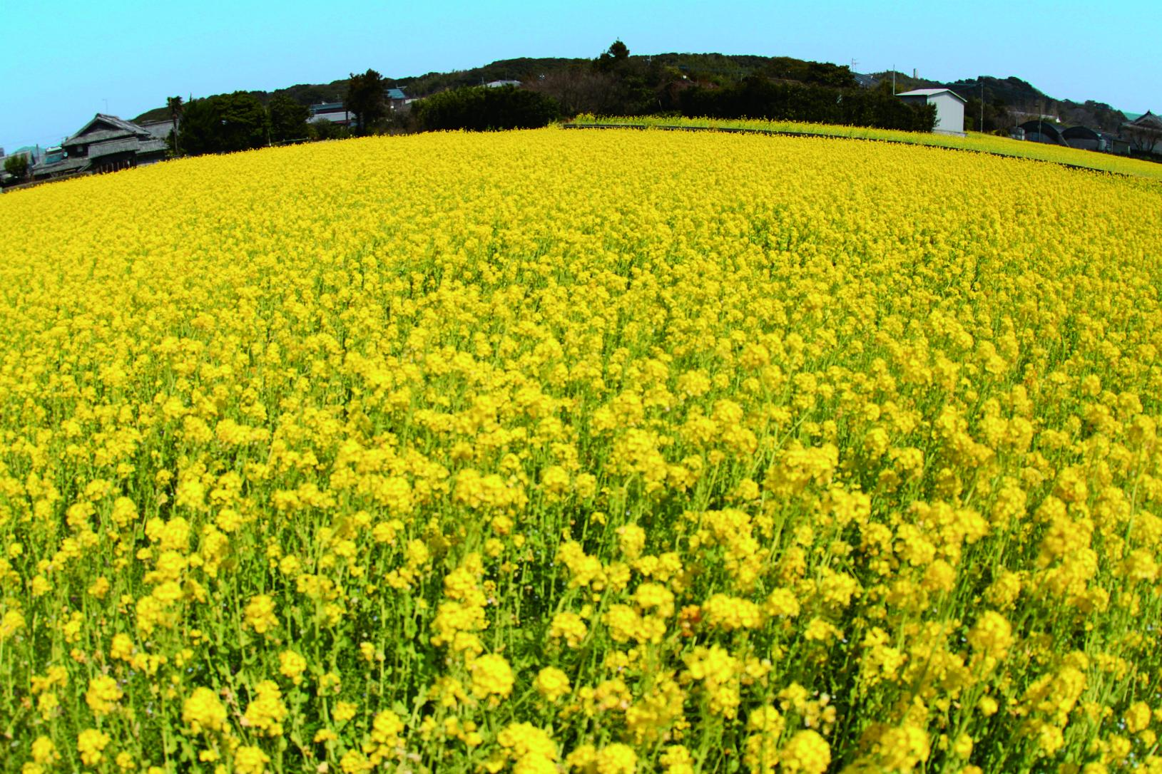
Spring
January |  |  | February |  |  | March |  |  | April |  |  | May |  |  | June |  |  | July |  |  | August |  |  | September |  |  | October |  |  | November |  |  | December
Nanohana・
Canola

Slide 4
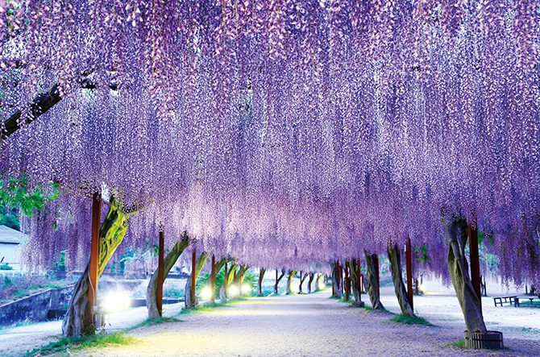
Spring
January |  |  | February |  |  | March |  |  | April |  |  | May |  |  | June |  |  | July |  |  | August |  |  | September |  |  | October |  |  | November |  |  | December
Fuji・
Wisteria

Slide 5
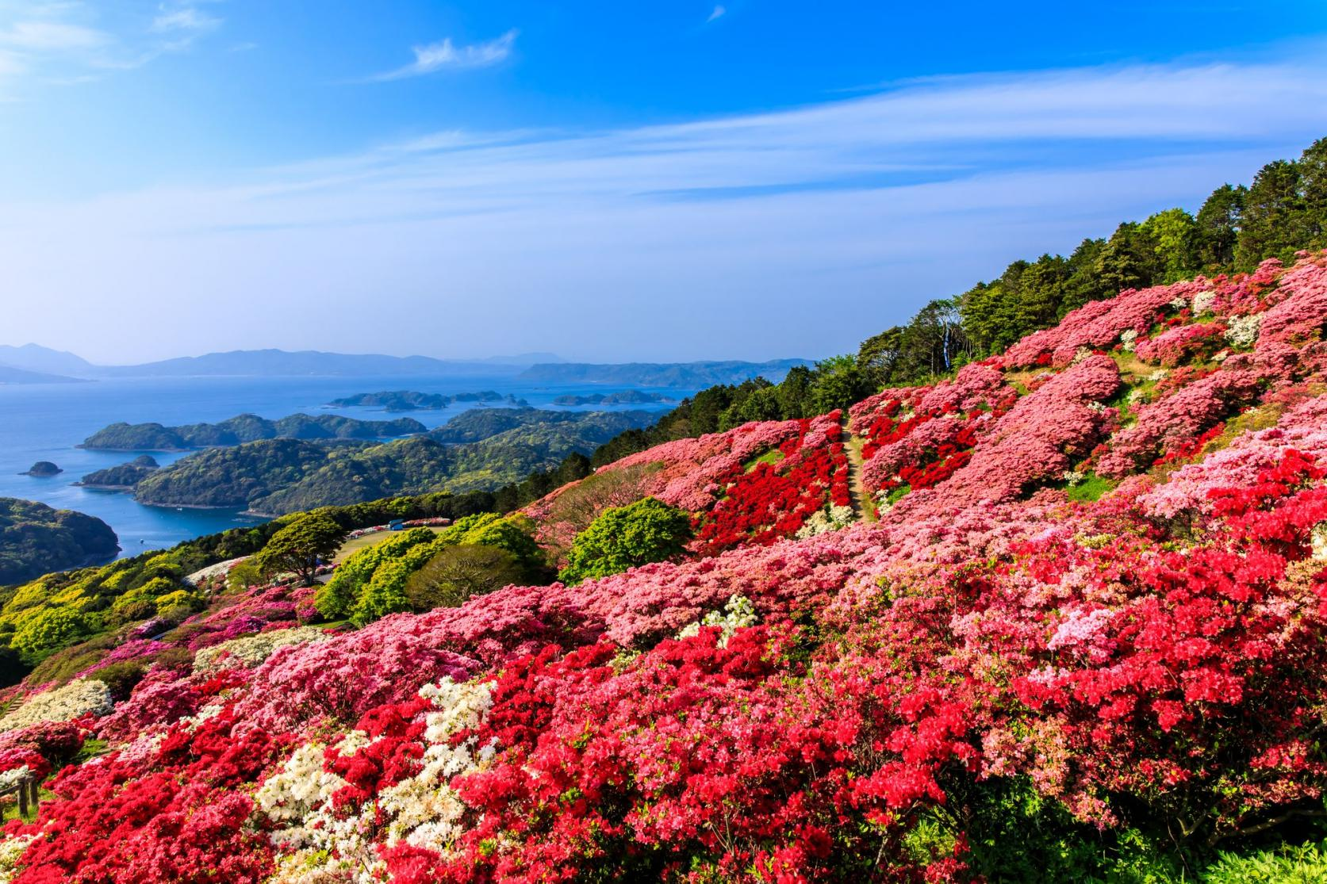
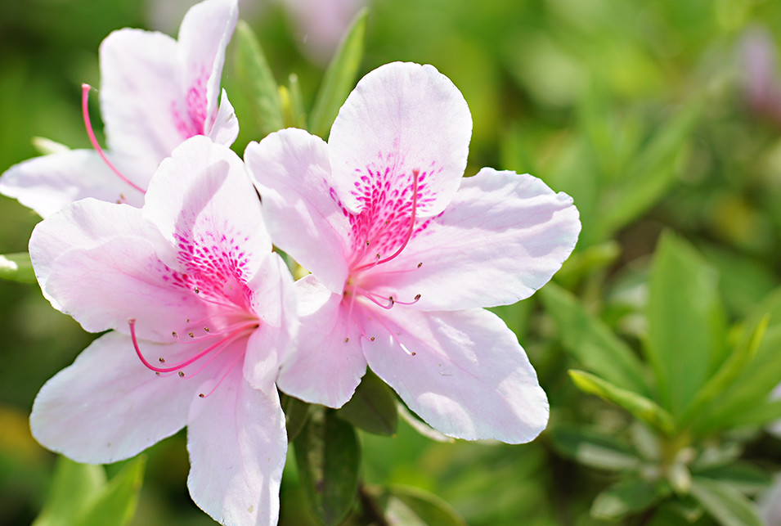
Spring
January |  |  | February |  |  | March |  |  | April |  |  | May |  |  | June |  |  | July |  |  | August |  |  | September |  |  | October |  |  | November |  |  | December
Tsutsuji・
Azalea

Slide 6
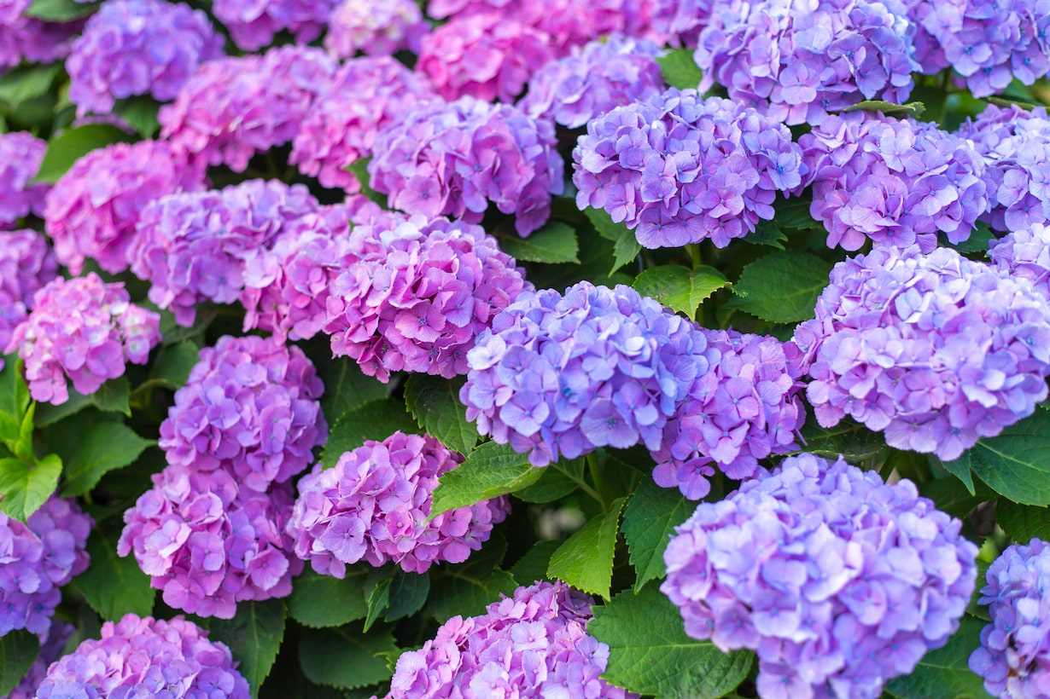
Summer
January |  |  | February |  |  | March |  |  | April |  |  | May |  |  | June |  |  | July |  |  | August |  |  | September |  |  | October |  |  | November |  |  | December
Ajisai・
Hydrangea

Slide 7
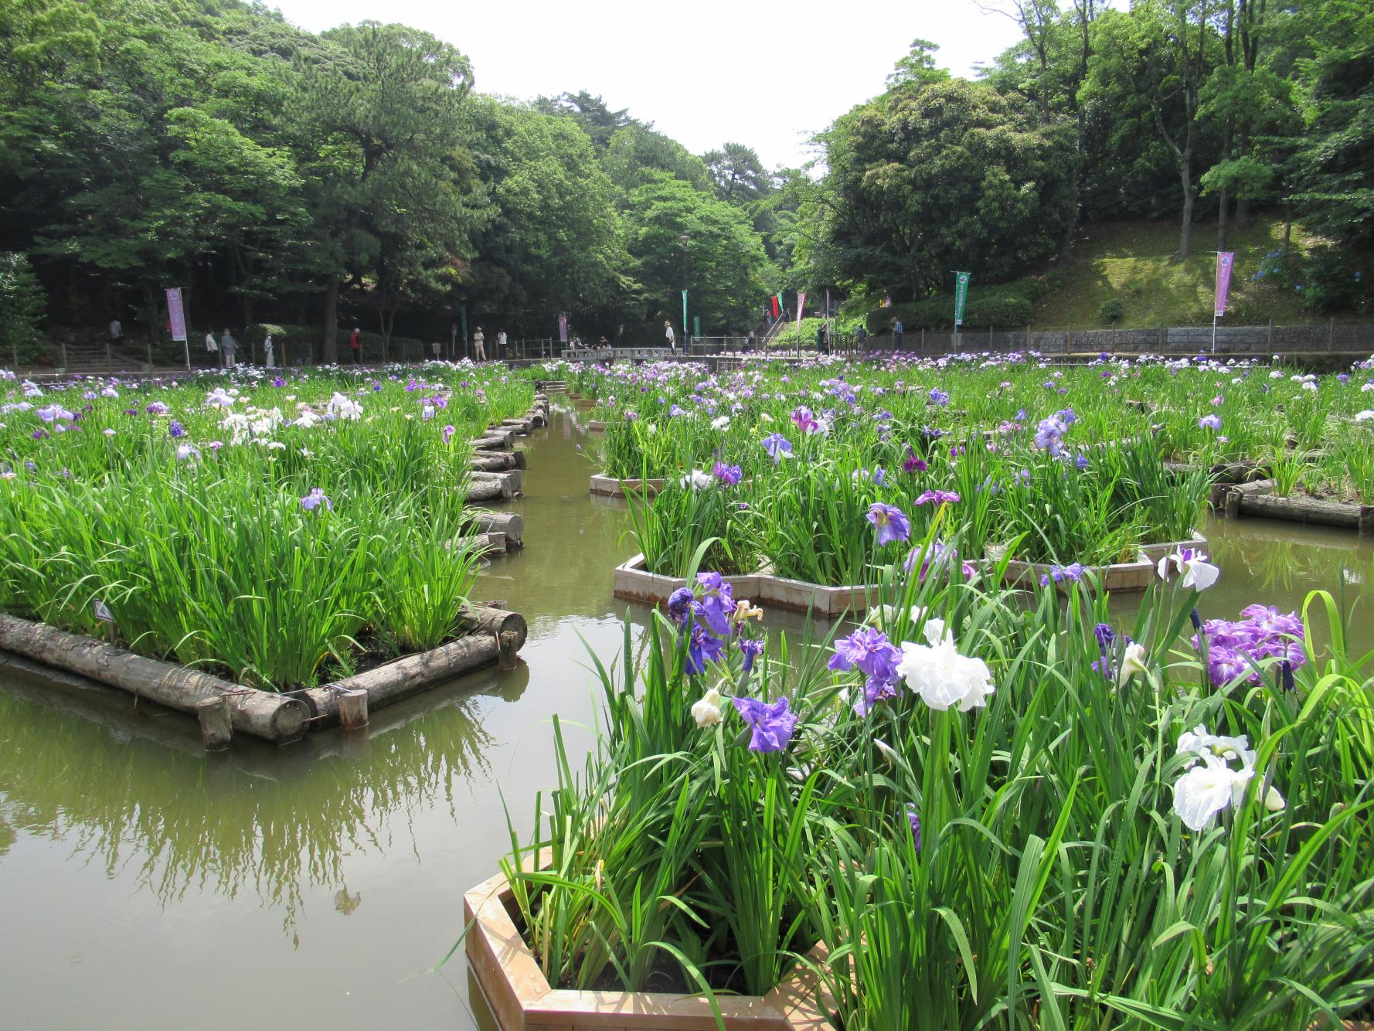
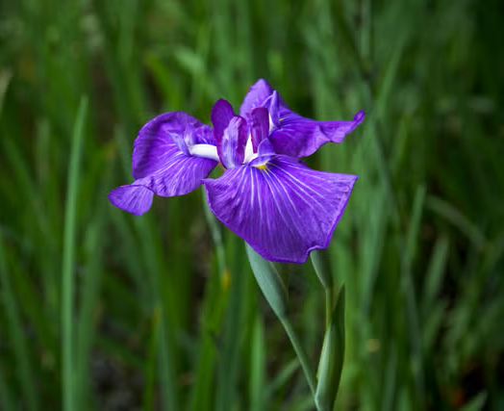
Summer
January |  |  | February |  |  | March |  |  | April |  |  | May |  |  | June |  |  | July |  |  | August |  |  | September |  |  | October |  |  | November |  |  | December
Syobu・
Iris

Slide 8
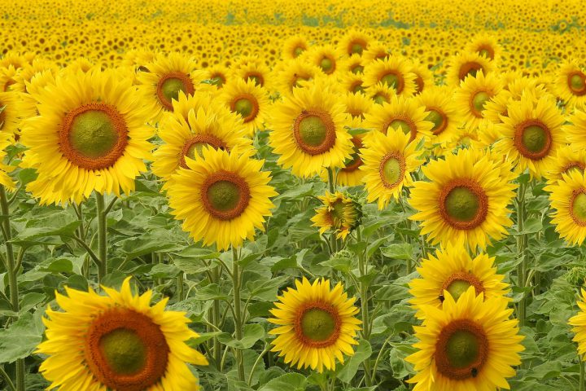
Summer
January |  |  | February |  |  | March |  |  | April |  |  | May |  |  | June |  |  | July |  |  | August |  |  | September |  |  | October |  |  | November |  |  | December
Himawari・
Sun Flower

Slide 9
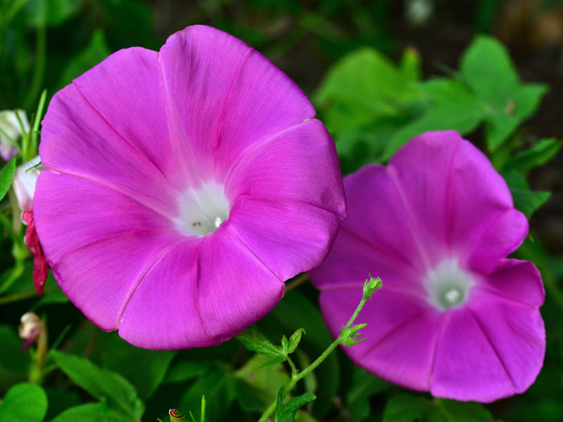
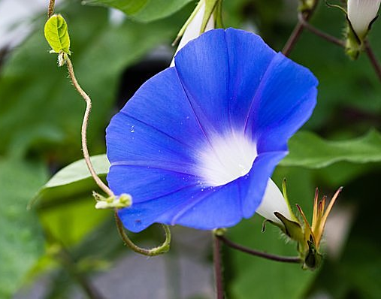
Summer
January |  |  | February |  |  | March |  |  | April |  |  | May |  |  | June |  |  | July |  |  | August |  |  | September |  |  | October |  |  | November |  |  | December
Asagao・
Morning Glory

Slide 10
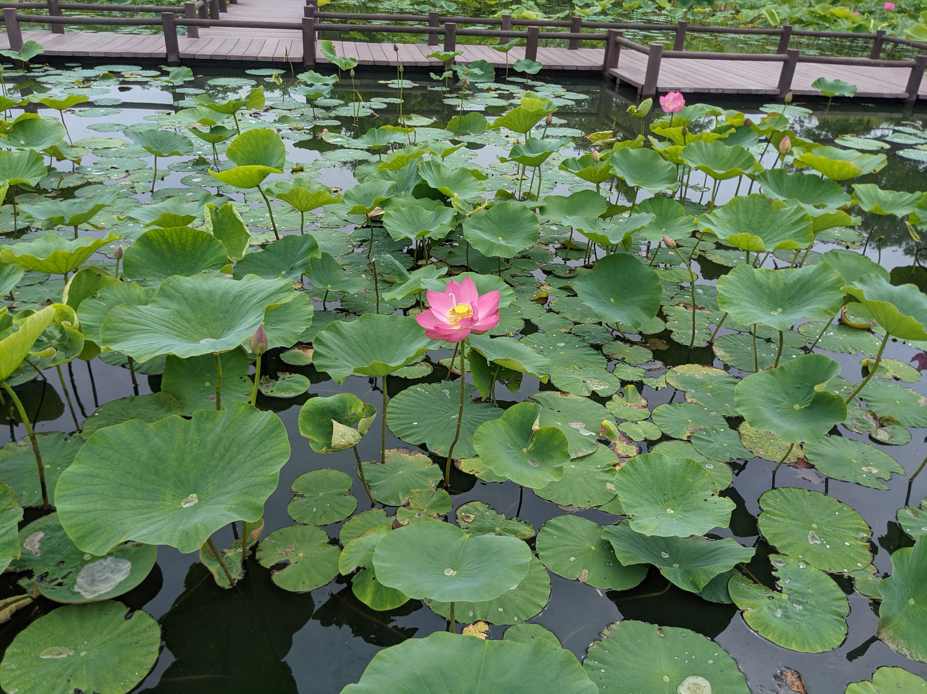
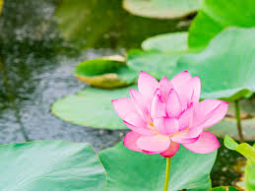
Summer
January |  |  | February |  |  | March |  |  | April |  |  | May |  |  | June |  |  | July |  |  | August |  |  | September |  |  | October |  |  | November |  |  | December
Hasu・Lotus

Slide 11
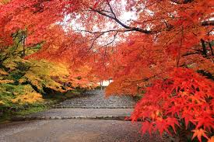
Autumn
January |  |  | February |  |  | March |  |  | April |  |  | May |  |  | June |  |  | July |  |  | August |  |  | September |  |  | October |  |  | November |  |  | December
Momiji・Maple

Slide 12
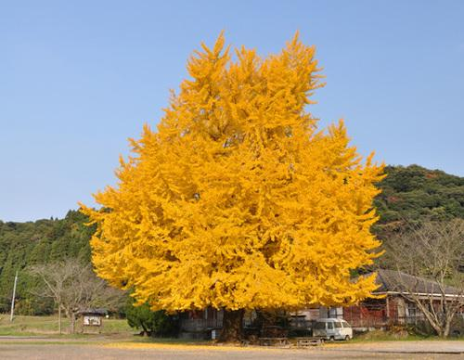
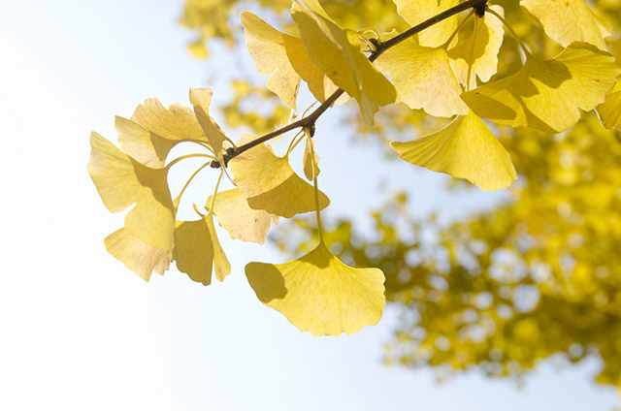
Autumn
January |  |  | February |  |  | March |  |  | April |  |  | May |  |  | June |  |  | July |  |  | August |  |  | September |  |  | October |  |  | November |  |  | December
Icho・Ginkgo

Slide 13
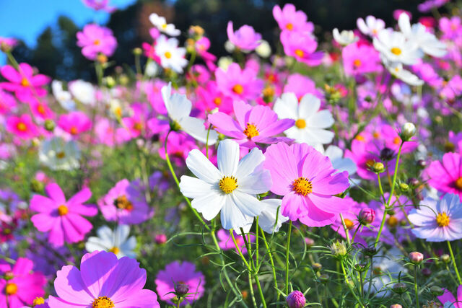
Autumn
January |  |  | February |  |  | March |  |  | April |  |  | May |  |  | June |  |  | July |  |  | August |  |  | September |  |  | October |  |  | November |  |  | December
Kosumosu・
Cosmos

Slide 14
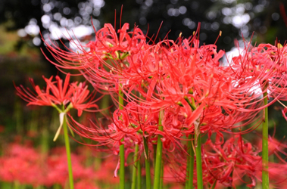
Autumn
January |  |  | February |  |  | March |  |  | April |  |  | May |  |  | June |  |  | July |  |  | August |  |  | September |  |  | October |  |  | November |  |  | December
Higanbana・
Red Spider Lily

Slide 15
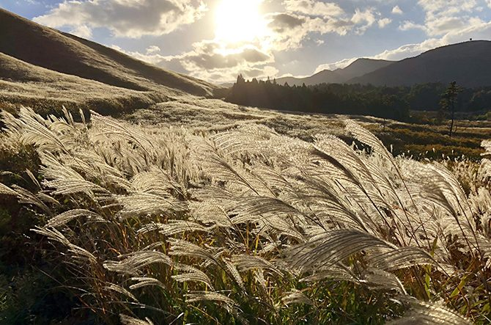
Autumn
January |  |  | February |  |  | March |  |  | April |  |  | May |  |  | June |  |  | July |  |  | August |  |  | September |  |  | October |  |  | November |  |  | December
Susuki・
Pampas Grass

Slide 16
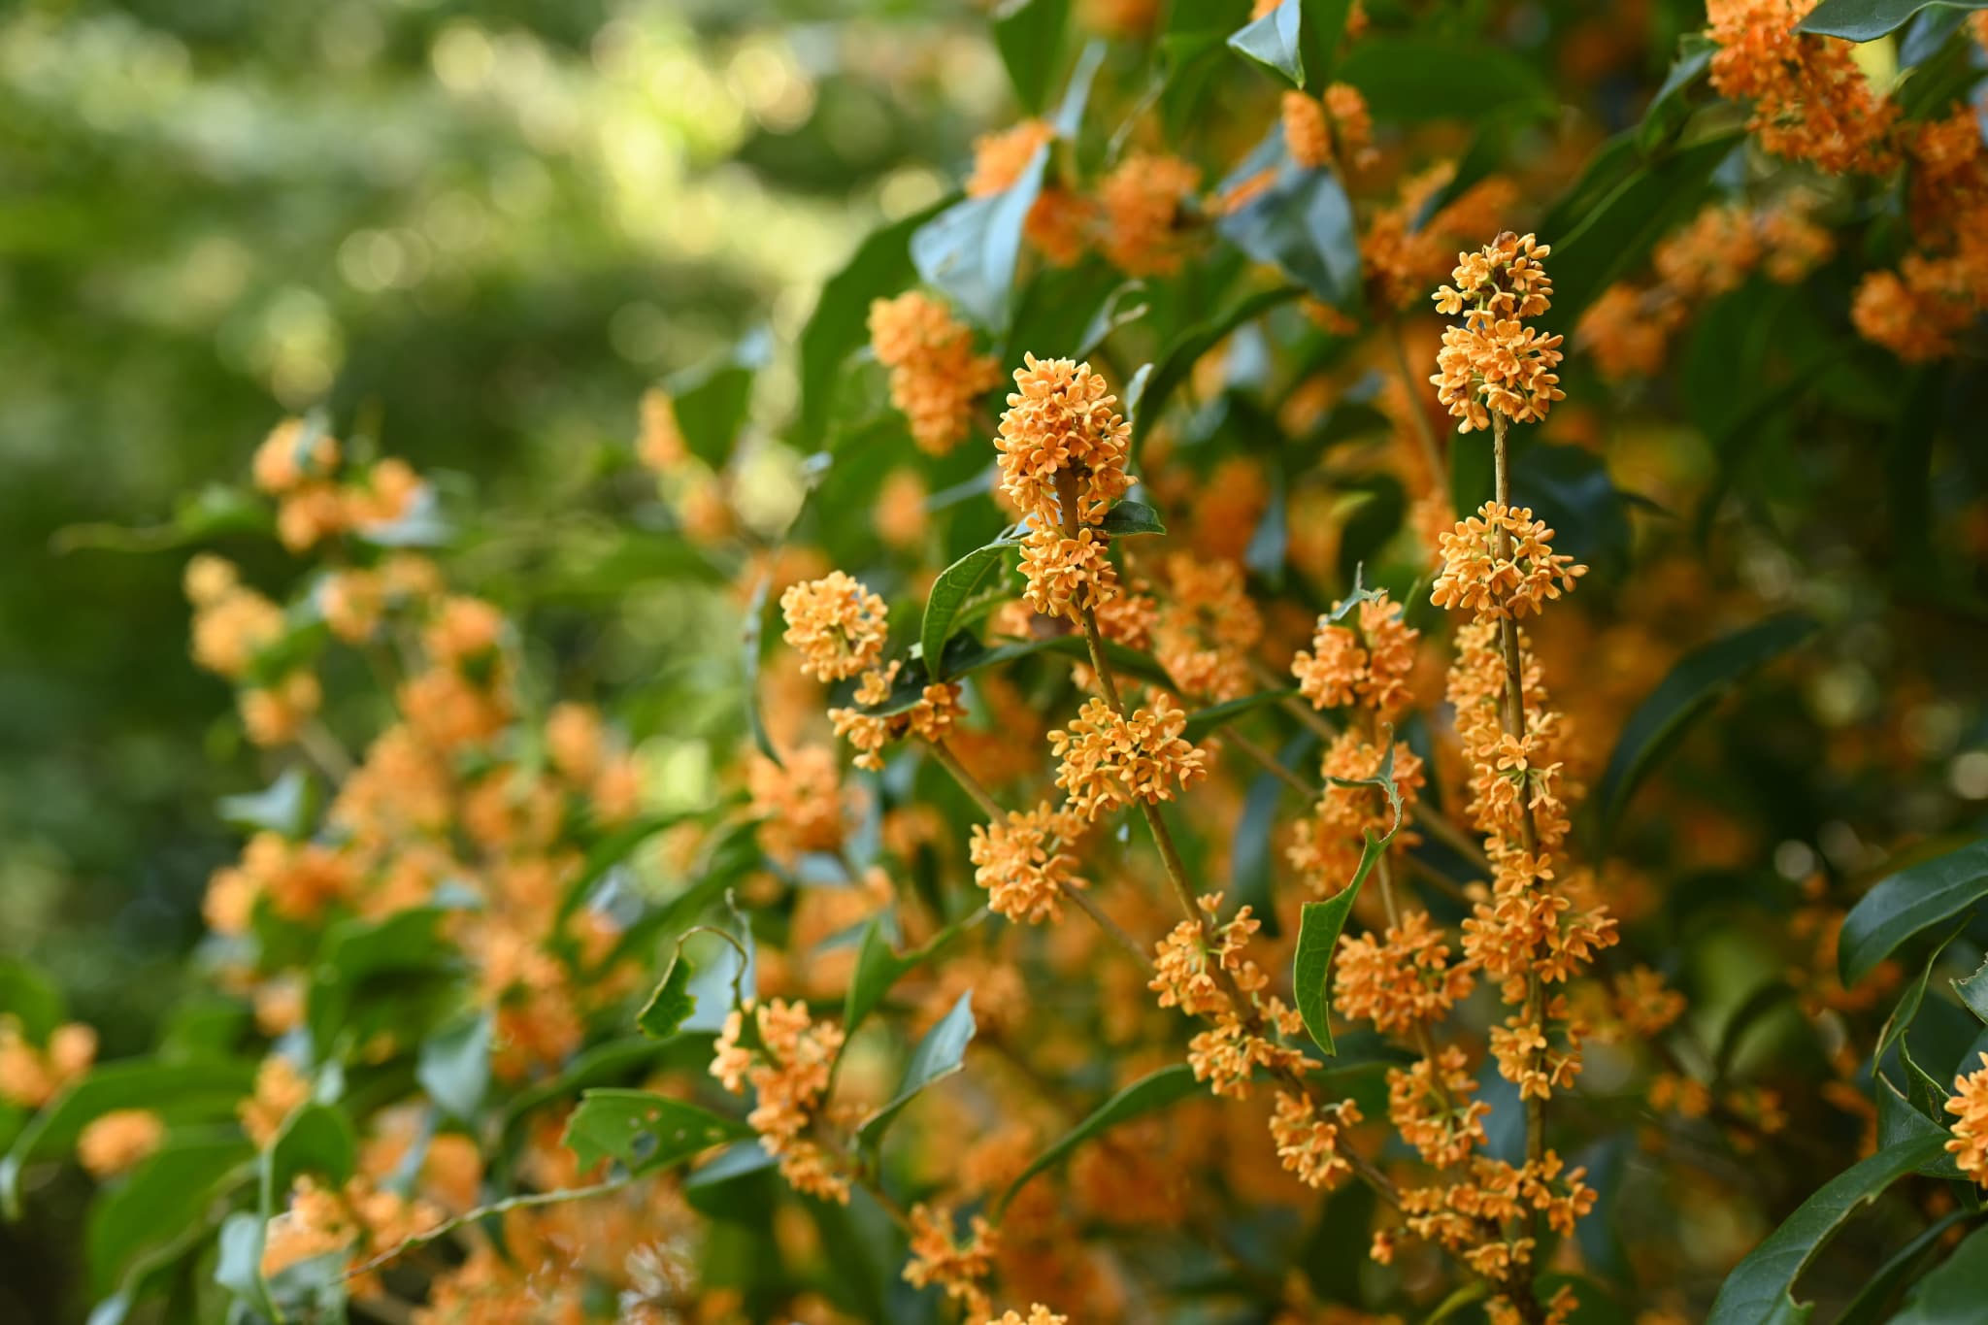
Autumn
January |  |  | February |  |  | March |  |  | April |  |  | May |  |  | June |  |  | July |  |  | August |  |  | September |  |  | October |  |  | November |  |  | December
Kinmokusei・
Fragrant Olive

Slide 17
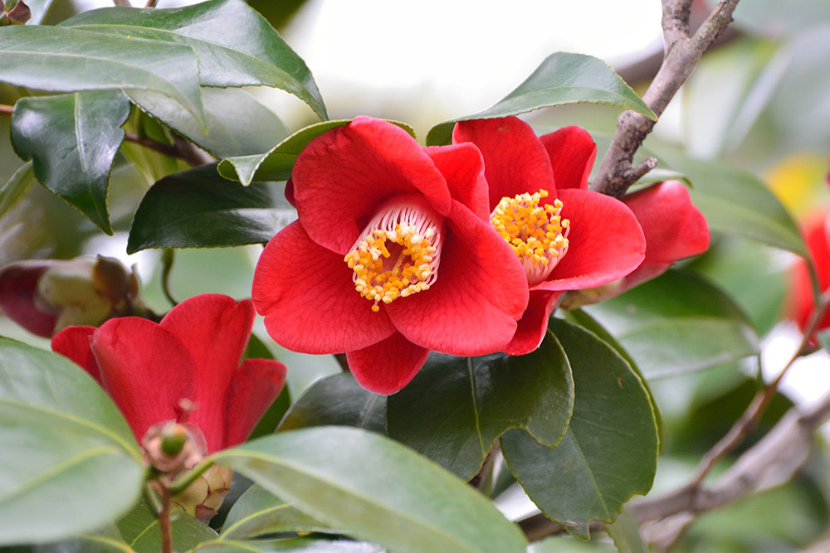
Winter
January |  |  | February |  |  | March |  |  | April |  |  | May |  |  | June |  |  | July |  |  | August |  |  | September |  |  | October |  |  | November |  |  | December
Tsubaki・
Camellia

Slide 18
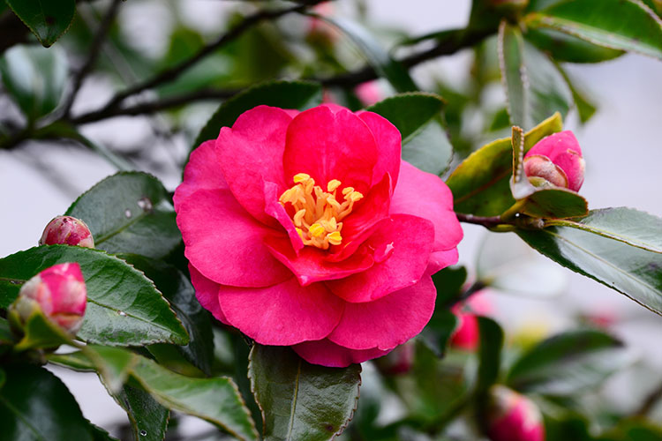
Winter
January |  |  | February |  |  | March |  |  | April |  |  | May |  |  | June |  |  | July |  |  | August |  |  | September |  |  | October |  |  | November |  |  | December
Sazanka・
Sasanqua

Slide 19
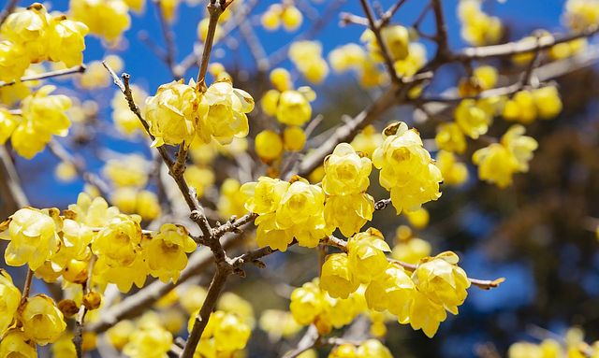
Winter
January |  |  | February |  |  | March |  |  | April |  |  | May |  |  | June |  |  | July |  |  | August |  |  | September |  |  | October |  |  | November |  |  | December
Robai・
Wax Plum

Slide 20
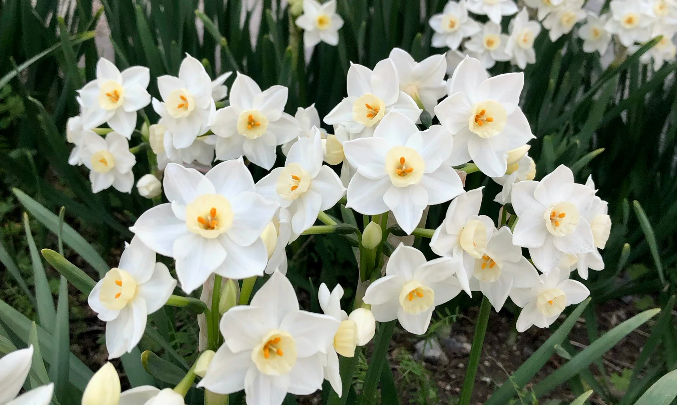
Winter
January |  |  | February |  |  | March |  |  | April |  |  | May |  |  | June |  |  | July |  |  | August |  |  | September |  |  | October |  |  | November |  |  | December
Suisen・
Narcissus

