Slide 1
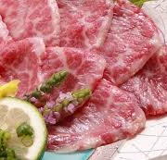
Horse meat:Sakura
Notes:
Horse meat: Sakura (Cherry Blossom)
It is said the name comes from the meat's vivid pink color, which resembles cherry blossoms.

Slide 2



Slide 3
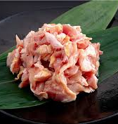
Chicken meat: Kashiwa
Notes:
Chicken meat: Kashiwa (Oak Tree)
This name began with a breed of chicken whose feathers were a brownish-red color, similar to that of fallen oak leaves.

Slide 4
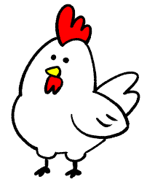
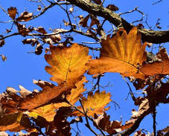

Slide 5
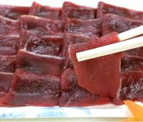
Deer Meat: Momiji
Notes:
Deer meat: Momiji (Maple Tree)
This is because the hunting season for deer coincides with the autumn maple leaf viewing, or because of the association with a specific hanafuda card that depicts a deer under a maple tree.

Slide 6

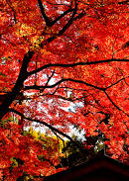
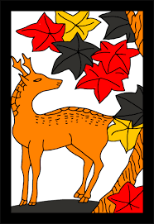

Slide 7
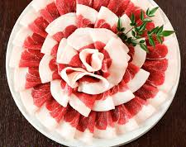
Wild Boar Meat: Botan
Notes:
Wild Boar meat: Botan (Peony)
Slices of wild boar meat are often arranged on a plate to resemble the shape of a peony flower. This is also a play on words, as the phrase "boar (inoshishi) and peony (botan)" is a classic ateji (当て字), where the characters for peony are used to write the word "wild boar."

Slide 8
